Slide 1
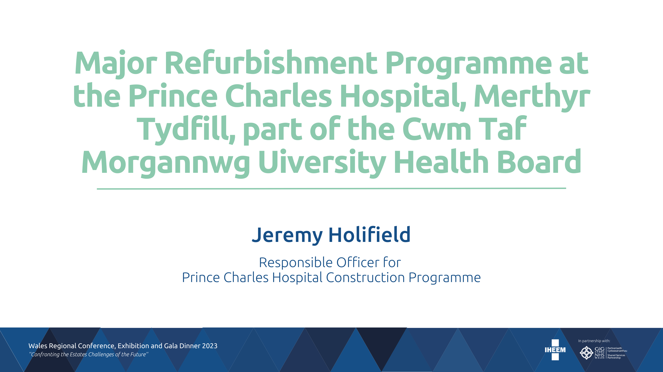
Challenges of Delivering a Complex Refurbishment Project within a Live Hospital Environment

Slide 2
Stakeholders
Patient
Estates
Non-Clinical
Security
Facilities
Porters
NWSSP
WelshGovt
Catering
Politicians
Unions
Public
Family
Deaneries
Clinical
Friends
Carers
SCP
SCMs
Ambulance Service
Suppliers
General Medical Council
Designers
Community Health Councils
Shareholders
Royal College Nursing
Notes:
Patient – paramount
Only exist to serve the need of the Patient
Patient experience to be considered not just the administering of care
Wayfinding
Clinical staff
Need to be unimpeded in caring for the Patient and undisturbed in their
Non-clinical staff

Slide 3

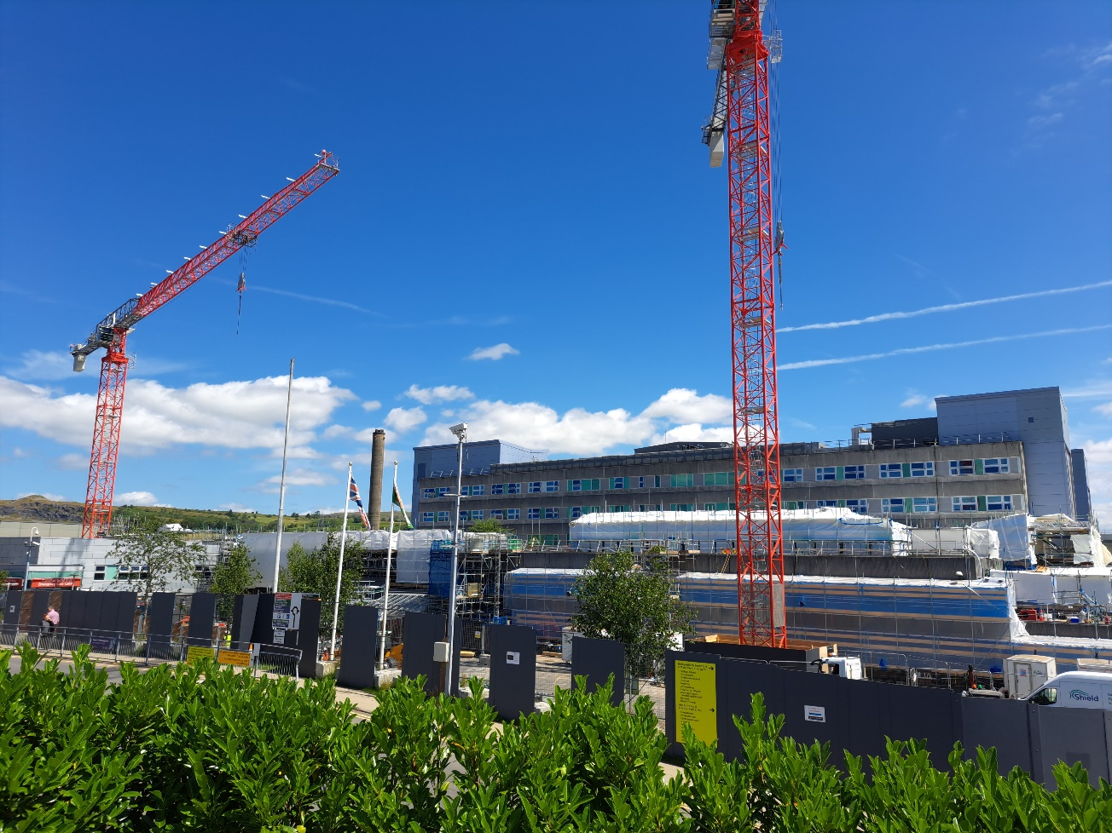
Built 1972-75
  Cost £4M
District General Hospital
Circa 400 beds
Year 22/23
  A&E – 59,286 attendances
    (162 / day)
  Outpatients – 97,139
    (372 / day)
  Inpatients – 28,110
    (77 / day)
  Babies born – 2,483
    (7 / day)
Prince Charles Hospital
Subheading (if any)
Main text here

Slide 4
Heading (if any)
Subheading (if any)
Main text here
Ground Floor

Slide 5
Heading (if any)
Subheading (if any)
Main text here
First Floor

Slide 6
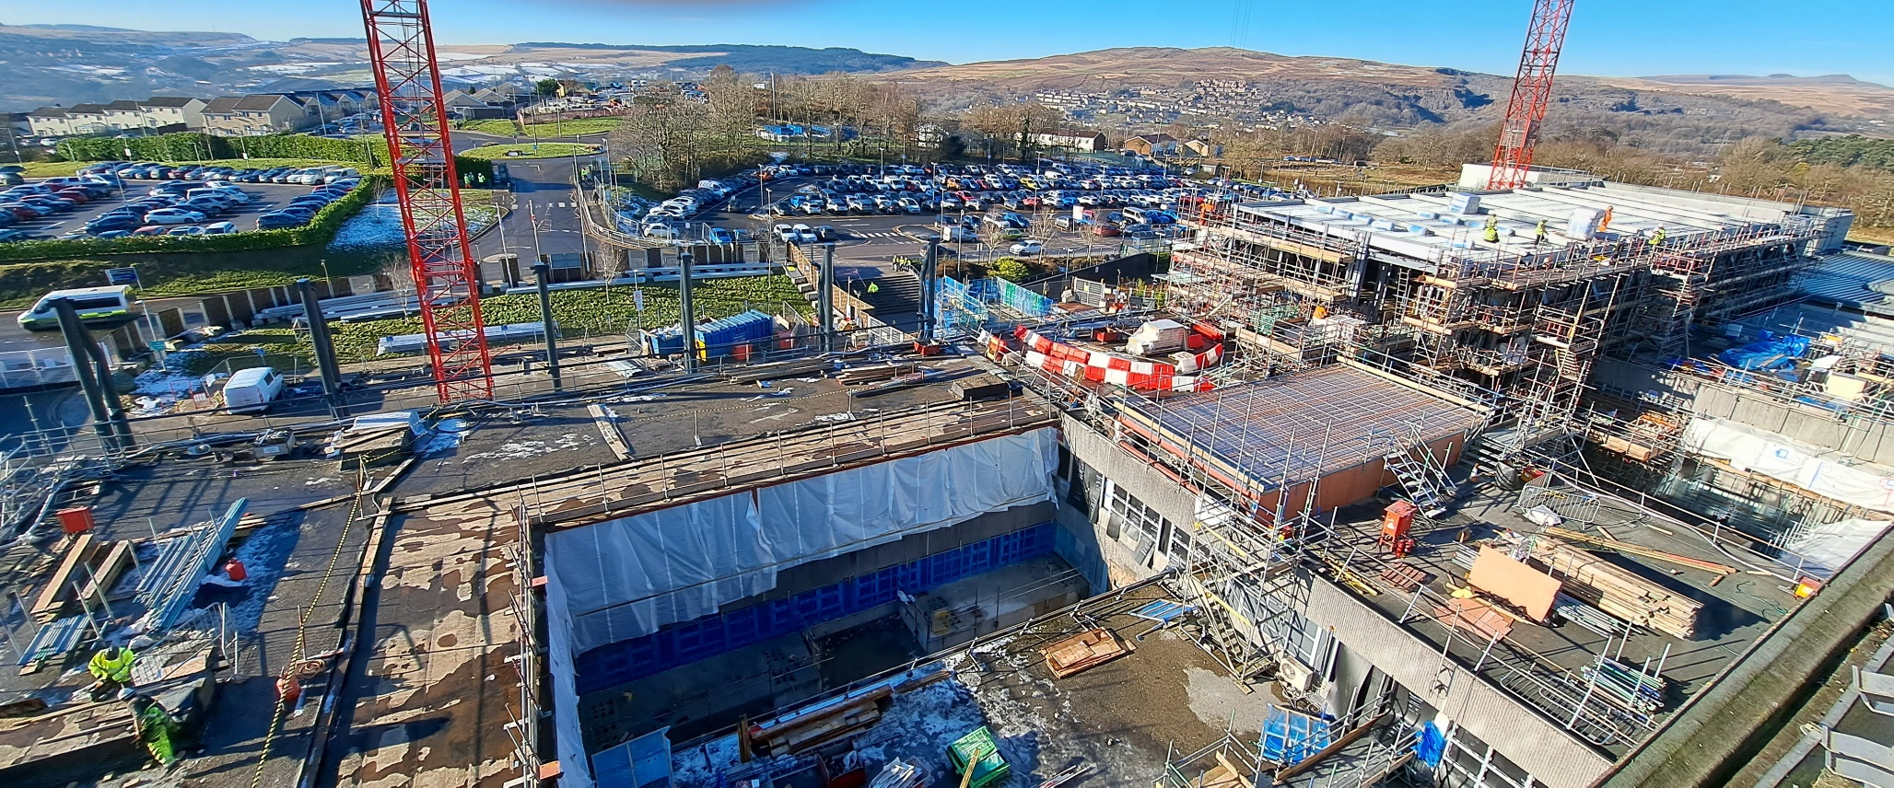
Parking
  Patient (Ambulant/Disabled)
  Staff
  Contractor
Deliveries
  Hospital
  Site
Ambulance
  Land & Air
  Blue light priority
Public Transport
  Schedules
Routes
  Safe and segregated
Wayfinding
  Visible & understandable
Heading (if any)
Subheading (if any)
Main text here
Logistics

Slide 7
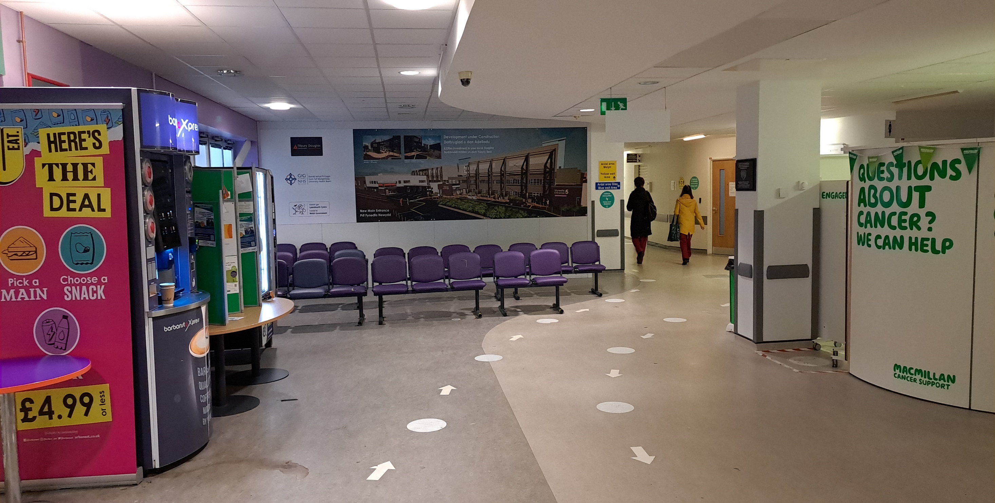
Sight
  Discreet
  Cleanliness
Infection control
  Aspergillus
Well-being
  Art work
Noise
  Tolerable
Reverberation
  Affects instrumentation
Smell
  Air monitoring
  Gases
Heading (if any)
Subheading (if any)
Main text here
Perception

Slide 8
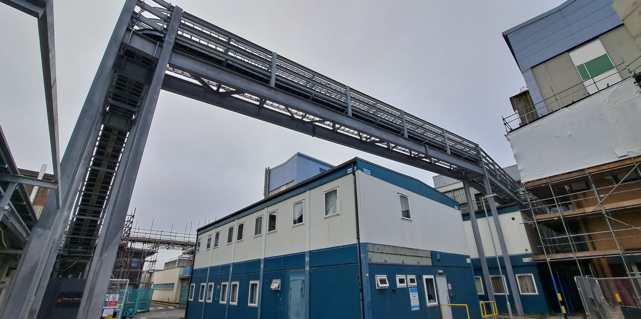
Infrastructure
  Fragile
  Compromising
Records
  None / inaccurate / dated
Capacity
  Limited
Isolations
  Lack of understanding
  Diversions / enabling works
Policies
  Control of Contractors
  Permits to work
Asbestos
  Inhibiting
Heading (if any)
Subheading (if any)
Main text here
Estate

Slide 9
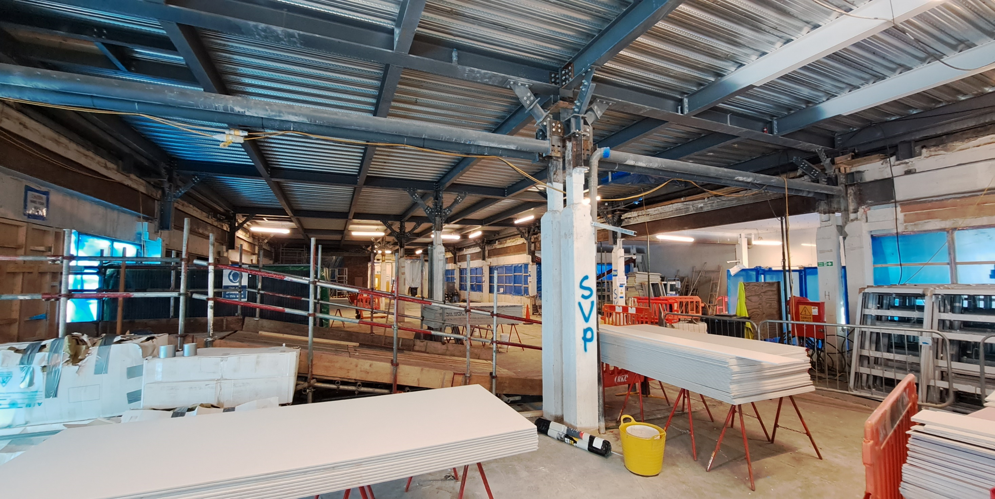
Maintenance
  Flushing / Legionella
Fire detection
  Unnecessary call-outs
Security
  Climbers / Jumpers
Access
  Emergencies
Commissioning
  Pre-emptive / scheduled
Defects
  Disruptive
  Statutory maintenance
Heading (if any)
Subheading (if any)
Main text here
Construction

Slide 10
Success
Communication
Relationships
Honesty

Slide 11
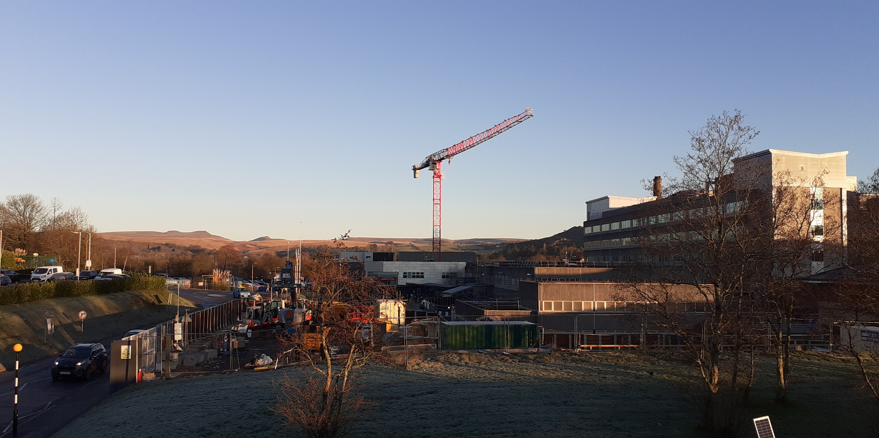
Diolch yn fawr

Slide 13
Heading (if any)
Subheading (if any)
Main text here

Slide 14
Heading (if any)
Subheading (if any)
Main text here

Slide 15
Heading (if any)
Subheading (if any)
Main text here

Slide 16
Heading (if any)
Subheading (if any)
Main text here

Slide 17
Heading (if any)
Subheading (if any)
Main text here

