Slide 1


Slide 2
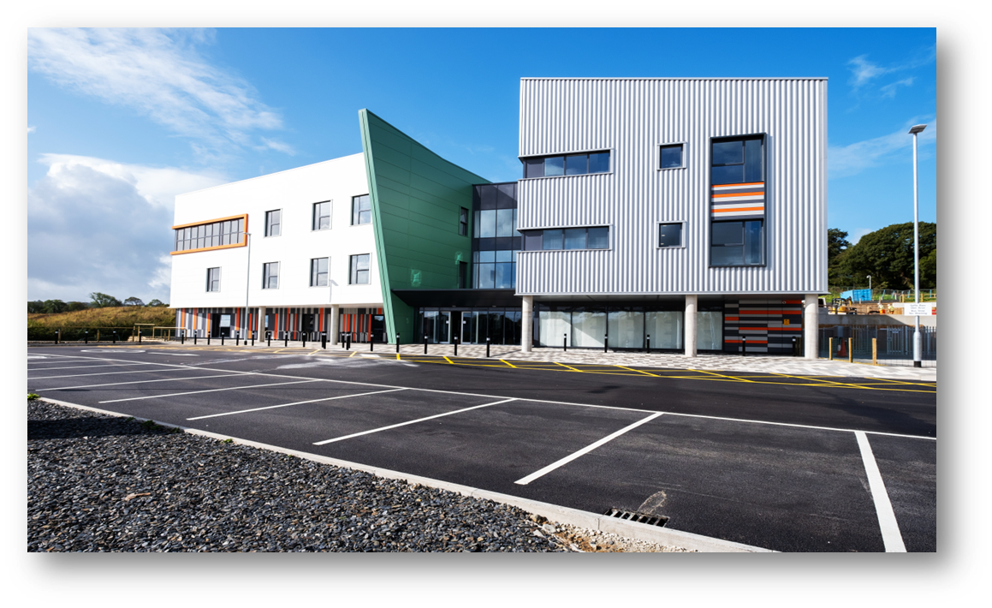
Background & Context
First Generation Frameworks
DfL1 started June 2006 & ended June 2012.
One mandated framework process for all NHS capital delivery above £4M.
Notes:
Sub Regional Neonatal Intensive Care Centre, SuRNICC. YGC. SCP- BAM, DFL2

Slide 3
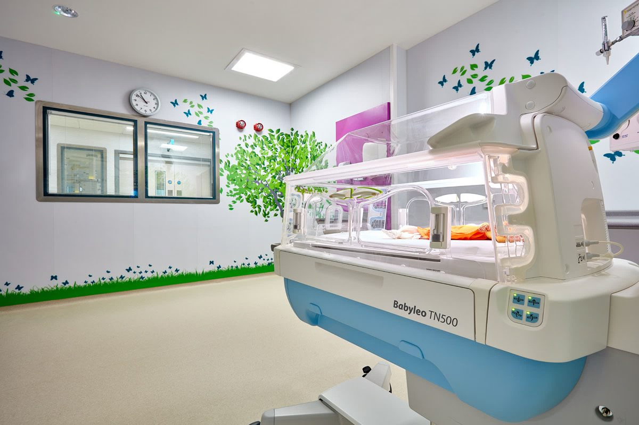
Background & Context
Second Generation Frameworks
Started in October 2011
Lessons learnt resulted in 4 frameworks:
  3 regional (DfL2) for projects between £4m - £10m
  1 national (DfL3) for projects over £10m
Notes:
SURNICC

Slide 4
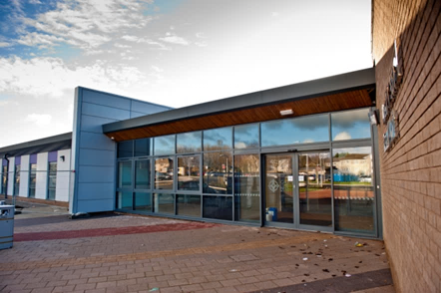
Background & Content
NHS Building for Wales frameworks
Commenced in April 2018
4 frameworks:
  3 regional for projects between £4m - £12m
  1 national for projects over £12m
Frameworks due to expire end of April 2024
Notes:
Illustration: Withybush Renal Entrance: SCP – Interserve, DFL1

Slide 5
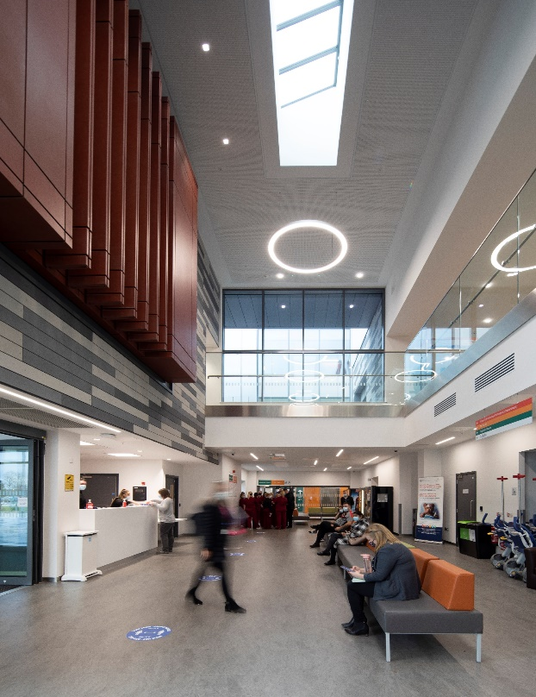
Consultation Process
360°consultation by CEW with Health Boards, Trusts, Welsh Government, Framework Partners & NWSSP-SES to establish requirements.
P23 and Framework Scotland shared best practice with NWSSP-SES
Notes:
Illustration: The Grange University Hospital, Llanfrechfa. SCP: Laing O’Rourke (LOR)

Slide 6

Consultation Process
All NHS Wales’ Health Boards & Trusts confirmed ongoing need for frameworks; and
Integrated supply chains;
Planning assumption for duration of new frameworks is an average annual works costs availability c.£148M (ex VAT & Fees)
Notes:
Illustration: Cardiff Children’s Hospital: Interserve. DFL1

Slide 7

The Proposed Way Forward
Notes:
Illustration: Withybush Renal Staff Base: SCP – Interserve, DFL1
To reiterate what’s been said already thankyou for attending today.
Some of you are representing HBs / Trusts and framework partners and have rightly have come along today to see what our proposals are for the next framework,
Some of you are possibly working direct for HBs and Trusts and want more information on how to get onto the new framework,
Some of you maybe on P23 framework in England and what to get onto NHS framework in Wales, and
Some of you here for the mince pies!!
All are welcome.
I’m going to take you through the structure of the next framework before handing over to Amy who will talk about framework requirements incorporating:
sustainability,
decarbonisation,
social value,
foundation economy and,
WBFGA.

Slide 8
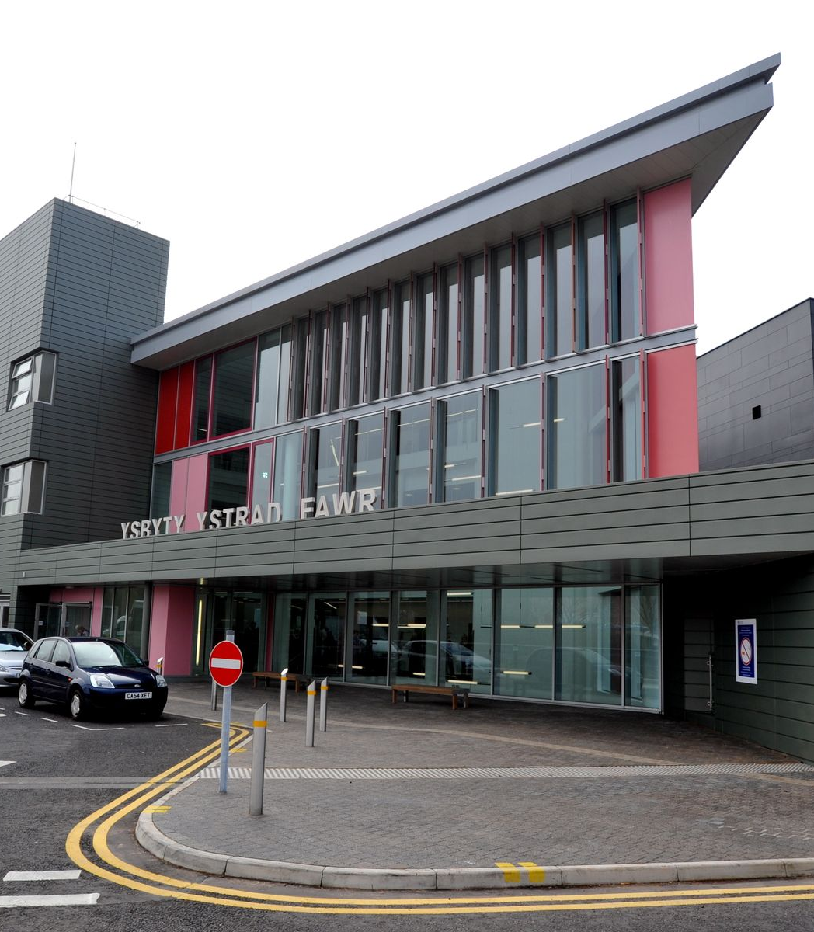
Procurement Routes
Main procurement routes for capital projects within NHS in Wales:
  NHSBfW2 national Frameworks
    Lot 1: Works Cost > £20M;
    Lot 2: Works Cost £7M - £20M;
  Local arrangements: Works value < £7M procured directly by Health Boards & Trusts.
Notes:
Illustration: Ysbyty Ystrad Fawr: SCP: BAM. DFL1
In order to establish a framework structure for the next iteration, we’ve carried out:
A review of framework objectives,
Undertaken PEST and SWOT analysis, and
Carried out Benefits criteria against a long list of framework models,
We determined that the requirements of key stakeholders principally: WG, HBs, industry and ourselves, is best served by a national framework split into value bands
We’ve worked on the basis that the All Wales Capital Programme and current discretionary capital allocations are maintained.
Taking the value of works committed through the current frameworks and applying an inflation allowance, we are forecasting a framework value of £600M.
This figure is based on construction value excluding VAT and fees.

Slide 9
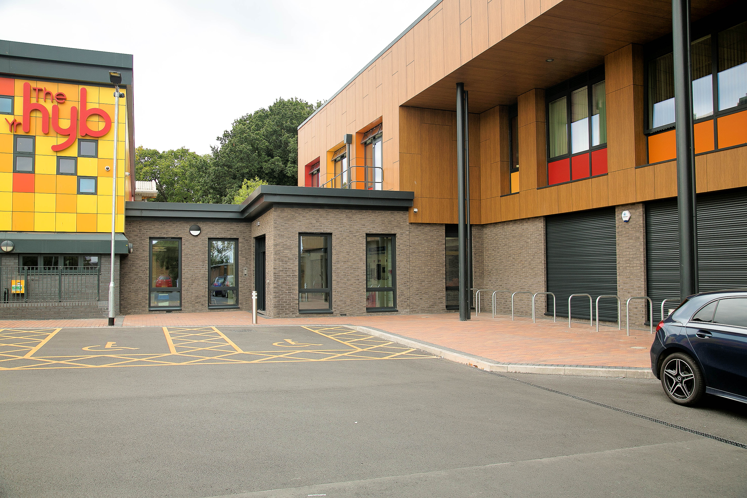
What’s in it for the client
Access to companies with relevant experience, resources, capability & proven track record
Shorter procurement time
Assurance to Board and Welsh Government of “due diligence”
Early engagement
Notes:
Illustration: Maelfa Health and Wellbeing Centre: SCP - Willmott Dixon. BfW.

Slide 10
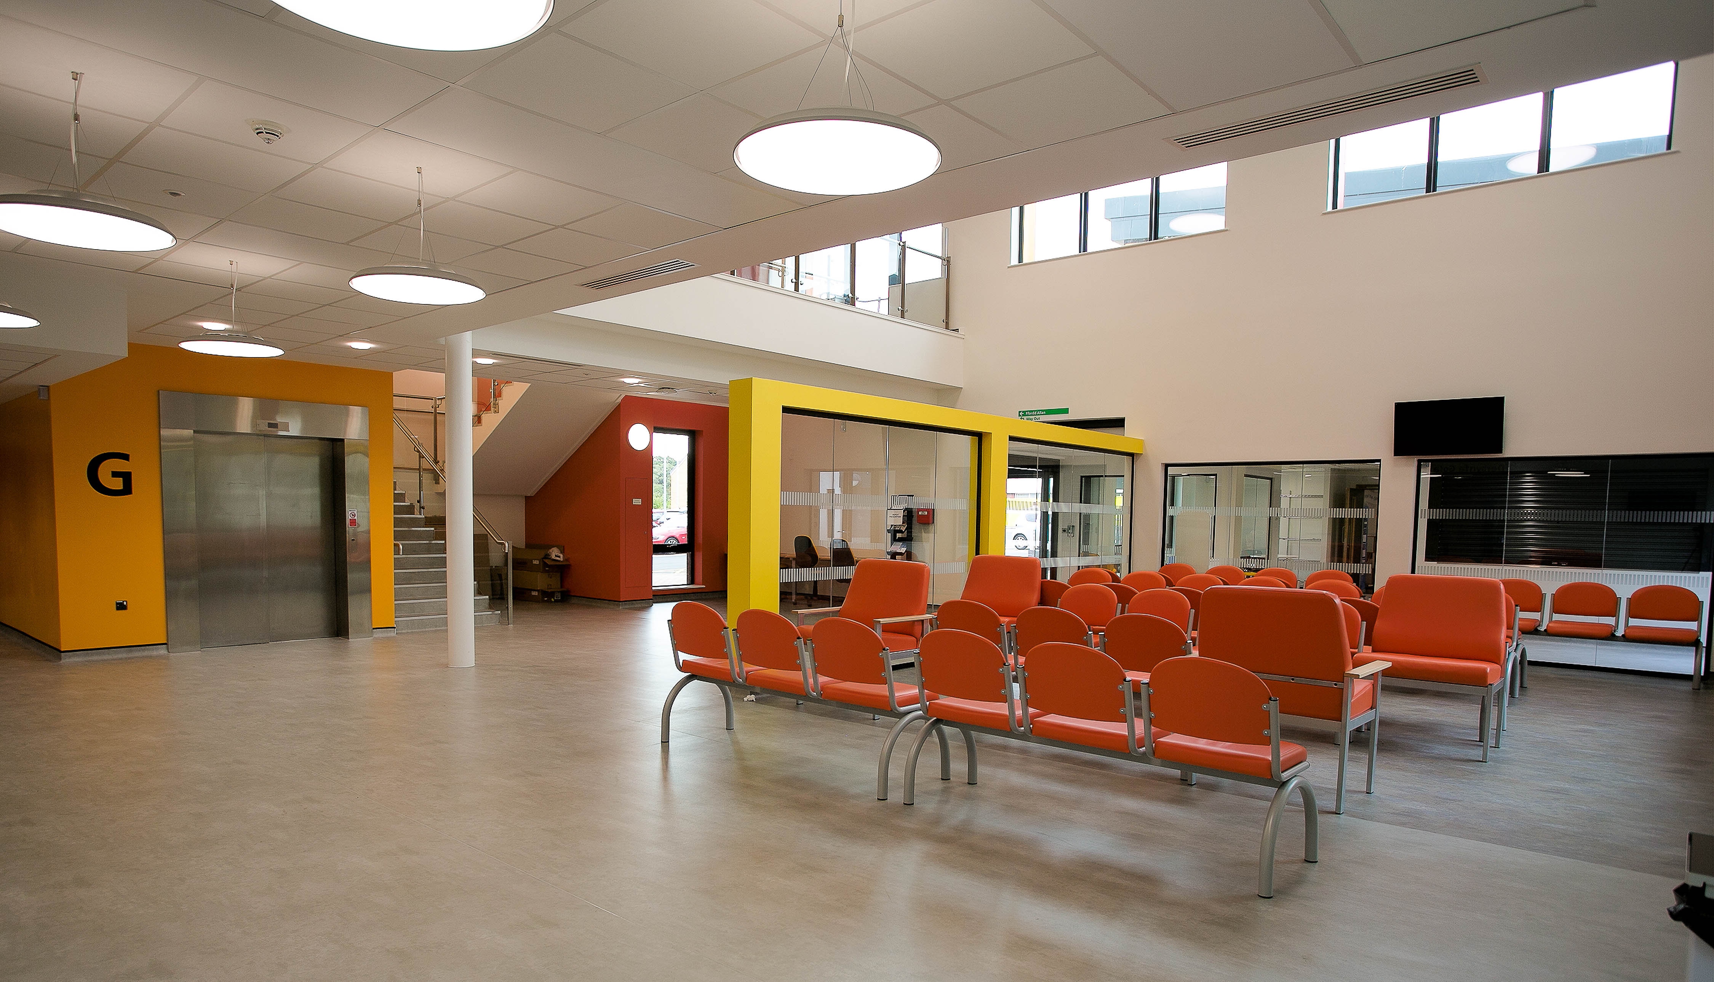
What’s in it for the client
Encourages collaboration
Longer term partnership
Someone else does all the boring and time-consuming process bits!
Notes:
Illustration: Maelfa Health and Wellbeing Centre: SCP - Willmott Dixon. BfW.

Slide 11

Procurement Process
  Restricted procedures (PQQ/ITT)
  Evaluation panels to be comprised of following members:
    Health Board/Trust Capital Estates;
    NWSSP-SES;
    CEW

Slide 12
Framework Governance
Frameworks are procured and managed by NWSSP-SES for, and on behalf of, NHS Wales
Framework Agreements to be executed by Velindre University NHS Trust, as host to NWSSP-SES

Slide 13
Proposed Arrangements
Allow access for joint agency working in provision of health & associated facilities in Wales.
Framework structured for capital schemes only. Revenue funded schemes are excluded.
Framework duration of four years with an option to extend 1+1 years.
Non- subscription for suppliers; and free at source for Client use
Notes:
Joint Agency may involve working with the local authorities in the future on sites involving multiple users.
New framework will run from 2024 to 2028
We believe a strong selling point to our frameworks is that there are no subscription charges unlike other public sector Healthcare frameworks.

Slide 14
Proposed Arrangements
Health Boards & Trusts access central framework arrangements and select private sector parties under a prescribed mini-competition.
Health Boards & Trusts will act as the Client under the terms of the contract.
New frameworks utilise the NEC4 suite of contracts.

Slide 15
Proposed Arrangements
NHSBfW2 Frameworks
Support consultant frameworks to be established in order to assist and represent Health Boards & Trusts from project outset comprising:
4 no. Project Managers
4 no. Cost Advisers
3 no. NEC Supervisors
Notes:
NEC Supervisors will be appointed at the beginning of FBC.

Slide 16
Proposed Arrangements
The Supply Chain Partner frameworks will comprise 4 parties per Lot.
Integrated Supply Chains to be comprised of two of the following supply chain members: Architect, Building & Services Engineer, Civil & Structural Engineer, Building & Services Installer
The Supply Chain Partner is required to act as Designer, Principal Contractor and Principal Designer in compliance with CDM 2015 Regulations.

Slide 17
Proposed Arrangements
It is proposed that the Client’s use of the national framework is mandatory for Lot 1 and non-mandatory for Lot 2.
‘Ground rules’ established for procurement to prevent conflicts of interest.
Parties representing Health Boards & Trusts will only be employed on the Client side of a project.
Notes:
……Subject to agreement between WG and HBs & Trusts at the outset to enable projects primarily involving reactive maintenance, equipment replacement or fire precaution works to be procured through alternatives means such as:
Crown Commercial Services,
NHS SBS

Slide 18
Proposed Arrangements
Model enables early contractor involvement, integrated supply chains & single point contractual responsibility.
Feasibility, design development & construction to be underpinned by RIBA Plan of Works 2020 & Schedules of Duties developed by NWSSP-SES.
Notes:
Our framework model……..
Updating from RIBA 2013 to RIBA 2020 plan of works

Slide 19
Forecast Project Volumes
Notes:
Forecast project volumes HB& Trusts 10 year capital requirements
Nearly 50% will be primary or social care schemes which follows the trend of projects being delivered through the current framework.
Estates infrastructure accounts for 12%
Reconfiguration & Expansion accounts for 10%
Mental Health accounts for 6%

Slide 20

The Well-being of Future Generations (Wales) Act 2015

Slide 21
Framework Building Blocks
Sustainability
Decarbonisation
Circular Economy
Biodiversity
Carbon Emissions, Embodied Carbon, Carbon Literacy, Carbon Footprint
Social Value / Well-Being Impacts

Slide 22

Wales: Getting the most out of every pound spent
Promote use of SMEs in Wales, and encourage subcontracting to these entities.
Encourage suppliers to advertise all subcontract opportunities on Sell 2 Wales.
Recognise social value as a positive outcome of procurement activity and aim to quantify social benefit as a metric that can be used to analyse tenders and award future contracts.
Support Welsh Government initiatives such as those identified within its Economic Action Plan, including its focus on the Foundational Economy.

Slide 23
What we are looking for in bids
Waste Reduction
Increased Biodiversity
Local Employment
Local Apprenticeships
Recycled / Recyclable Materials
Carbon Sequestration
Local Procurement
Energy Reduction
Packaging reduction
GHG Reduction
Reverse Logistics
Local Manufacturing
Employee Skill Development
MSME Development
Pay Equality
National Living Wage
Ethical Procurement
Well Being-Impacts
Transport Reduction
Carbon Off Setting

Slide 24
Key Milestones
2023
Publish FTS notice & PQQ
Q2 2023
2023
Short list candidates
Q3 2023
2024
Selection & Award
Q2 2024

Slide 25
Close
Notes:
Thankyou’s
To the other presenters thankyou for taking time out today to present and your continued support in the new framework,
Mecure Hotel for hosting us and providing those lovely mince pies!!
To our Admin Team for helping organise todays event,
Finally to you for taking the time out of your busy schedules to come and listen to our proposals
Diolch
Nadollig Llawen

