Slide 1
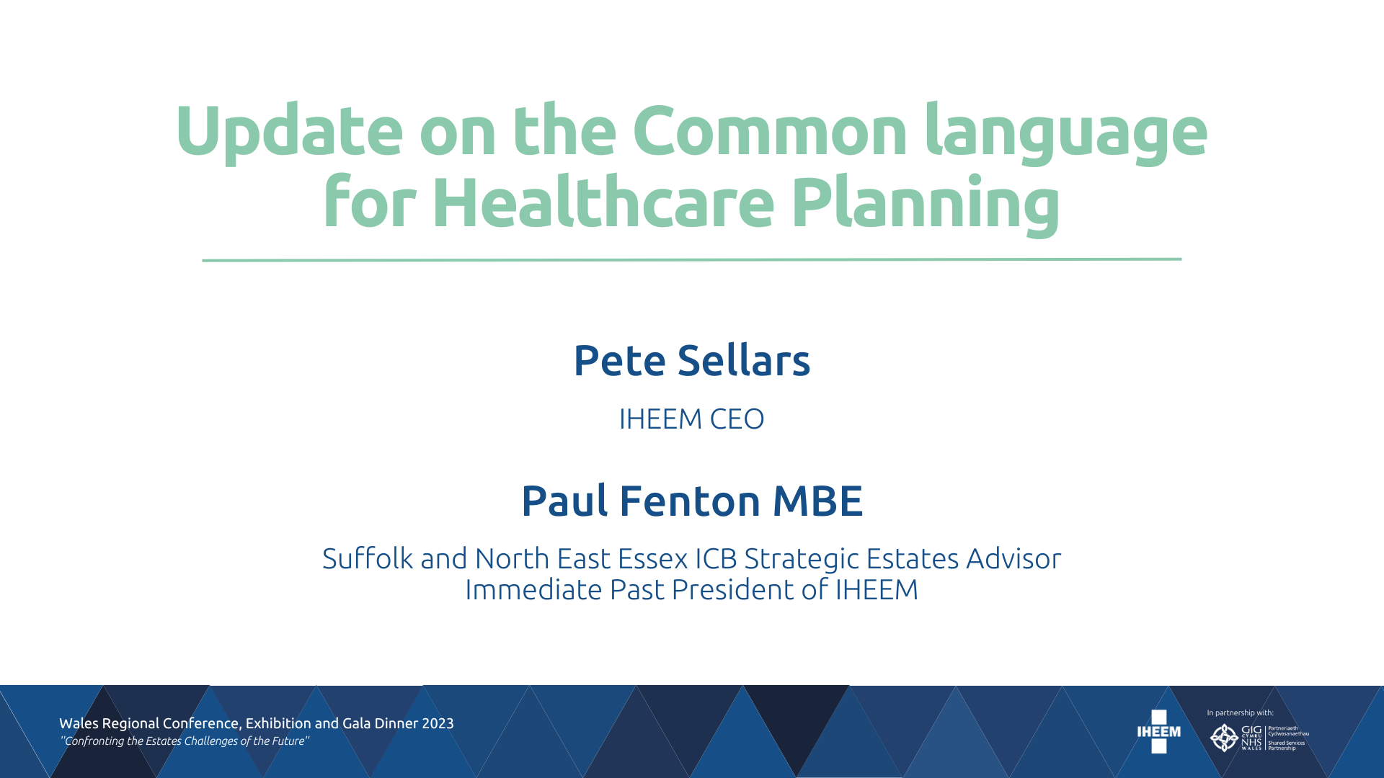

Slide 2



Why are we saying that we need a common language?
The era of planning and building siloed hospitals is over!
The way we measure hospital workload is outmoded.
What matters now is the wider health and social care system: there is no such thing as a good hospital; there is only a hospital that is good for the system.
System stakeholders are diverse and multi-agency. Hospital planning and design are highly complex activities.
We need a common language and approach so all stakeholders can actively engage and understand

Slide 3
Common language Three Key Stages
Common Language Three Key Stages
Acuity - Using Acuity to determine the clinical care services
System Economic Modelling – Rather than traditional M2 capital costs to determine the benefits of the investment
Using Integrated Health Planning Planning Framework – Through a common language to facilitate and unite dialogues between stakeholders & decision-makers

Slide 4
Acuity and Clinical Planning Overview
Acuity - Using the WHO definition, but offering a broader view, as a proxy measure of patient and population health status, encompassing severity of disease or condition, as well as characteristics such as complexity, frailty and multi-morbidity.
The acuity metric is scalable:
  applicable to planning for individual patients,
  to care pathway cohorts,
  to individual facilities or regional (ICS) health systems –
  to inform decisions about the most appropriate locations and typologies of healthcare facilities, the nature of services within them and the roles of the staff who provide care

Slide 5
Using the language – What do we mean by Acuity

Slide 6
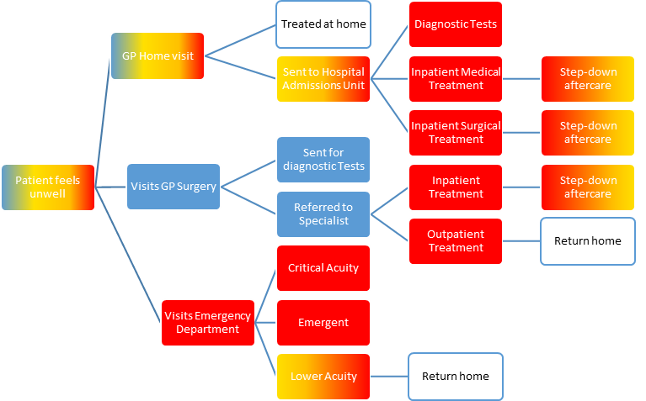
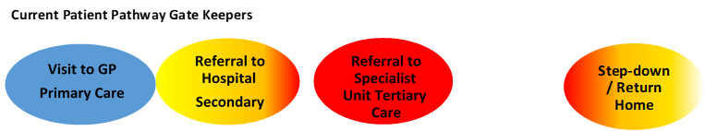
Rethinking Care Pathways using Acuity

Slide 7
Plan and Design Differently using Acuity as the ’Currency’
Disease acuity is defined by the WHO according to the severity of patient condition. Specifically, Critical (life threatening signs or symptoms), Emergent (high probability of morbidity if not treated) and Low (low probability of rapid progression to more serious disease or complications). These acuity levels can be translated into healthcare settings, as shown, where the top three levels relate to inpatient (hospital) accommodation.

Slide 8
Designing for Acuity

Slide 9
SYSTEM ECONOMIC MODELLING
Health Infrastructure – “more than just bricks and mortar..” hospitals have a greater social and economic value to the wider community
If hospitals are to be ‘embedded partners’ in fully integrated care ecosystems they should be assessed through system economic modelling. Not standalone units.
Investments in new hospitals, must add to the system’s capacity to address population and patient health need, but ultimately the operation of the health system matters more than any individual hospital organisation.
Crucially, system economic modelling introduces the notion of ‘trade-offs’ to reconcile competing demands… “We simply cannot afford to have everything”

Slide 10
Life Cycle, Revenue Vs Capital Investment, Capacity
Historically driven Capital Planning/Investment linked to planned activity on a cost-per-sqm2 basis and a standard capital envelope, focussed on ‘stand alone’ design.
Requires investment ‘headroom’ to build in additional flexibility for additional capacity
Consideration needed for the significant Revenue costs, particularly the workforce
Capacity is the ability for the health system to do more work, not the hospital alone
Whole-life: Should be calculated over a time that reflects the likely lifespan of key elements of the infrastructure, and consider alternative, Net Present Cost (NPC)-based scenarios.
Lower NPCs mean that the system accordingly is cheaper to run for its lifetime, as long as Quality aspects are fulfilled

Slide 11
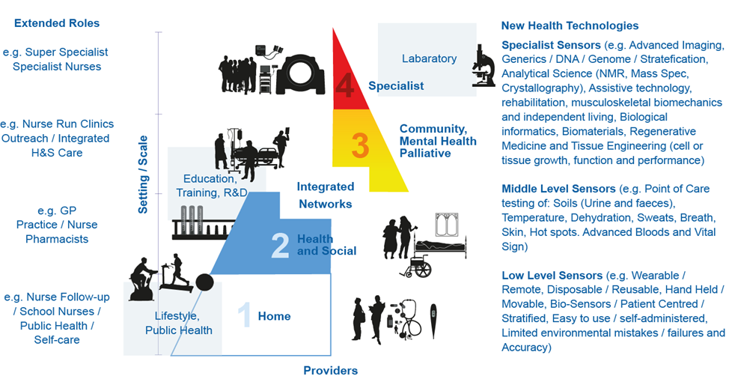
Translating Patient Acuity into Integrated Health System Acuity

Slide 12
Benefits of Building Differently: Aims, Ambitions, Reality
Whilst a large amount of data exists in various formats and authorities, too often, data is treated, without due consideration of the effects elsewhere in the local health economy. At best this approach is inefficient, at worst it can be counter-productive and stifling of innovation.
One highly innovative approach would be to create an Integrated Health and Estates Information Model (IHEIM):
This would be, in effect, ‘a single source of truth’ offering a detailed, dynamic, digital representation of population health status, acuity, and estates data, to provide capacity for economic modelling and scenario building.

Slide 13
Benefits of Building Differently: Aims, Ambitions, Reality (contd.)
Then by establishing a common platform, to accompany the IHEIM at national and ICS level, to:
Create centralized, clear guidelines for facility planning and design, based on the principles of acuity adaptability and whole-system economic modelling.
Enable delivery of rapid and detailed briefing based on Service Oriented Architecture (SOA).
Use existing and in-development ready-to-use design components.
Use modular construction techniques where possible and appropriate.
Share knowledge and learning reliably between project teams.
Incorporate the latest technologies and build in capacity to adapt these in the short to medium term.

Slide 14
Progress to Date
Continue to work in partnership with EuHPN, UCL, & the Bartlett in progressing the work around our successful submission to the Wolfson Economics prize in 2021.
Continue our partnership with Total Alliance Health Partners (TAHPI) – delivering training on the Health Facility Briefing System and access to the International Health Facility Guidelines
To drive this project forward IHEEM have established a new working group, namely the Strategic Estate Management Advisory Platform, as part of it’s Group of Technical Platform’s with experts from across the industry sector, this group will aim to:
Assist with the work around the IHEIM
Share knowledge and Learning on Strategic Healthcare Planning
To develop Healthcare Planning as a recognised and accredited professional discipline

Slide 15
Progress to Date
The IHEEM Strategic Estate Management Advisory Platform held it’s inaugural meeting on the 7th February 2023 and agreed the formation of Five Working Groups to progress the following actions:
Workstream Aim 1 - Best Practice for project initiation: the strategic front end through to concept and feasibility
Workstream Aim 2 - Member Benefits and Supporting the IHEEM Business Plan
Workstream Aim 3 - To Develop and Promote Healthcare Planning as a Recognised Profession
Workstream Aim 4 - Working collaboratively with likeminded organisations and institutions to explore and develop innovation in healthcare provision, with an emphasis on healthcare facilities requirements.
Workstream Aim 5 - Collating and monitoring appropriate courses and training which align with and are relevant to the overall aims of SEM
A Management Group will manage the co-ordination and progress of all Workstreams against our Programme

Slide 16
IHEEM Strategic Estates Management Advisory Platform - Structure
Advisory Platform
(29 members)
Management Group
Set the agenda for the platform, monitor and report on progress of working groups and liaise with all AP members on a regular basis
(Membership Inc Chairs of Working Groups)
Working Group 1
Best Practice for project initiation: from the strategic “front end” to concept and feasibility
Working Group 2
Develop & Promote healthcare planning as a recognised profession
Working Group 3
Collaborate with relevant organisations and bodies to develop and promote innovation in healthcare efm provision
Working Group 4
Learning, Development Training Opportunities for SEM (To be Established Later)

Slide 17
Final Feedback
High degree of interest from various professional parties as to progressing this project and advancing our Common Language for Hospital design
Shifting the balance towards whole life costs and revenue impacts of projects
Challenging the business case process to focus on better outcomes
‘System approach’ to healthcare modelling rather than ‘siloed’ thinking including recommendations in ICB Estates Infrastructure Strategies (in development) on system planning and using ‘Acuity’ modelling for the ICS estate
Tested Internationally (i.e Canada, Argentina, Europe, England) with interest in progressing this model and shared learning across the globe
Opportunities to advance the latest digital and other technologies for planning, design, construction and maintenance.
To act as consultative panel for future releases of HBN/HTM Technical Guidance regarding the built environment to ‘change the mindset’

Slide 18

ANY QUESTIONS?

