Slide 1


Slide 2






Scott Hislop

Slide 3




About us
Independent safety investigations in
NHS-funded care
Do not apportion
blame or liability
Focus on system-level (policy and regulatory) change
Professionalise the patient safety investigator role
3

Slide 4




Our approach
Wide ranging expertise from safety-critical industries
Multidisciplinary and inclusive teams; patient and family involvement
Focus on learning not blame to reduce further risk of harm
Transparent and collaborative to support learning
4

Slide 5
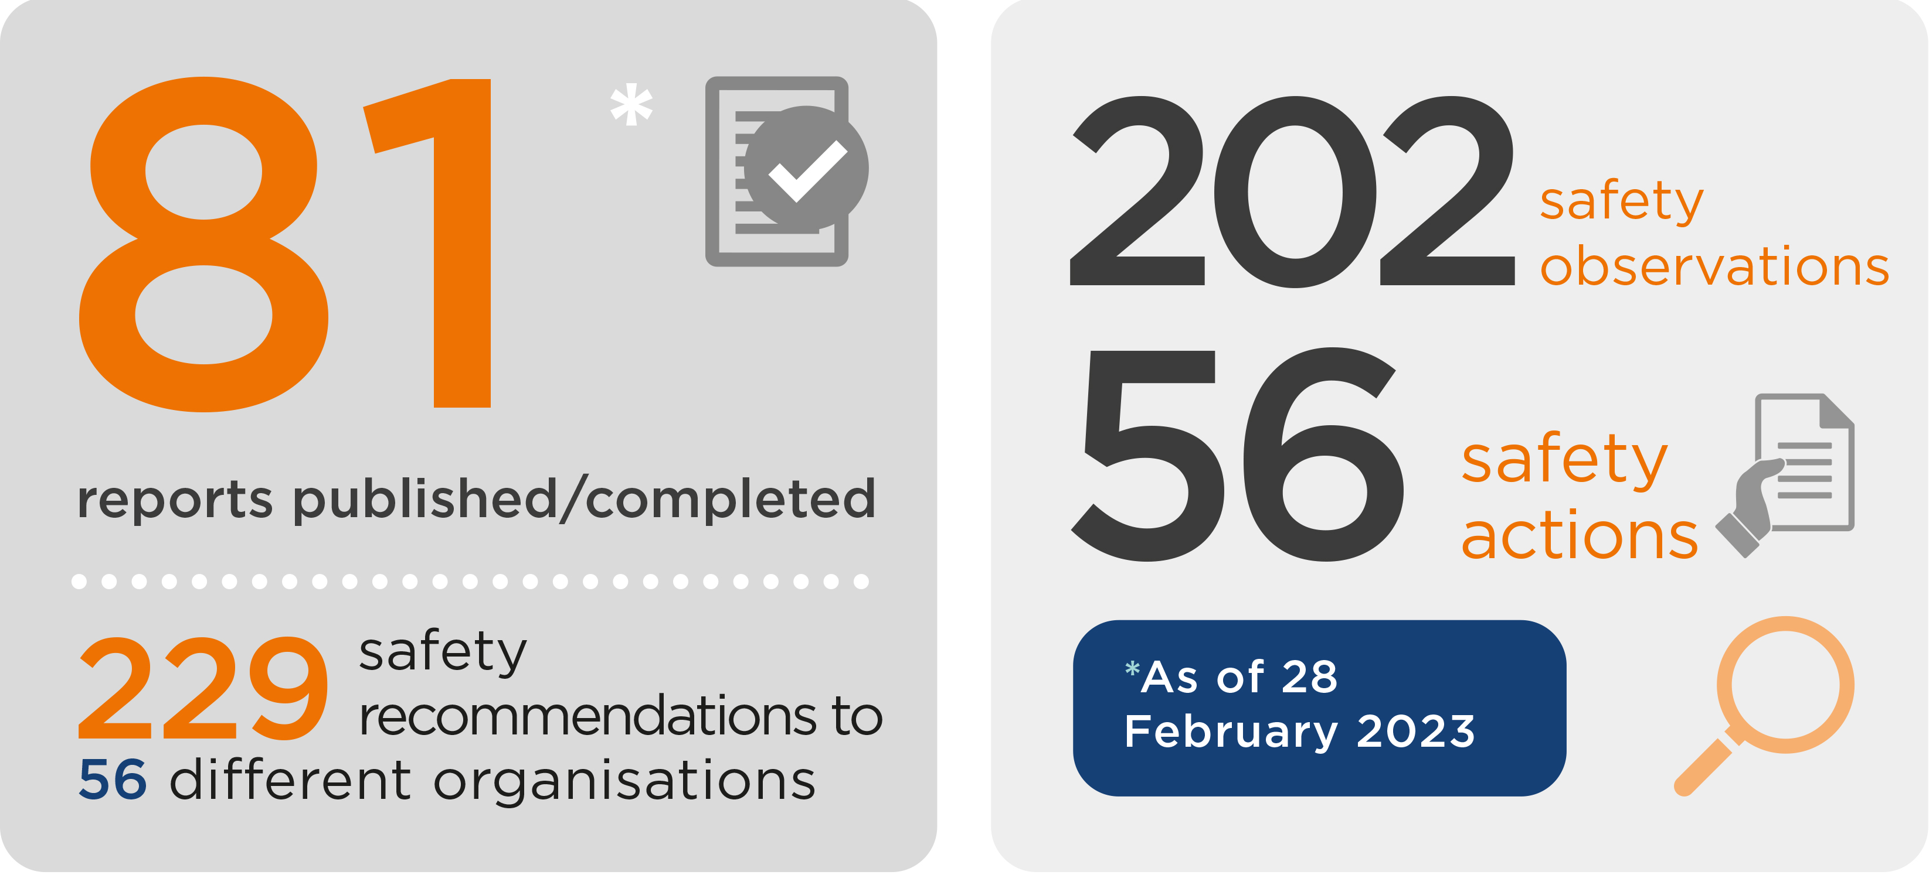
HSIB’s national investigations

Slide 6
How we are changing
Health Services Safety Investigations Body (HSSIB)
Established as an ALB of the DHSC in the Health and Care Act 2022 – Part 4, schedules 14-16 Function of investigating incidents that: Occur in England during the provision of health care services, and have or may have implications for the safety of patients. Will have remit to investigate all healthcare services in England including the private sector
New powers: Safe space (‘prohibition on disclosure’) The HSSIB, or an individual connected with the HSSIB, must not disclose protected material to any person. If an investigator considers it necessary for the purposes of an investigation, may seize materials, compel personnel to give evidence or enter / inspect premises in England
Notes:
.

Slide 7



Our investigation approach
Focus on systems not individuals
Seek to understand human performance through human factors

Slide 8

Hierarchy of hazard control
Most effective
Elimination
Physically remove the hazard
Substitution
Replace the hazard with a less hazardous one
Engineering controls
Use equipment to prevent or separate the hazard
Administrative controls
Implement procedures and change the way people work
Protect the worker with personal protective equipment
Adapted from Health and Safety Executive (2019) and Leadership and Worker Engagement Forum (2011)
Least effective

Slide 9
Forcing functions
Automation & computerisation
More effective
Simplification and standardisation
Reminders, checklists and double checks
Hierarchy of Intervention effectiveness
Rules & polices
Education & training
Less effective

Slide 10
Forcing functions
Automation & computerisation
More effective
Find technological solution
Simplification and standardisation
System-focused
Increase visibility of swab
Standardise count board
Adjust and standardise process
Minimise distractions
Have a ‘STOP’ moment
Improve environment
No non-xray identifiable swabs in theatre
Simplify procedural pack
Reminders, checklists and double checks
Rules & polices
Education & training
Increase supervision
Improve communication
Change composition of team
Review the process or policy
Adjust policy or documentation
Improve clarity of roles
Debriefs
Assess staff competency
Staff training
Staff reflection
Audit staff adherence to procedure
Remind staff to adhere to procedure
People-focused
Less effective

Slide 11
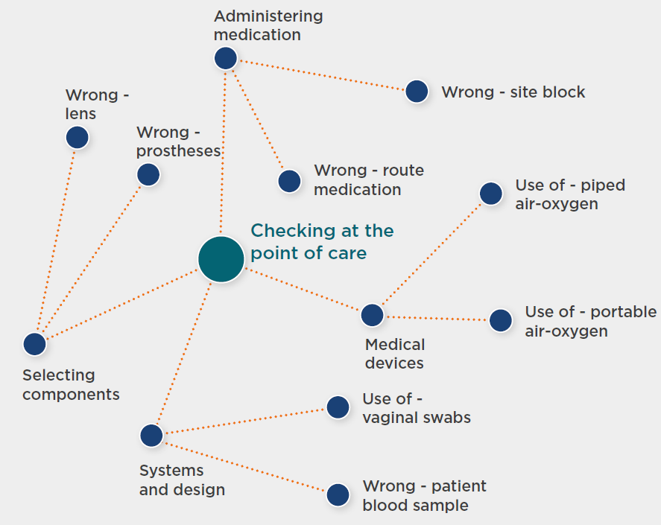
Checking at the point of care
  Many routine activities require healthcare workers to check that the intended treatment is being delivered correctly.
  The aim should be to reduce the reliance on checking by developing procedures that mitigate against known risks by design.

Slide 12

Case Study
3 fentanyl overdose bolus incidents occurred in November 2018 across 3 different critical care areas within the same Trust
Incidents were linked by the Trust to the introduction of smart pump technology – specifically when the “drug library went live”
Fentanyl had been excluded from the drug library as the doses were not standardised – requiring dose-rates to be manually programmed or selected from a menu
The user was required to check the fentanyl concentration in the syringe prior to programming, calculate the dose-rate, and program in a “new way” even though the hardware was familiar
“…confusion between dose-rate and flow-rate due to introduction of new Drug Library”

Slide 13
Actor & Artefact Map for the procurement, usability and adoption of smart pumps
Accimap of findings
International and National Regulators and National Bodies
NHS England
FDA (US)
Medical Devices Directive (EU)
Injectable Medicines Guidelines (Various)
NHS X
NHS E/I
Safety Alerts
MHRA
NHS Trust / Device Manufacturer
Business Case
Safety Case
Manufacturer’s User Profiles
Medication Safety Committee
Trust’s IV Drug Guide
Medical Engineering Led Evaluation
Usability Testing
Drug Library Implementation Group
Management (operational)
Training and Implementation Plans
Policies and Protocols
Elicitation of Work-As-Done Expertise
Post-Procurement Surveillance
Elicitation of Specialist Medicines Expertise
Process and actor activities
Error Reporting
Device Training
IT Infrastructure Work
Intravenous Medication System
Nurses IV Administration
Doctors IV Administration
Work, equipment and surroundings
Smart Pump Use

Slide 14
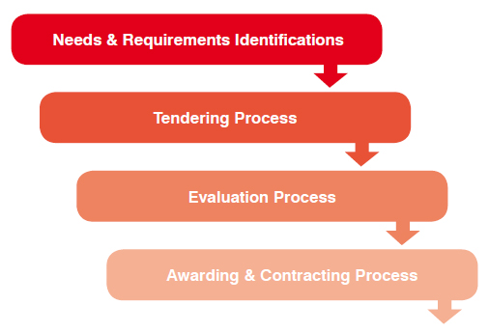
Lifecycle
2016 (Q1) – Ageing pumps, mobility and equipment standardisation, patient safety
2016 (Q2) – User testing, start drug library development
2016 (Q3) – Proceed on the basis that drug library will take 6-8 weeks develop and will “go live” later
Manufacturer to support development of drug library and provide device training…
2016 (Q4) – Funding obtained for drug library development
Development took 2 years – A bespoke implementation framework was designed
2018 (Q3) – Training for drug library “go live” was provided “in a compressed way” to coordinate with EPR rollout
2018 (Q4) – Shortly after “go live” the incidents occurred. Attempts at pushing out a new version of the drug library to prevent future incidents of that type were unsuccessful.

Slide 15
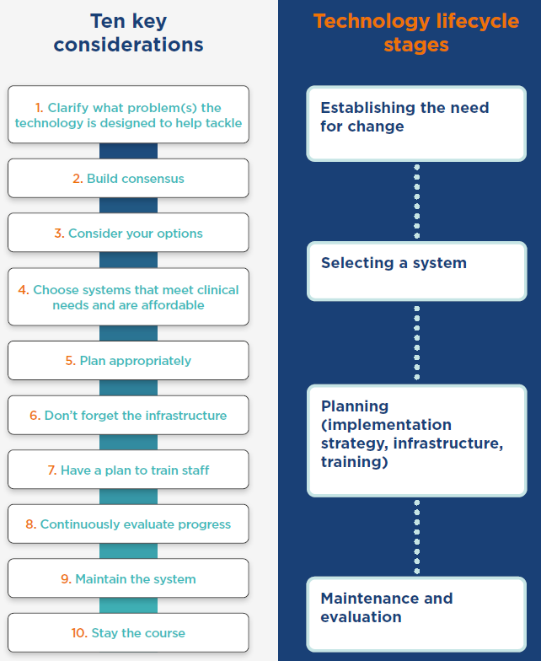
Cresswell, K. M., Bates, D. W., Sheikh, A. (2013) Ten key considerations for the successful implementation and adoption of large-scale health information technology, Journal of the American Medical Informatics Association, vol. 20, no. e1, pp. e9-e13 [Online]. DOI: 10.1136/amiajnl-2013-001684.

Slide 16
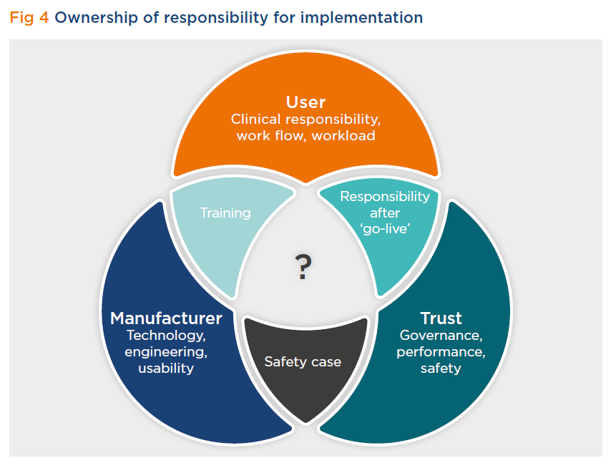

Slide 17
Supportive systems
Manufacturers supply and use proprietary software when developing and updating drug libraries
Data inputted either by Trust or manufacturer
Drug library then sent / installed on pump
Who has ownership and responsibility that the data / drug library is correct?
Why can’t data from the pumps be easily shared?

Slide 18
Clinical Risk Management
Clinical Risk Management - Data Safety
‘Health IT Systems are defined as products that comprise hardware, software or a combination of both.
Hazards to patients arising from hardware and software - both in normal operation and in cases where the hardware and/or software exhibit unintended behaviour. Assessing safety risks in hardware and software is a practice common to many industries and several strategies for managing these risks have been developed over the years. These strategies have typically been embodied in a variety of standards and best practice guides’
NHS Digital
NHS Digital Clinical Safety standards -
Compliance with DCB0129 and DCB0160 (previously known as SCCI0129 & SCCI0160)

Slide 19



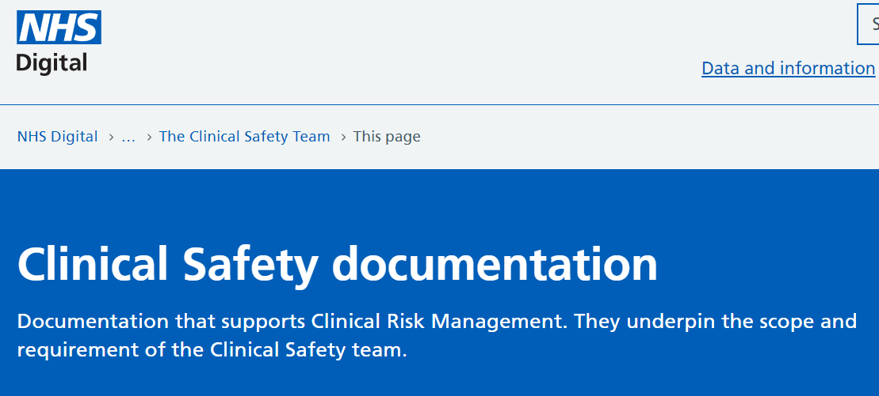
Safety Cases
Safety Case
A structured argument, supported by a body of evidence that provides a compelling, comprehensible and valid case that a system is safe for a given application in a given operating environment.

Slide 20

20

