Slide 1

JASON WILLIAMS & MARK FURMAGE
CWM TAF MORGANNWG UNIVERSITY HEALTH BOARD
Challenges of Retaining and Developing the Operational Workforce.

Slide 2

Objectives
The current landscape & backdrop
Retaining Staff
Recruitment
Apprenticeships
Developing your workforce

Slide 3
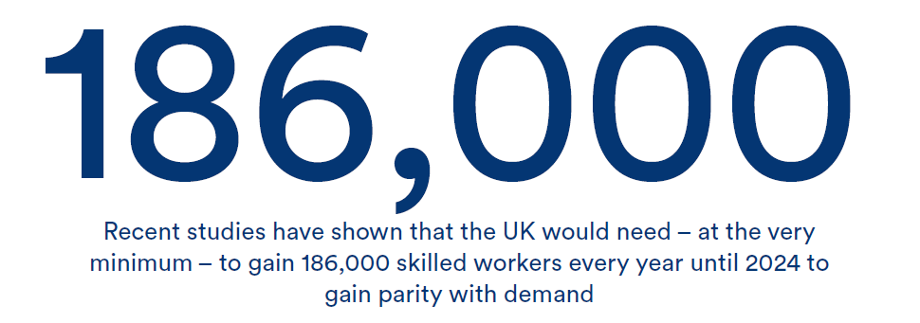
CTS Whitepaper 2016

Slide 4
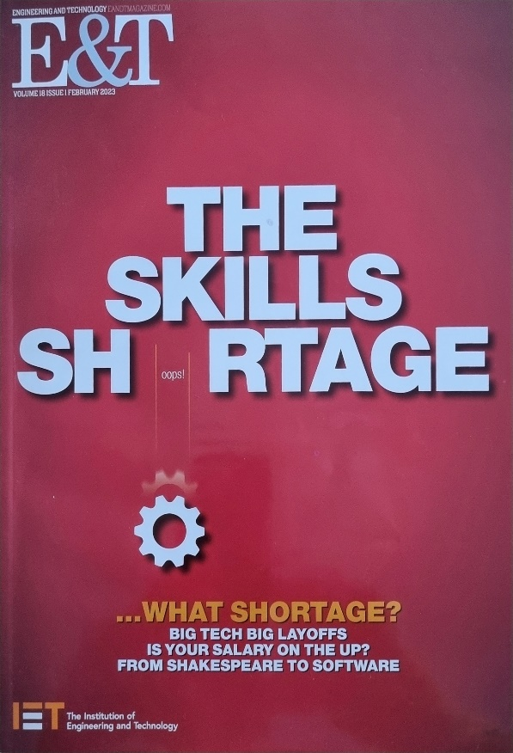
INSTITUE OF ENGINEERING & TECHNOLOGY (IET), E&T February 2023 Publication
“Based on data from the British Chamber of Commerce, the Open University concluded in June 2022 that almost 90% of large employers and more than 2/3s of SMEs are facing skills shortages”
“The majority of employers stated the shortages are piling pressure on existing staff, reducing output & productivity and profitability”
“In engineering specifically, the 2021 skills survey by the IET found 2/3s of those surveyed reported gaps were they couldn’t or were having trouble filling”

Slide 5
SKILLS SHORTAGES
The skills shortages are probably linked to the historical decrease of engineering and manufacturing within the U.K.
National industries - NCB, British Steel, etc. Even local authorities did have dedicated apprenticeship programmes, producing quality and well trained staff.
Hinkley Point – Resource Drain
For far too long U.K. has outsourced engineering & manufacturing, leading to less market demand and quantity of skilled engineering staff, with less focus on STEM careers for school leavers

Slide 6

Pay an Issue? – Retention & Recruitment…
Scarce resource / Inflated salary's – Top companies want the best people and best trained tradespersons
NHS Pay structure – means we cannot currently compete for the top people, the wages we can offer don’t make us competitive, in a extremely competitive market
External and private companies have more flexibility to pay more and provide additional perks and incentives such as a company vehicle, more training, van stock etc.

Slide 7

Waging a War for Talent
Retaining staff has never been so crucial with increased governance & demands on the service.
This can also be said for recruiting staff, the NHS is no longer considered a lucrative employer

Slide 8


M&E Staff Vacancies 2021 - 2023
Examples:
Elec Position at YCR – 7 times
Elec Position at PCH – 11 Times
Fitter Position at POW – currently 5 times
Elec Positon at RGH – 9 times
Elec Position at YCR – 4 times

Slide 9
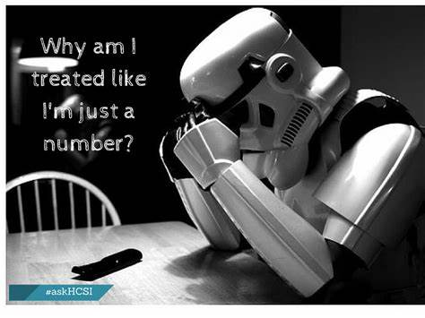
Staff Affects
Low moral
Lack of opportunities
No end in sight
Frustrations
Disillusion with role
Ambiguity over objectives
Low pay with added pressures
Management Affects
Reduction in productivity
Additional costs
No end in sight, leading to frustrations
Targets not being met
Constraints on using agencies due to budget limitations

Slide 14

Current Constraints
Lack of dedicated training budgets
Lack of managerial training for Estates professionals, more clinical based / focused
Lack of budgets to support apprentices
Brexit – Less foreign labour available / work permits and visa restrictions
Cost of living crisis
Industrial action – Concerns and unrest may put applicants off or aid staff to leave / unvalued - unpaid
Apparent lack of value in apprenticeships – decreased productivity / hindrance?
Potential lack of understanding of apprenticeships and their frameworks
Notes:
Training budget – not enough to do stat, mandatory in addition business critical & professional development training

Slide 15

Time to act is now!

Slide 16
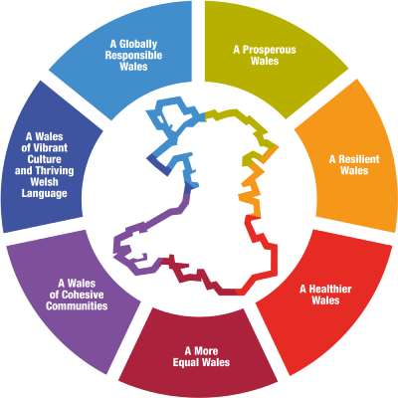
What can we do?
Upskilling existing staff
HR Support & Future Generations Act 2015?
Free training or apprenticeships
Managerial training to help support existing staff but also staff with aspirations of developing into managerial roles – succession planning
CPD training & webinars
NHS Wales & NWSSP-SES to support no outsourcing and fund upskilling & apprenticeships
Notes:
How do we become the employer of choice again? / invest in EFMs to effectively manage & develop their teams – funding is low

Slide 17
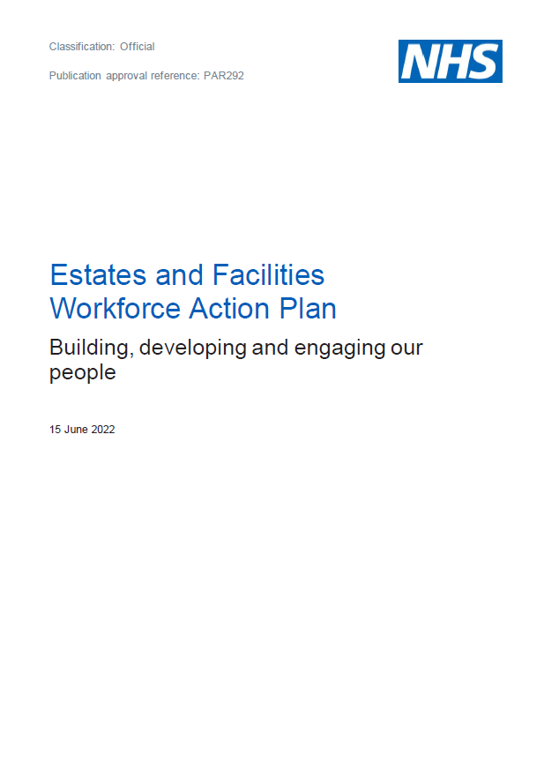
What can we do? - Continued
NHS England published the Estates & Facilities Workforce Action Plan, June 2022 setting out a framework to improve the current resource issues.
Promotes a “culture of inclusion and belonging as well as growing the workforce, train our people and work together differently”.
Within the workforce action plan there are 4 priorities that include 9 key actions that link to the NHS England – People Plan.
Welsh version covers the broader NHS workforce not just Estates & Facilities, perhaps a rethink is required???
Notes:
10 Year Plan – annual review and reshaping if neccessary

Slide 18
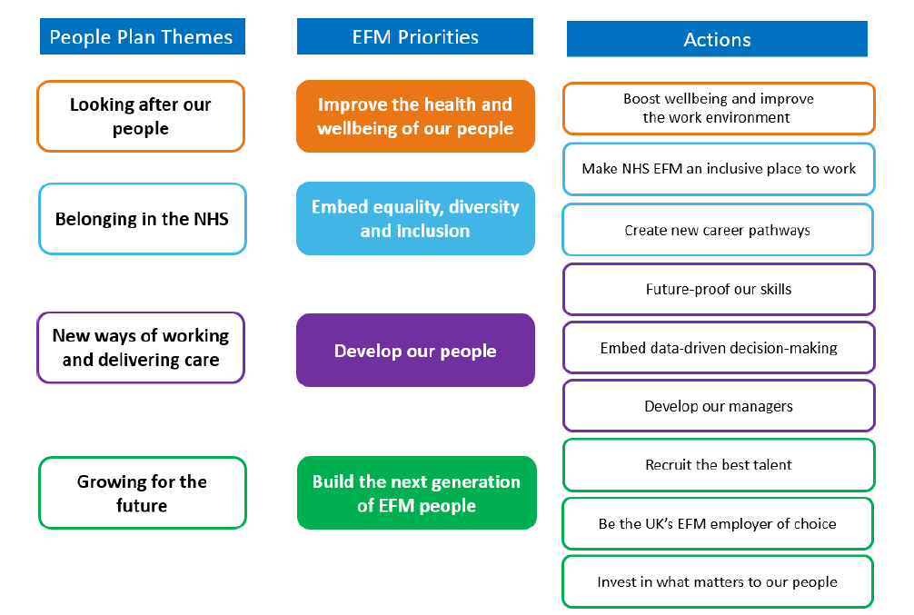

Slide 19
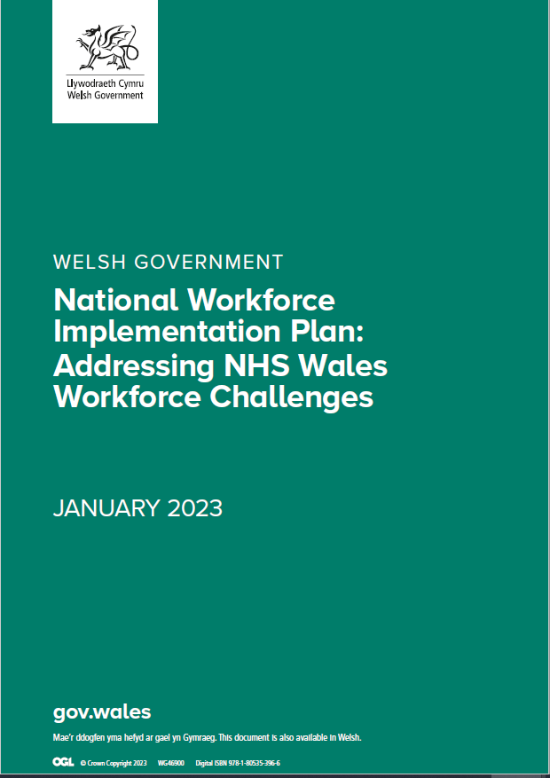
NHS Wales
Outlines – recruitment & retention issues due to
Stress
Fatigue
Burnout
Unattractive working conditions
Poor professional development opportunities
Does not mention Estates or Facilities in timetable for workforce plans
Is it time for a rethink?

Slide 20
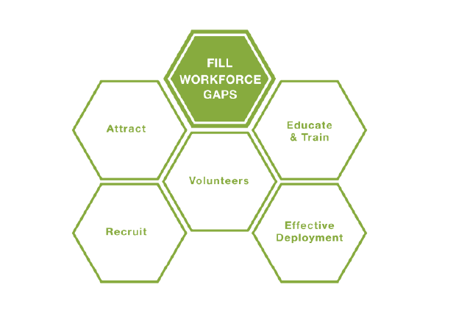


Slide 21

Pay & Conditions – Are radical changes required?
Medical & Dental staff have different terms & conditions – do we need same to address the issues?
Unless changes are made centrally to help, retaining & developing the workforce, the existing acute pressures will remain
Notes:
Breakdowns take longer – other staff have to help to support EO/Supervisors, other trade staff

Slide 22

Do We Use The IMTP Well Enough?
Are we highlighting the need for apprentices?
Do we feel our workforce is fit for purpose?
Are we highlighting the recruitment & retention problem?
Are we highlighting the need for more budget for training or apprentices?
Are we highlighting the need for upskilling or multi-skilling
Are we highlighting the risks?
Notes:
Ask audience?

Slide 23
Train them and they will stay?.....
Increased compliance & governance obligations… the need for a competent and well trained workforce has never been more important.
Fire requirements – fire doors, fire dampers, emergency lighting
Water & legionella – sentinel monitoring, sampling, temperature checks
Decontamination – new testing standards, more rigorous reporting
More complex engineering systems + additional assets
Notes:
No guarantee they will stay if things don’t change and climate improves / Field of dreams

Slide 24
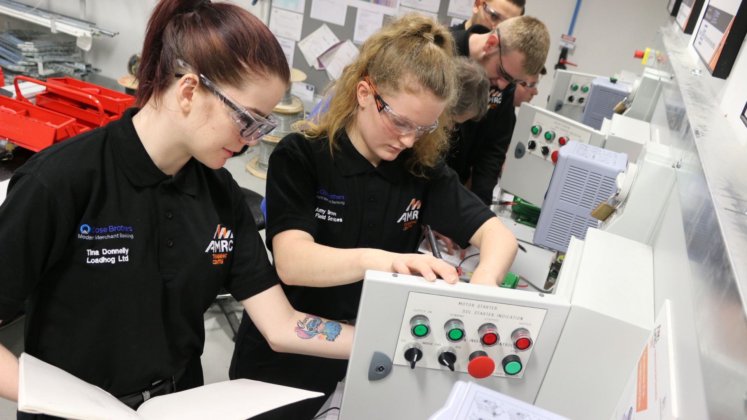
Upskilling…
Robert Moritz, Global Chairman of Management Consultancy PwC
“Upskilling gives people more confidence and research has shown it is the people lacking the skills who are more likely to leave”

Slide 25
CTM Apprenticeships
Assistant Director – Apprentice Carpenter – Sept 1982
Assistant Head of Estates – Apprentice Electrician – Jan 2003
Senior Estates Manager – Apprentice Fitter – Sept 1990
Operational Maintenance Manger – Apprentice Electrician – Sept 1987
Energy Manager – Apprentice Electrician – Sept 1987
Senior Capital Officer – Apprentice Fitter – Jan 2003
Capital Officer – Apprentice Electrician – June 2010
Estates Officer – Apprentice Fitter – Sept 2003
Estates Officer – Apprentice Paint & Decorator – Oct 1988
Mechanical Tradesperson – Apprentice Fitter – Sept 1995
Mechanical Tradesperson – Apprentice Fitter – Sept 2006
Electrical Tradesperson – Apprentice Electrician – Sept 2015
Electrical Tradesperson – Apprentice Electrician – Sept 2015
Paint & Decorator – Apprentice Paint & Decorator – Sept 2005
Plumber – Apprentice Plumber – Sept 1990
Plumber – Apprentice Plumber – Sept 1982
Electrical Tradesperson – Apprentice Electrician – Oct 2007
Estates Officer – Apprentice Fitter – Sept 1981
Equating to a total of 434 Service Years
Notes:
Ask audience, how many are former NHS Apprentices? Highlight we have recently lost two apprentices we gave jobs to

Slide 26

Our industry is in need of a new generation of skilled workers, therefore it is vital that we continue pumping out the quality worker required to keep our industry thriving. Introducing an apprenticeship scheme will keep both your business and the sector as a whole above water.
Taking on an apprentice will grow your workforce and can improve how you work, increasing productivity and profits, it is a no-brainer.
Jonathan Lee Recruitment – Aging Workforce
“The skills shortage is exacerbated by the impeding retirement of a aging workforce. 19.5% of engineers currently working in the U.K. are due to retire by 2026, leaving a KSE gap

Slide 27
Workforce landscape in 2023
Where are we now?
Where do we want to be?
How do we get there?
Taking a holistic approach to retention & development of our existing workforce is critical
Notes:
Retention is also based on opportunities to use skills & develop expertise

Slide 28
Plan for the Future
Not as bad as it seems?
Easier said than done?

Slide 29

Thank you for listening
Hope you enjoyed the content
Any questions?

