Slide 1
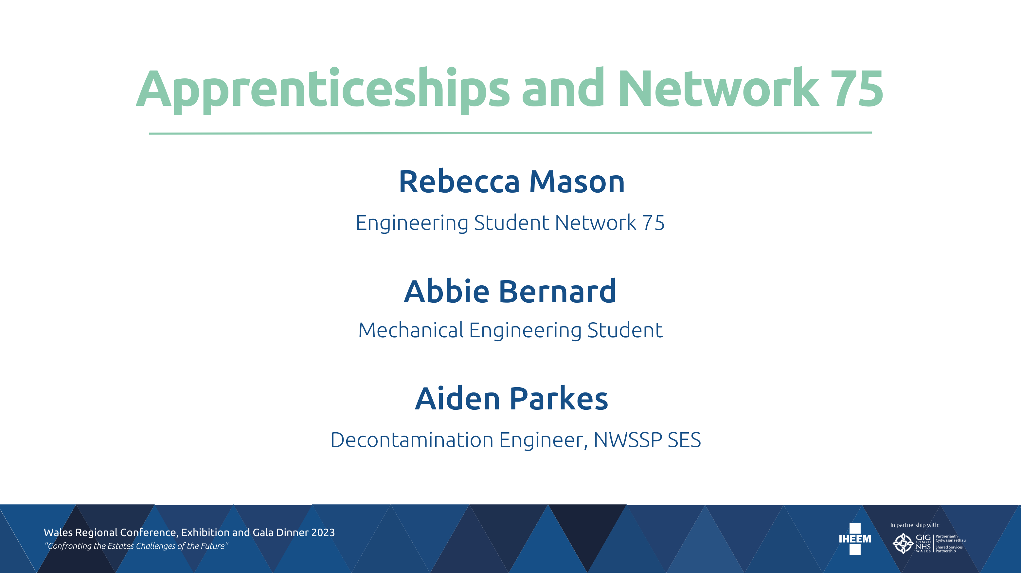

Slide 2

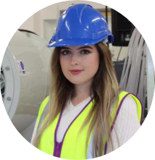
Rebecca Mason
Started at NWSSP September 2018
Network 75 Student (USW)
BEng Mechanical Engineering
Final year
Notes:
Hello. My name is Rebecca Mason. I joined NHS Wales Shared Services Partnership in September 2018 as part of the Network 75 degree scheme at the University of South Wales. I have just completed my finBal year of my 5 year degree course in mechanical engineering.

Slide 3




Network 75 Degrees
BEng (Hons) Civil Engineering
BSc (Hons) Civil Engineering
BEng (Hons ) Electrical and Electronic Engineering
BEng (Hons) Mechanical Engineering
BSc (Hons) Building Surveying
BSc (Hons) Construction Project Management
BSc (Hons) Real Estate
BSC (Hons) Quantity Surveying and Commercial Management
BA (Hons) Accounting and Finance​
BA (Hons) Business Management​
BA (Hons) Human Resource Management​
BSc (Hons) Logistics, Procurement and Supply Chain Management​
BSc (Hons) Marketing Management​
MSc Human Resources Management​
BSc (Hons) Computing​
LLB (Hons) Legal Practice SQE
Notes:
I first heard about Network 75 when I was in my final year of sixth form. We were read out a long list of degrees, which you can see here on the screen, and told to stay behind if we were interested in studying any of them.
I had never heard of Network 75 before, but during a short presentation we were told all about the scheme. The scheme allows you to work alongside your degree, in the sector which you are studying for. It is only offered at the University of South Wales

Slide 4
The Application Process
Online application form
Interview with Network 75
Interview with host company
Notes:
After being informed about the scheme, I decided to apply. You can apply alongside your normal UCAS university applications, meaning that you can still go to university full time if you are unable to find a suitable host company, which I don’t think has happened to date.
After filling out my application form, I was invited to the University for an interview with Network 75. They provisionally accepted me onto the scheme as long as they could find me a suitable company. They then sent my application form out to several companies that they thought would suit me on the scheme and arranged two interviews for me, one with NHS Wales Shared Services Partnership, and another with GE aviation.

Slide 5






Companies on the Network 75 Scheme
NHS Wales Shared Services Partnership
Aneurin Bevan University Health Board
Swansea Bay University Health Board
Cardiff and Vale University Health Board
Dwr Cymru
Network Rail
The Royal Mint
Centregreat
GE Aviation
Morrisline Engineering
Morgan Sindall
F P Hurley & Sons Ltd
Notes:
There are lots of companies currently on the scheme, far too many to list. I have put a short list here of some of the companies that you may recognise. As you can see, the NHS has lots of Network 75 students, throughout the health boards as well as shared services. The NHS students are studying a range of degree courses, ranging from law to computing, not just engineering.

Slide 6


Benefits of Network 75
Balance (3 days in work, 2 days in university)​
Networking​
100 % employability
Work, earn, learn
No student debt
Notes:
There are lots of benefits to completing your degree this way, rather than the conventional full time university route. The Network 75 slogan is ‘work, earn, learn’, which I think sums the scheme up perfectly. All course fees are paid by the host company, so the student doesn’t have any student debt, there is a nice balance during term time as you spend three days in work and two in university. There are great opportunities for networking, and due to having five years experience at the end of the apprenticeship, so far there has been a 100% employability rate from Network 75, which is amazing considering that lots of full time university students struggle to find a job relating to their degree once they graduate.

Slide 7
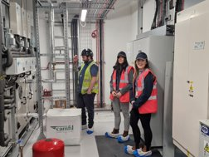
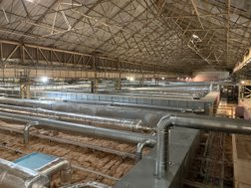
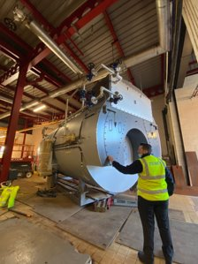
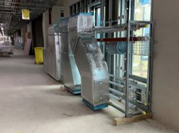
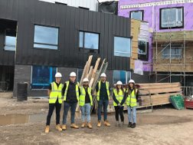
My Network 75 Experience
Notes:
Throughout my five years at shared services, I have had lots of amazing opportunities and experiences. I have been lucky to work with really skilled and knowledgeable engineers, who have always taken time to explain concepts to me and show me things that they believe will benefit my development as an engineer. I have completed lots of annual verifications with Nigel Baker, I’ve completed validations of new schemes, I have witnessed the commissioning of new schemes, and also had the opportunity to go on some amazing secondments.
My first secondment was with the estates department at the Royal Glamorgan Hospital. I then went on to do a placement with estates at Prince Charles Hospital, and then Velindre Cancer Centre, where I was able to get involved in sustainability work.
During Covid, I spent a few months at the Grange University Hospital during the final stages of construction. I did lots of witness testing, particularly on the BMS system and the ventilation.
I was lucky to return to the Royal Glamorgan Hospital for a second secondment with estates, although I also got involved with the capital projects the second time around. This taught me a lot about capital schemes and the tendering process. I was lucky to be involved with the replacement of the Princess of Wales steam boilers from tender to installation.
My most recent secondment was at Aecom, where I learned to design the systems I have spent the last five years validating and verifying. It was great to learn how these systems are designed, and all the aspects that need to be taken into consideration. I was involved with some exciting projects, one of which being the new burns operating theatres at Morriston Hospital, which I am looking forward to seeing get to site in the near future.
Now that my network 75 experience is over, I am just waiting for my university results, which will be available on the 28th of June. I have been offered a position at shared services, and they have also offered to support me to pursue a masters, which will help me one day become chartered.

Slide 8
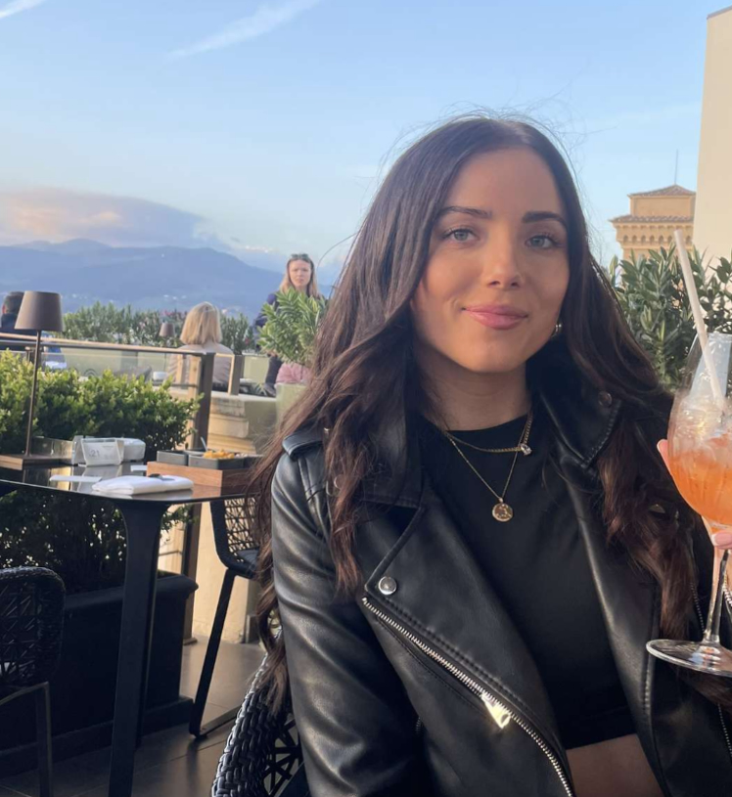
Abbie Bernard
Started at NWSSP in September 2019
Mechanical Engineering, BEng
4th Year
Currently studying for final exams

Slide 9
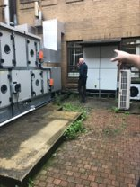
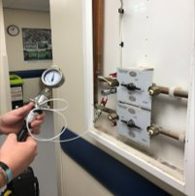
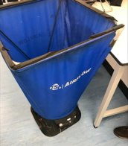
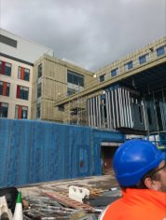
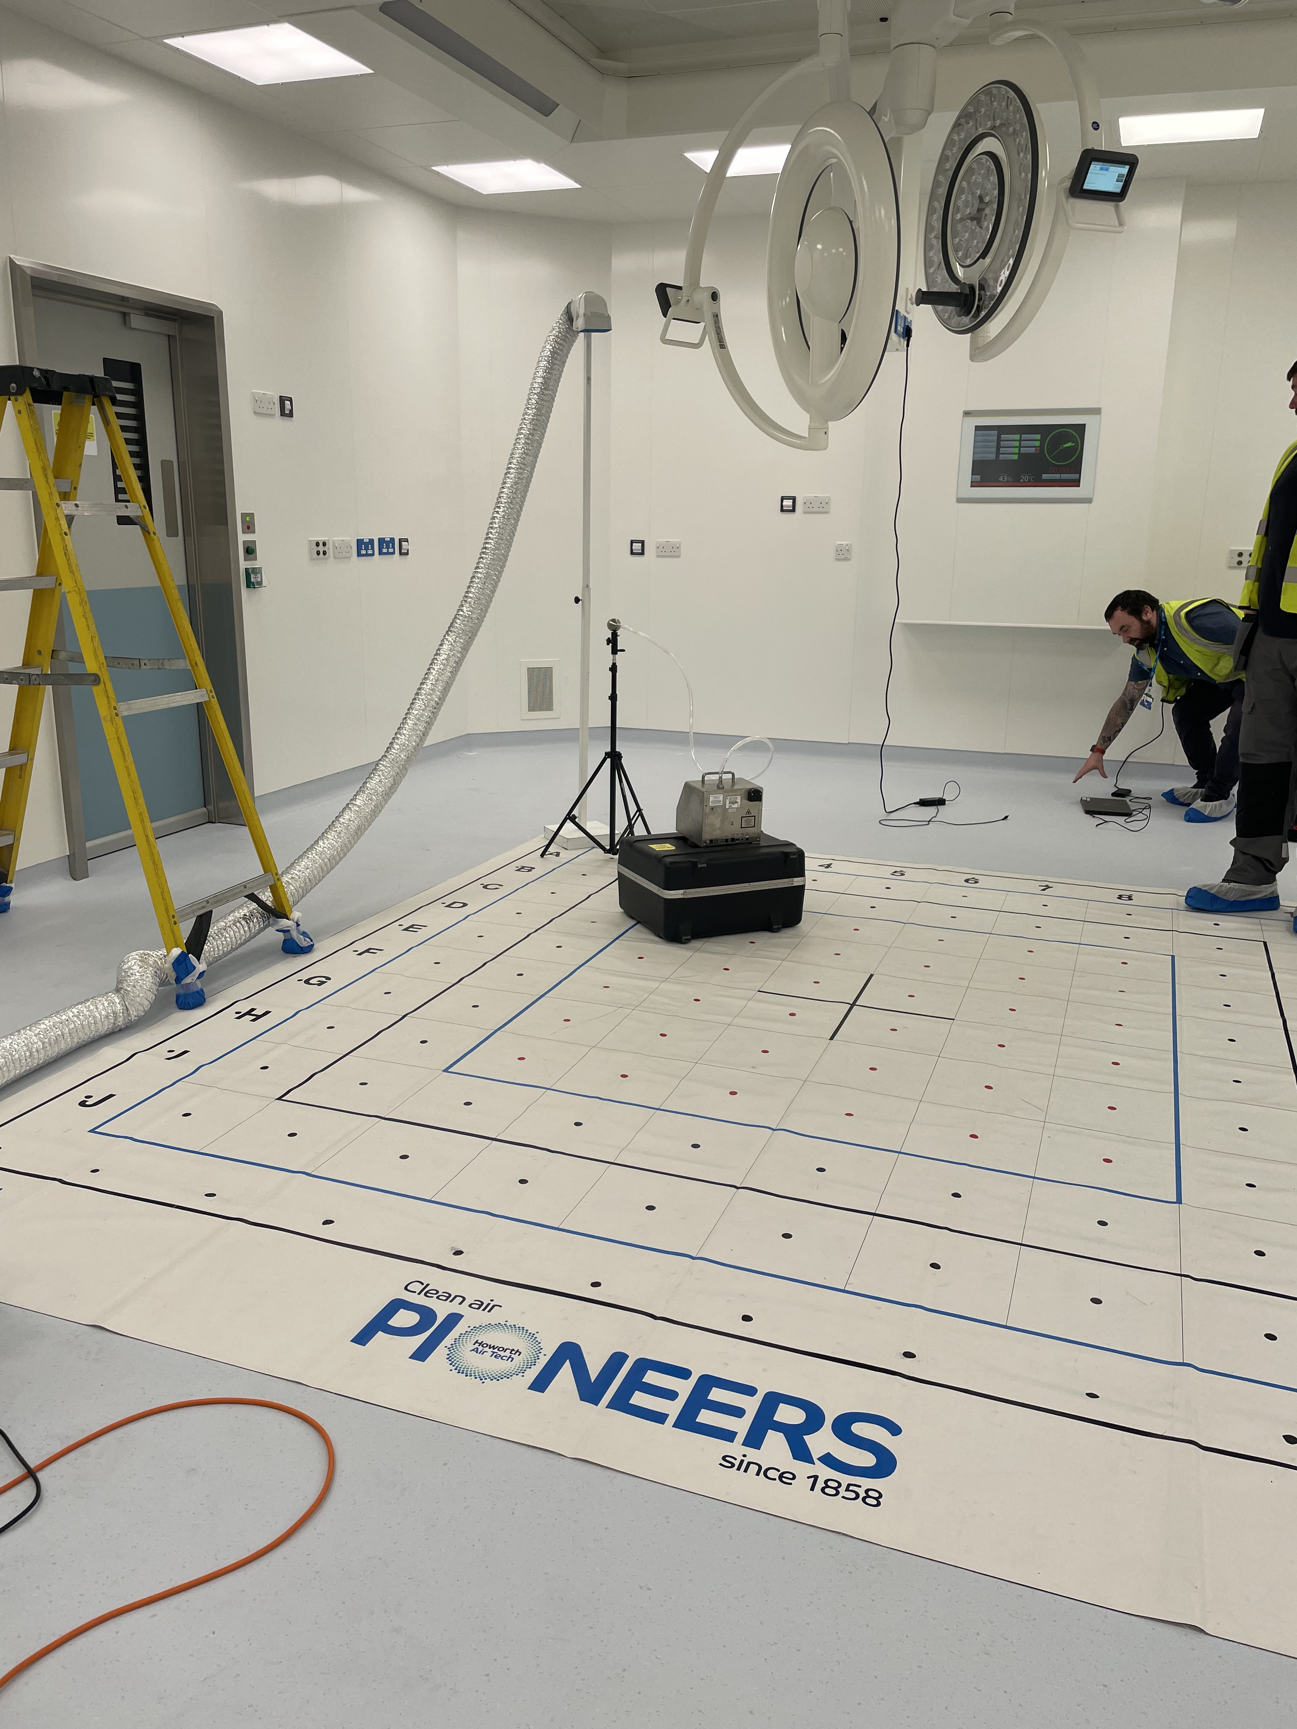
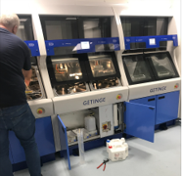
Estates Experience within SES

Slide 10
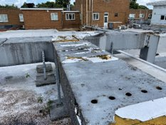
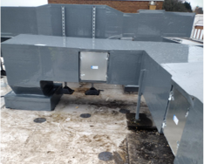
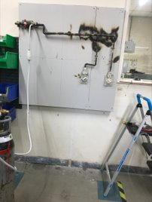
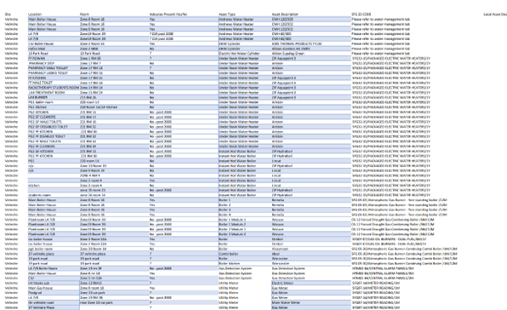
My Network 75 Story
Projects
Before
After
Asset Management
New cafm system
Cataloging over 6000 assets for site
Medical Gas CP Course

Slide 11
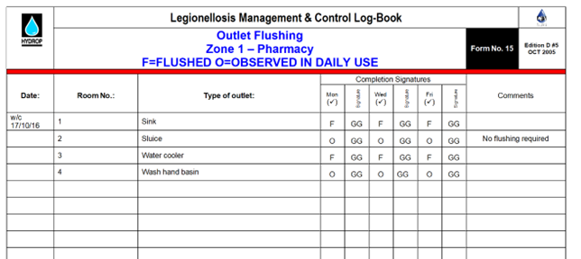
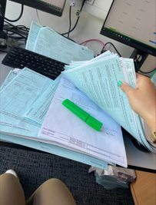
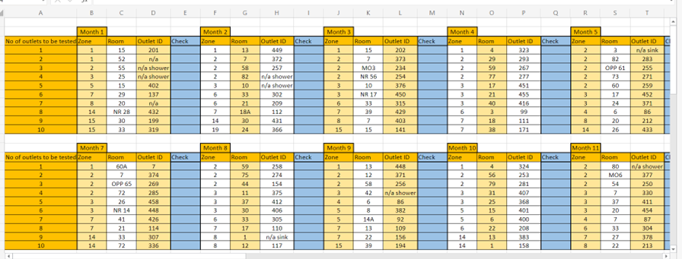
My Network 75 Story
Water
Management
Analysing water samples
Creating sampling regimes, ppm schedules
Flushing regimes
Sentinel temperature monitoring

Slide 12
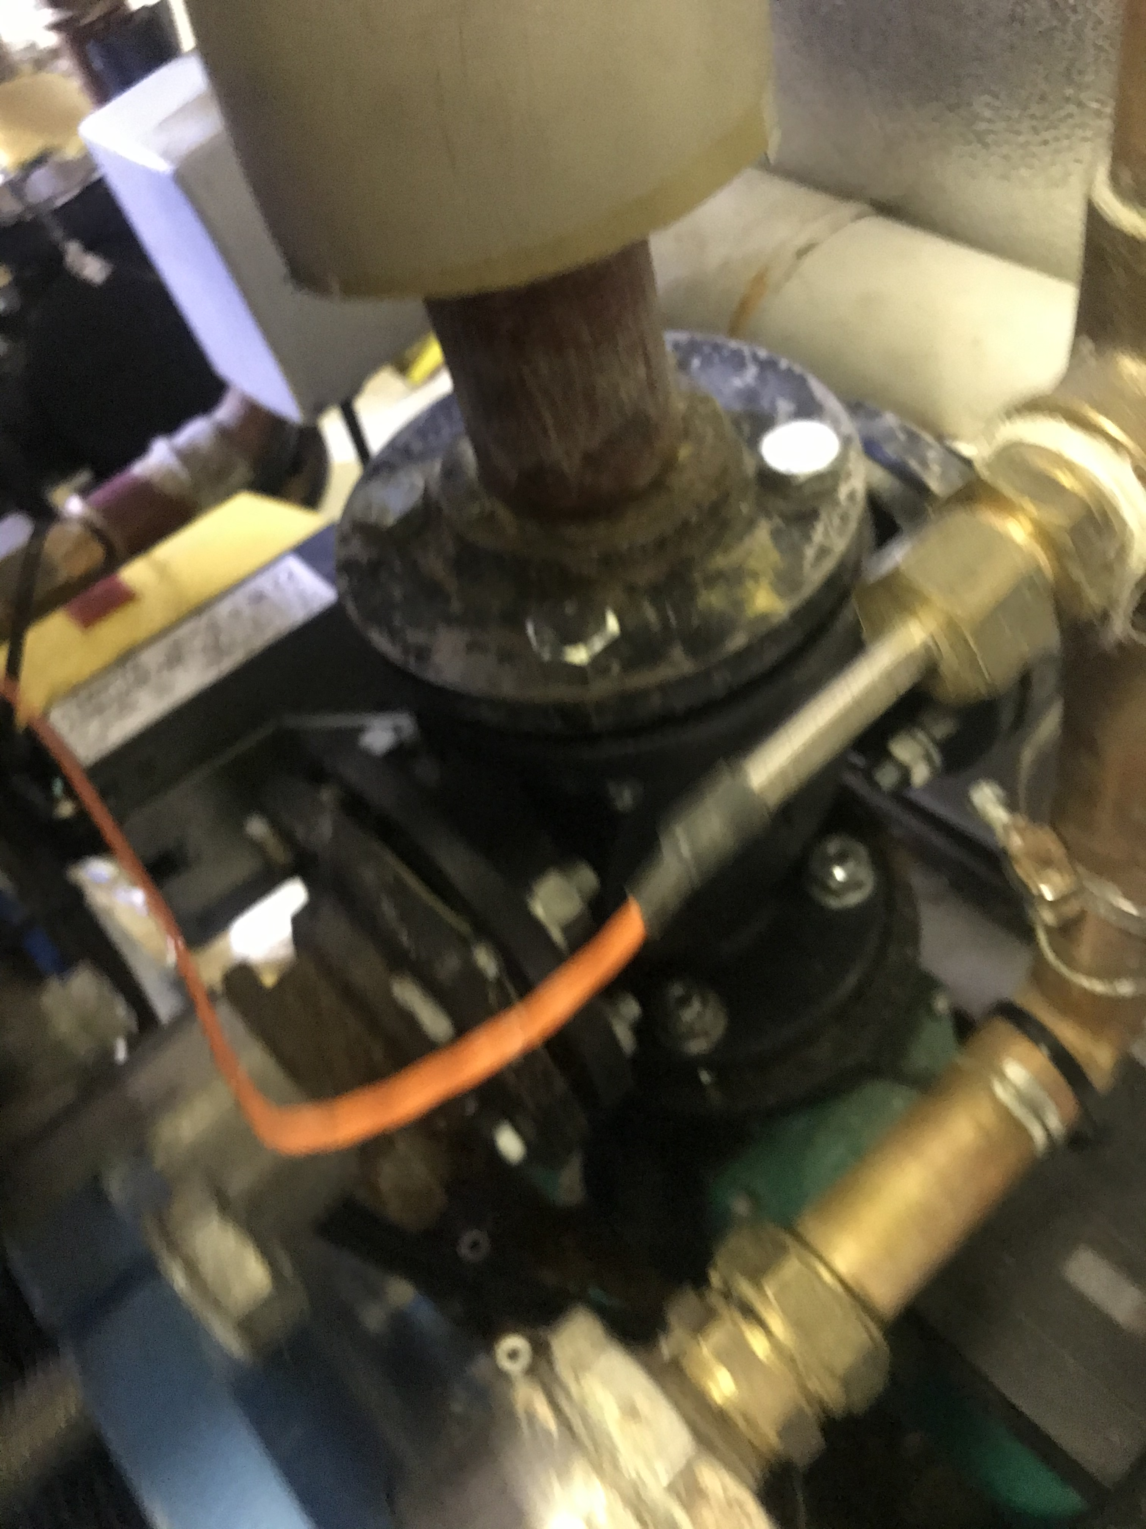
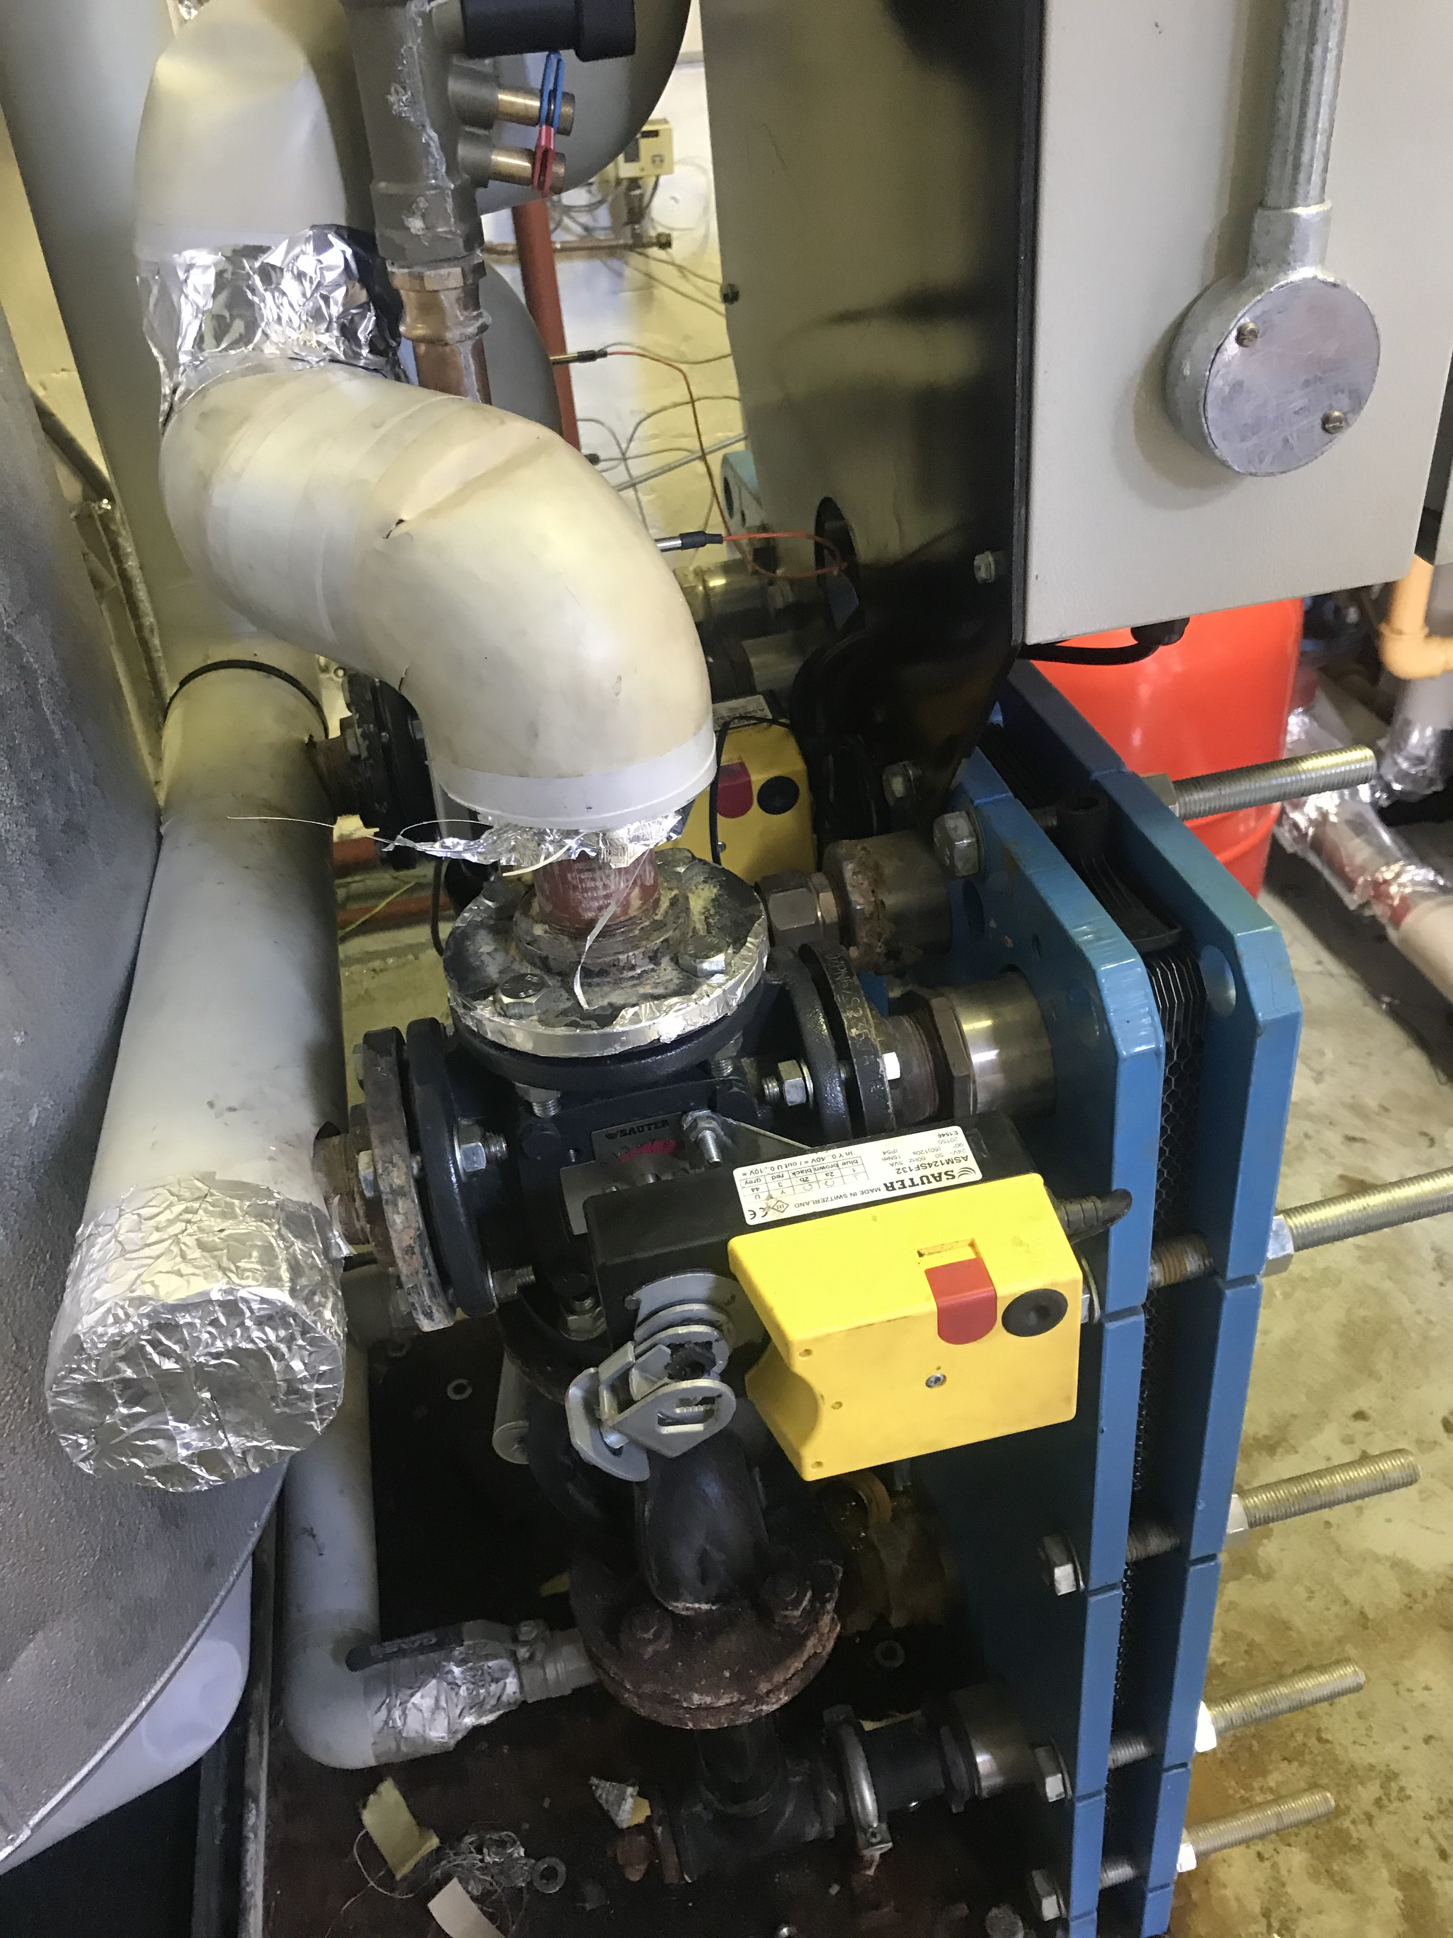
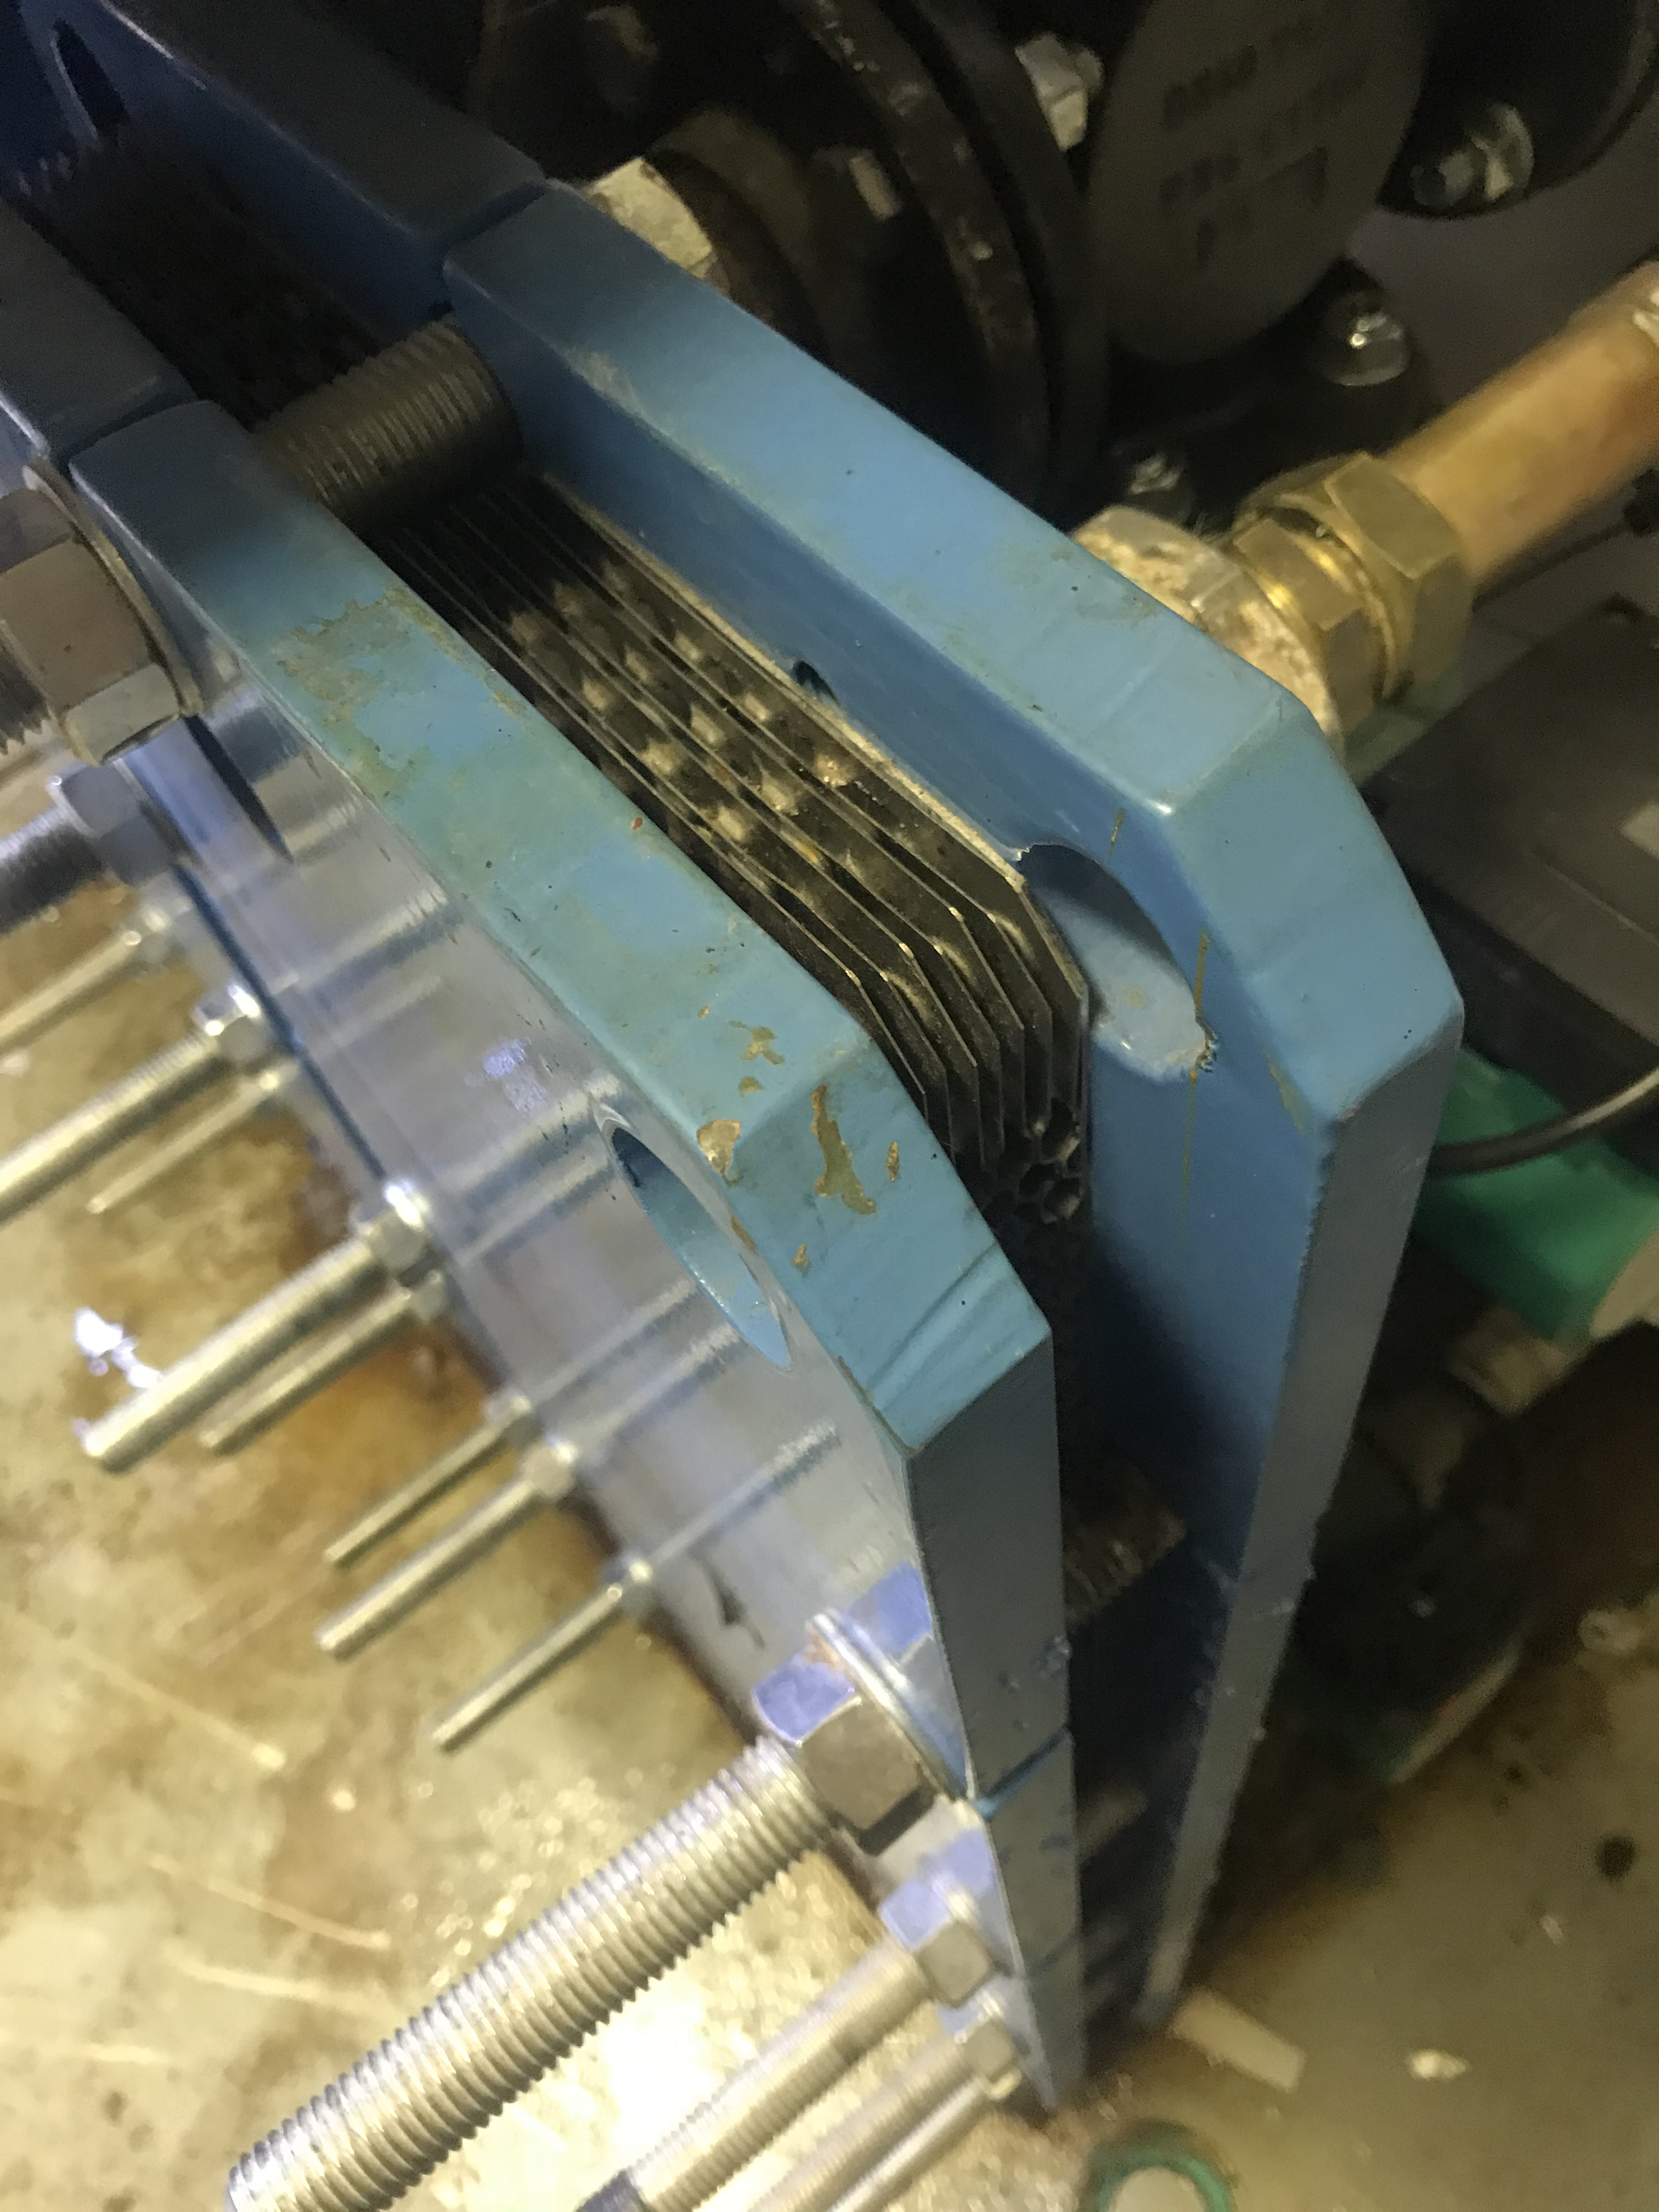
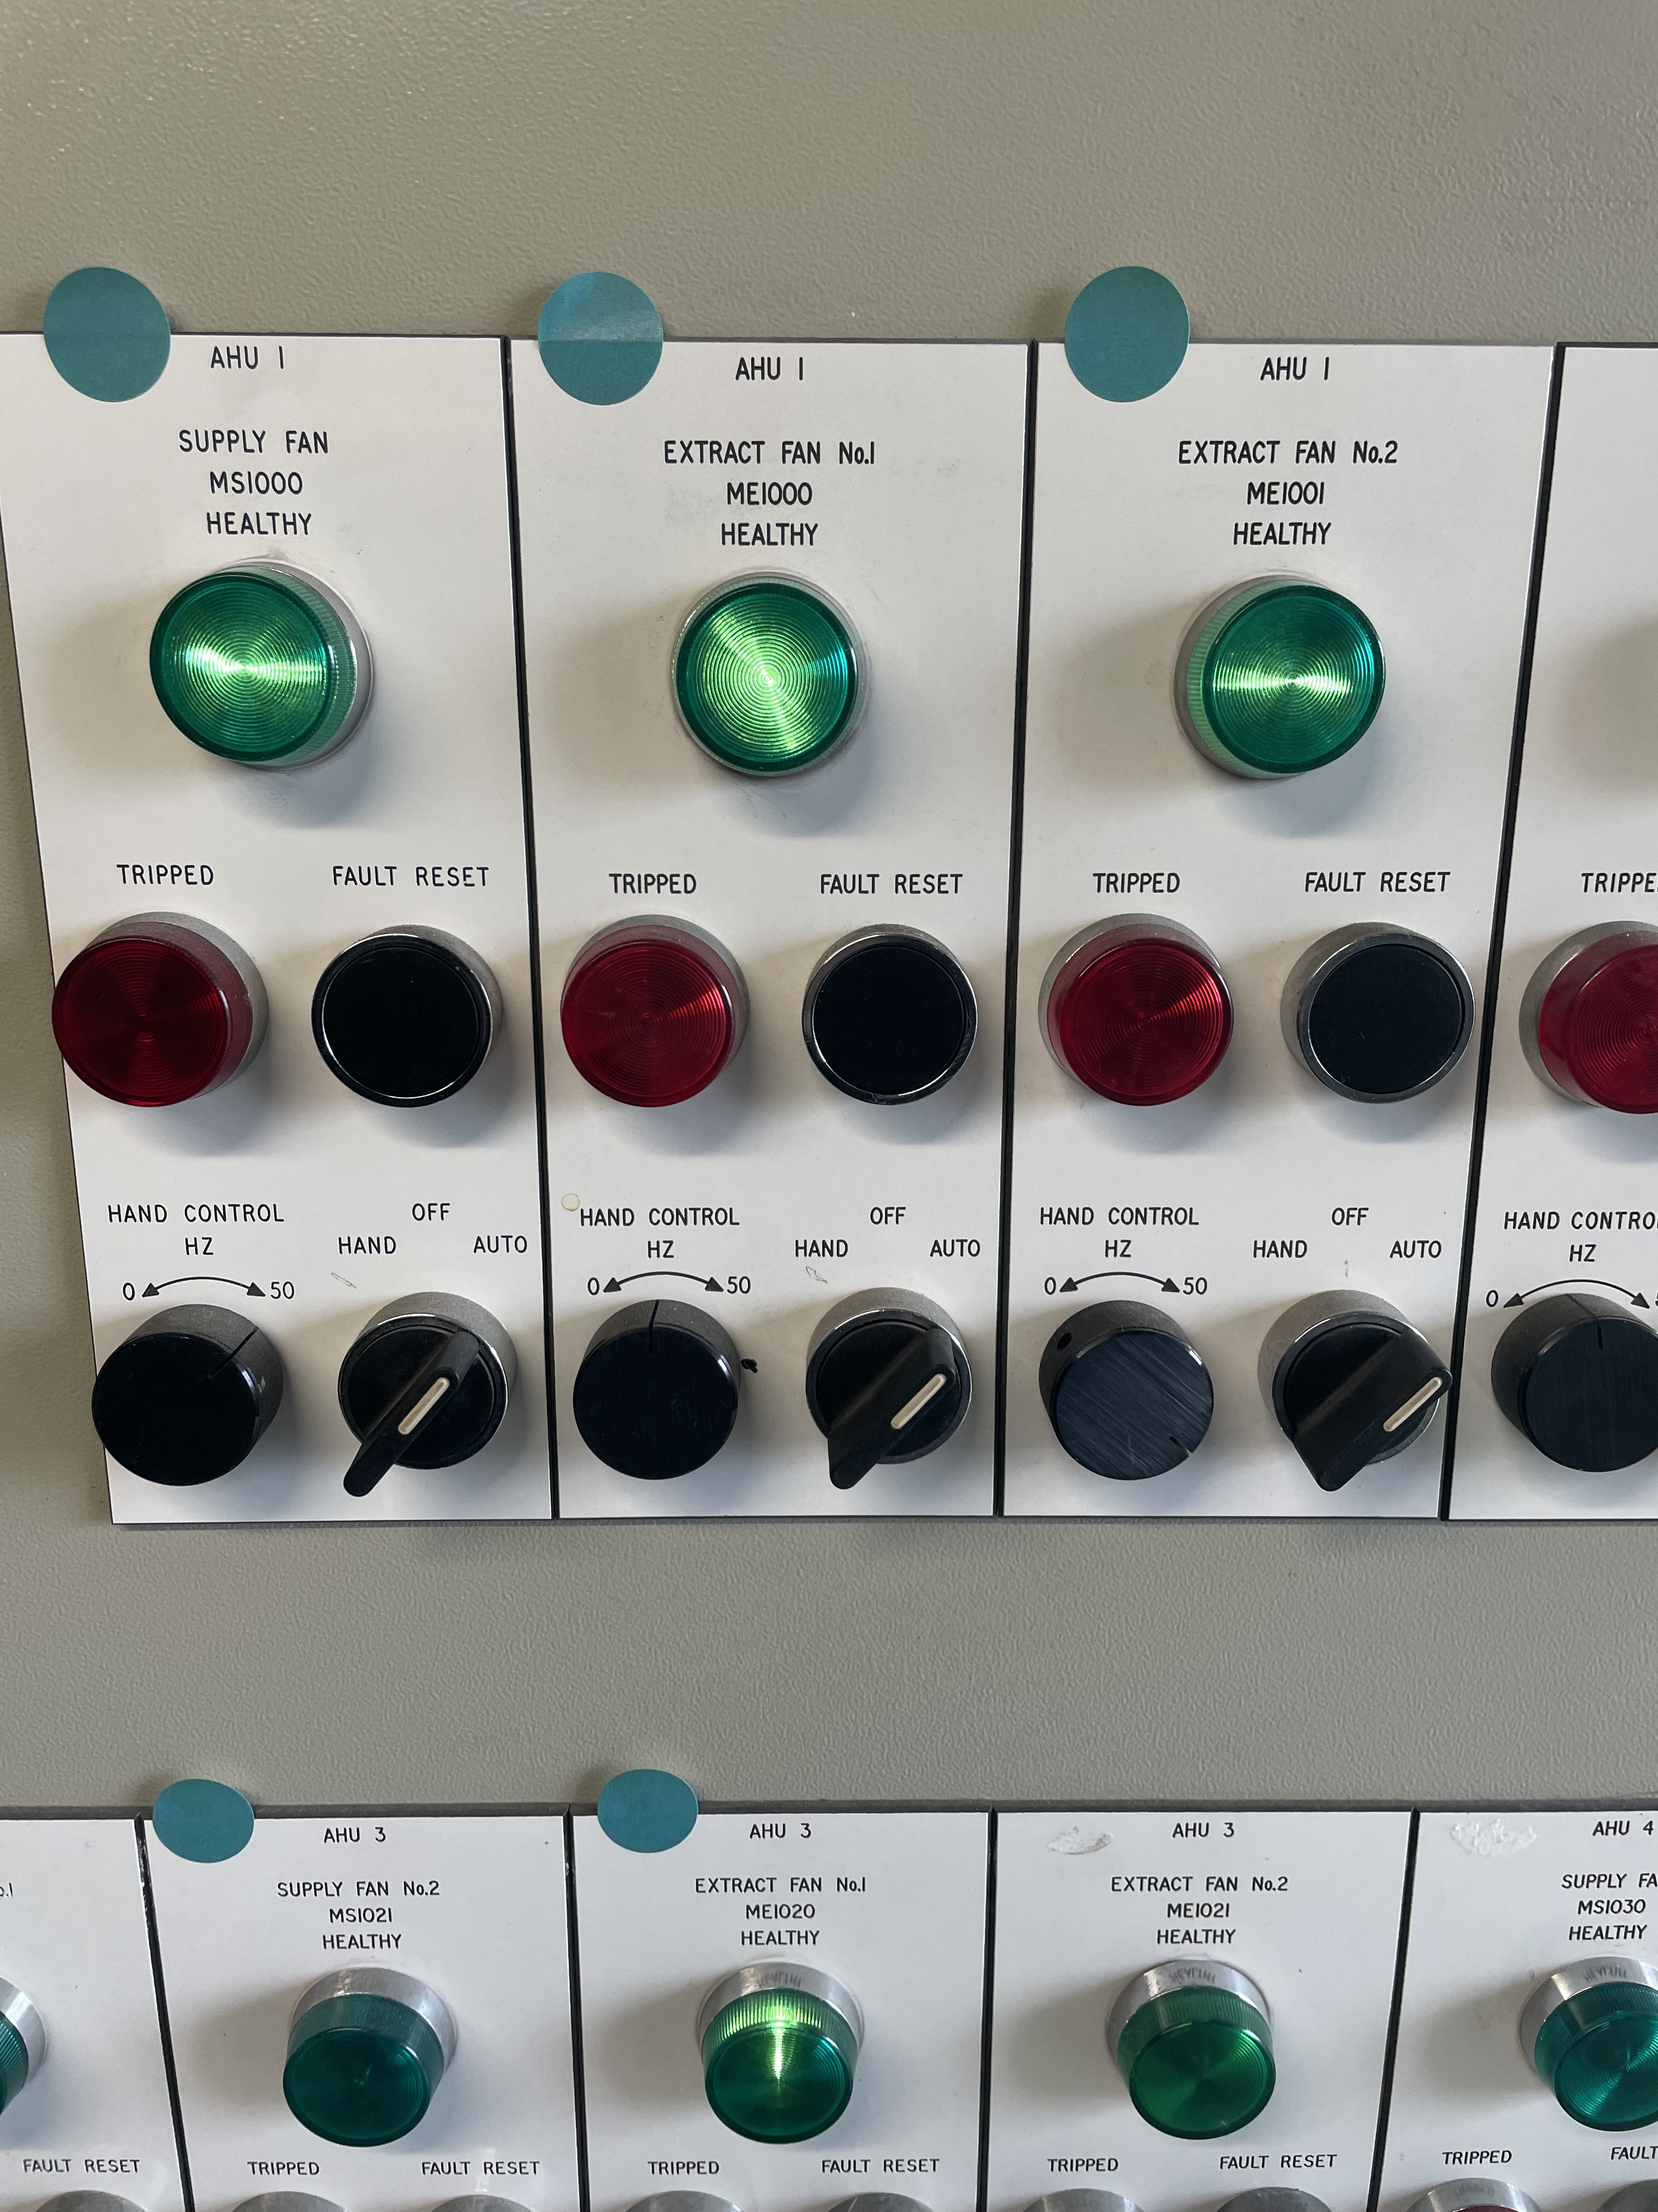
Aligning University and Work
Plate Heat Exchangers – Thermofluids
BMS – Control and Instrumentation

Slide 13
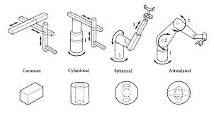
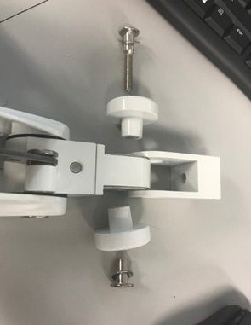
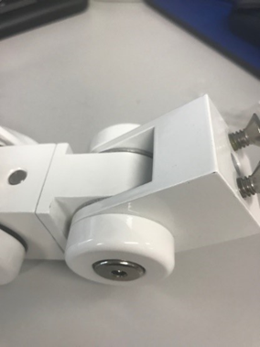

Aligning University and Work
Constant support in university and placement
Articulated Robotic Arm Assignment - 74% (1:1)

Slide 14
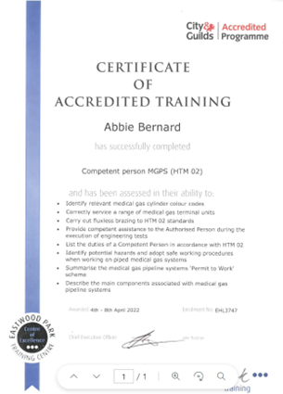
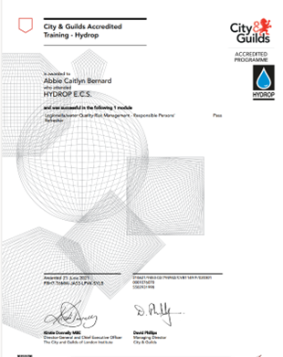
Plans for the future
Currently at Royal Glamorgan Hospital
Plan to go to a design company for more experience
Continue my professional development

Slide 15


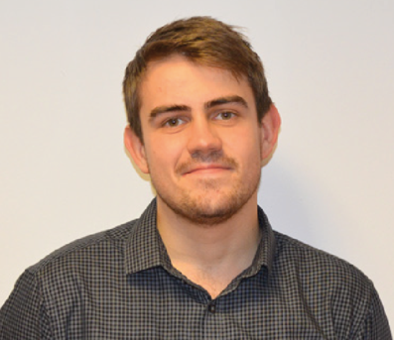
Aidan Parkes
First two years of the scheme within CAVUHB, in Saint Marys Pharmaceutical Unit in Cardiff:
MHRA licenced and regulated pharmaceutical specials manufacturer
My first exposure to Specialist Estates Services – Decontamination Team
Remaining three years of the scheme with NWSSP-SES
Experiences as above. Time with all the different AEs, placements etc.
Notes:
SMPU – Here I worked as part of the management team, using asset management software, co-ordinating maintenance etc.
Spoke to Network75 about finding a different placement, and rather than boot me off the scheme they accommodated me, and allowed me to go through the application process again
I first met the NWSSP-SES decon team during my time in SMPU, as they performed annual validation of our laboratory Sterilizers, as well as delivering steam condensate samples to the lab for analysis.
I was fortunate to finish off the remaining 3 years of my degree with NWSSP-SES

Slide 16
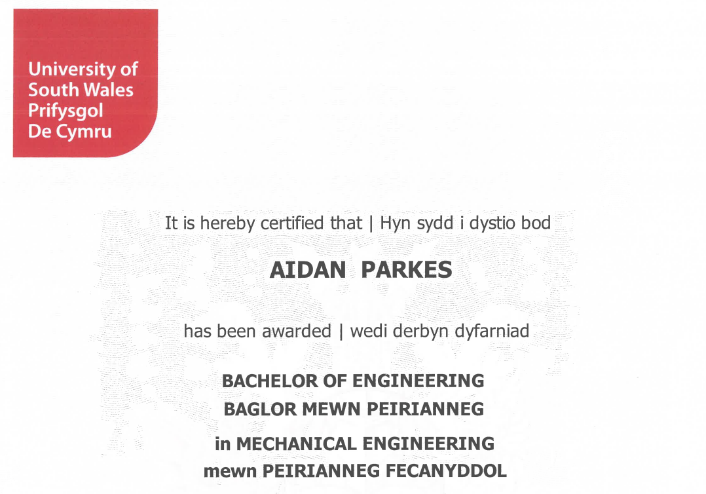
After Network75:
Graduated in 2020
After that:
Applied for a Decontamination Engineer Position within NWSSP-SES
Given a Band 5 Trainee Position
Once competency displayed in review process, awarded a band 6 Decontamination Engineer role
Notes:
Trainee decontamination engineer position – this took me 1 year to fulfill required competencies
Attended Eastwood park courses
Aimed to achieve a set amount of annual validations in a year - (Team works in line with WG SLA)

Slide 17
My Role Now
Decontamination Engineer – NWSSP-SES
Travelling across Wales to perform the Annual Validation tests on Porous Load Sterilizers, Washer Disinfectors, Laboratory Autoclaves and Steam Quality Testing.
Work largely independently and confidently
I rely heavily theory-based understandings from my degree
I'm able to draw from my experiences as a student with all SES disciplines.
Notes:
Work independently and confidently – both skills instilled from my time in Network 75
Theory Based – particularly Thermodynamics, Thermofluids, Mechanics & Control.

Slide 18
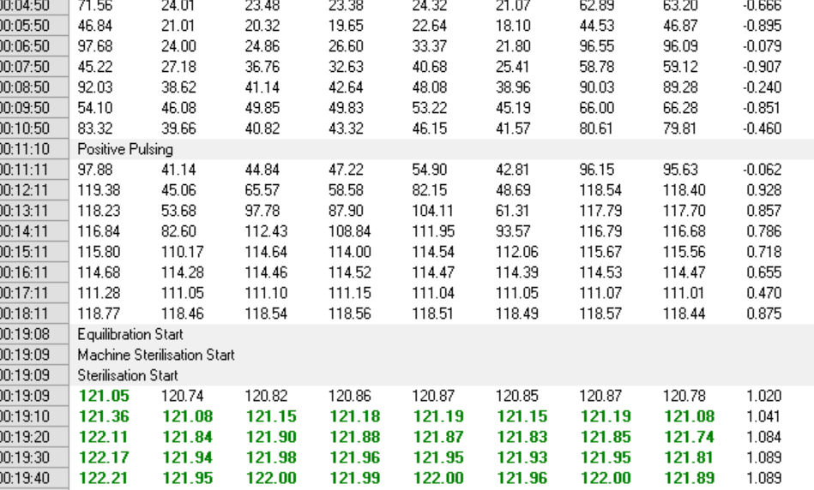
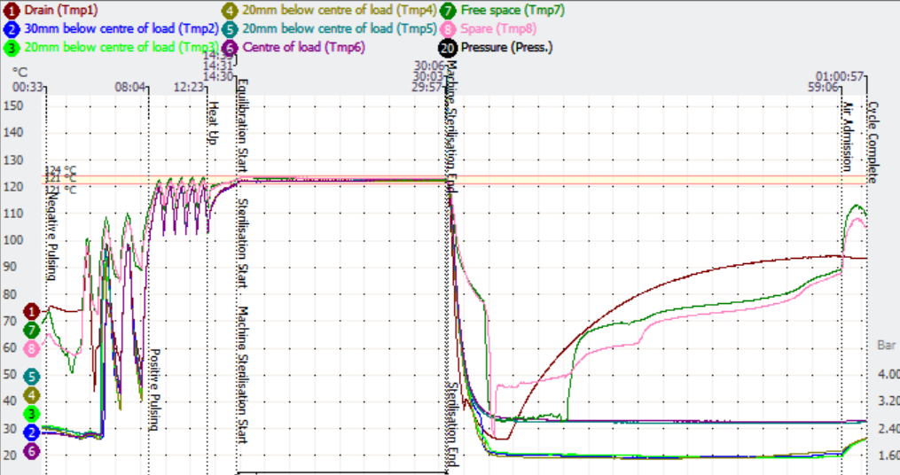
Annual Validation of Decontamination Equipment
Guidelines: WHTM 01-01 Parts A-D, HTM 2010(labs)
In addition: BS EN285:2015, ISO 15883 etc.
Notes:
Performing a suite of tests conforming to set guidelines & regulations:
Our Bread and butter for annual validations – A thermometric test chart
Generated through our Validation Software TQSoft.
For those of you who know the software – a learning curve by itself

Slide 19
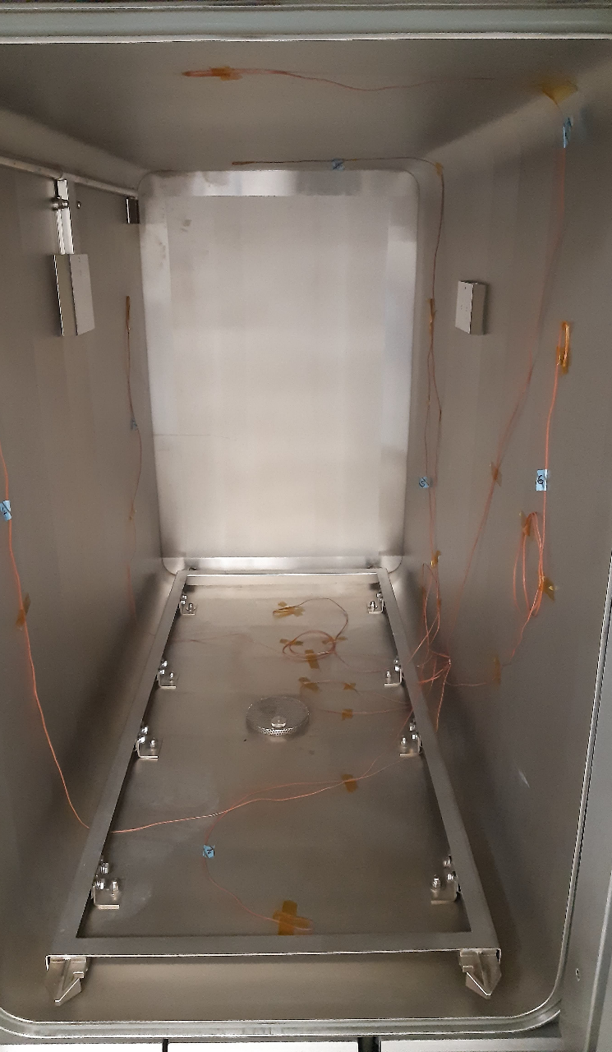
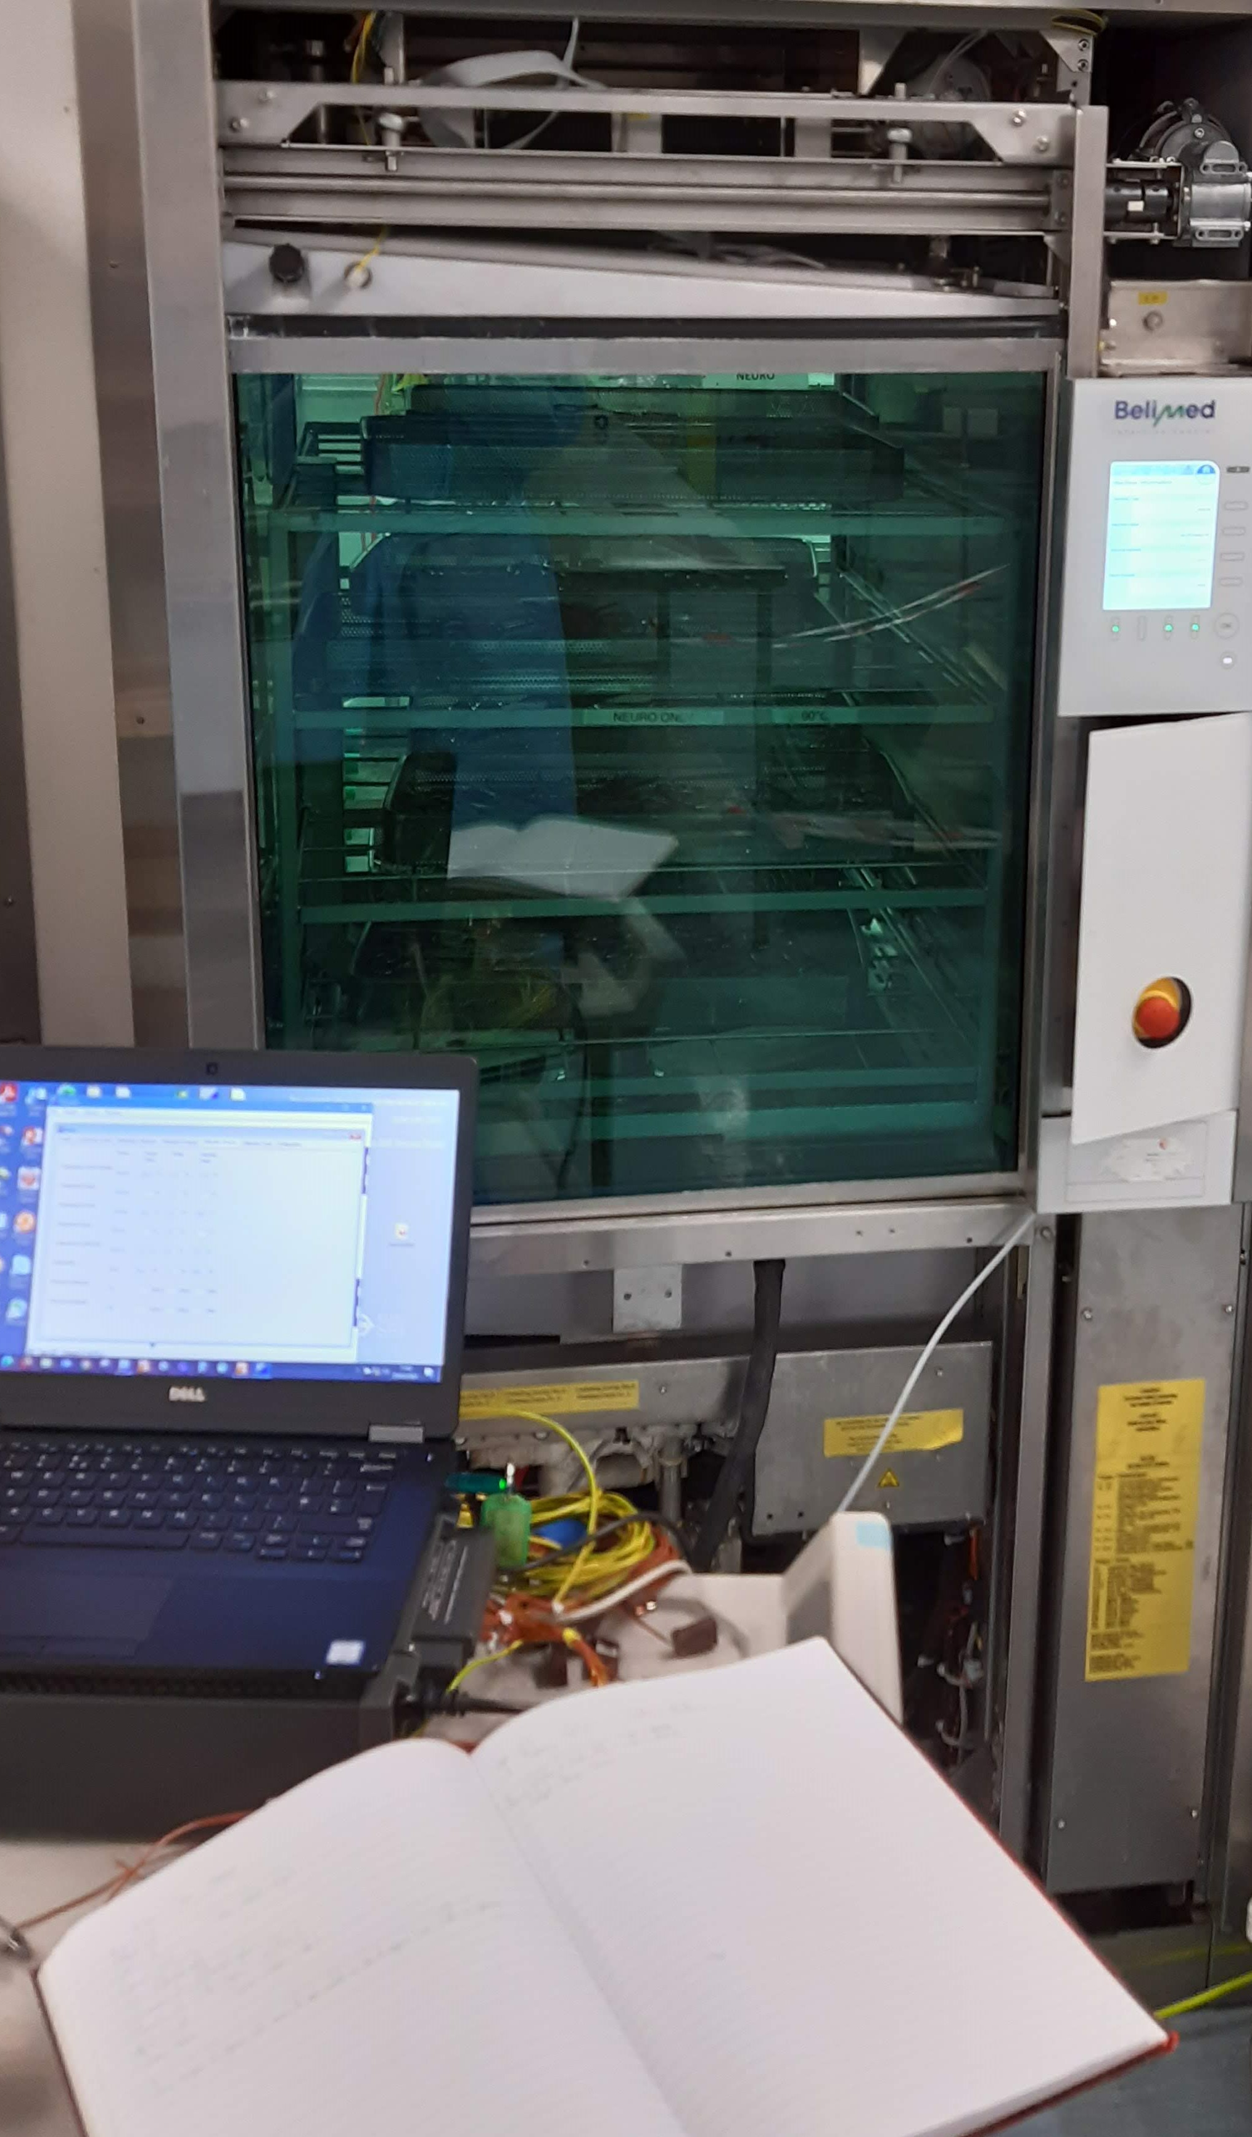
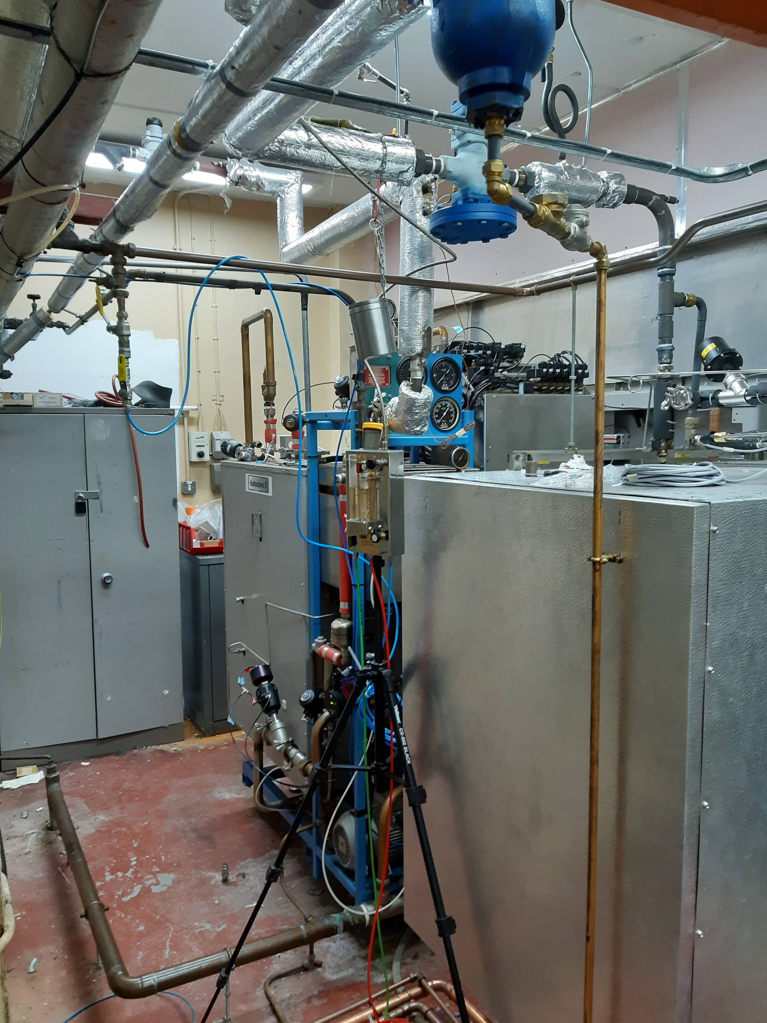
Notes:
Some examples of my work:
1 – Steam quality testing of a supply to HSDU porous load sterilizers
2 – My validation equipment sat in front of a HSDU Washer Disinfector
3 – Example of a Performance Qualification Test – Chamber wall temperature test of a Porous Load Sterilizer

Slide 20

Next Steps
Continue to develop:
Further my experience in using both new & existing validation technologies
Apply to the IHEEM AE(D) competency framework (begin process to become an Authorising Engineer (Decontamination))
Notes:
Gain further practical experience through my work across NHS Wales.
Making my own mistakes, managing my own work

Slide 21

How Network75 Benefitted me
Graduated with 5 years of Engineering experience
Grew straight into my full-time career with no student debt
Confidence & work ethic
An employer interested in further development
  Management that is keen to see me develop further.
  Surrounded by team members that are keen to share their experience and knowledge
Notes:
I'm employed by a company that is interested in developing me, rather than hiring me to do a job and that's all.
Surrounded by team members that have seen me develop, and know what I'm capable of and what I still need to learn.
Given me inspiration to learn what can be a niche and somewhat intimidating area to an outsider.
I would particularly like to thank the engineers that helped and inspired me throughout my time as a student, the engineers that continue to do so now in the decontamination team, and particularly John Prendergast for his unending patience and efforts in seeing me develop.

