Slide 1
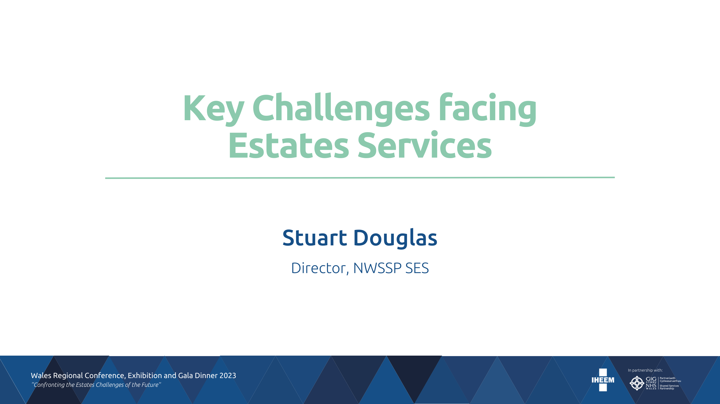
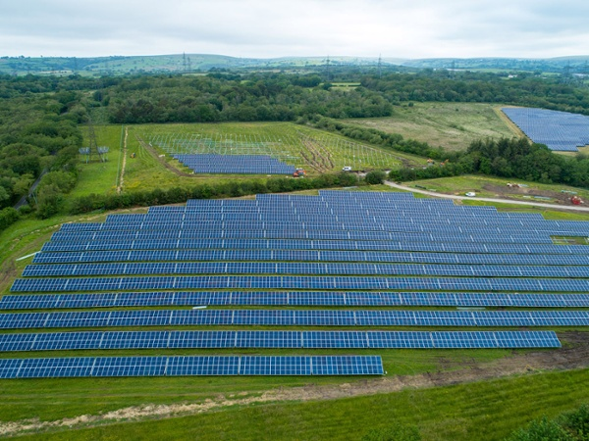
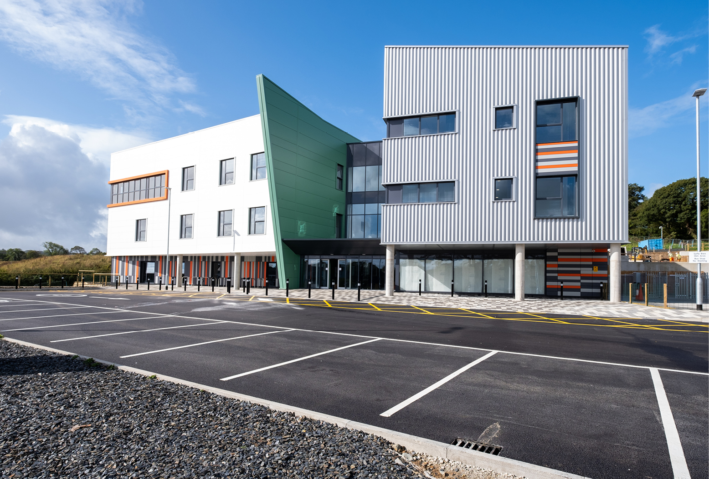

Slide 2
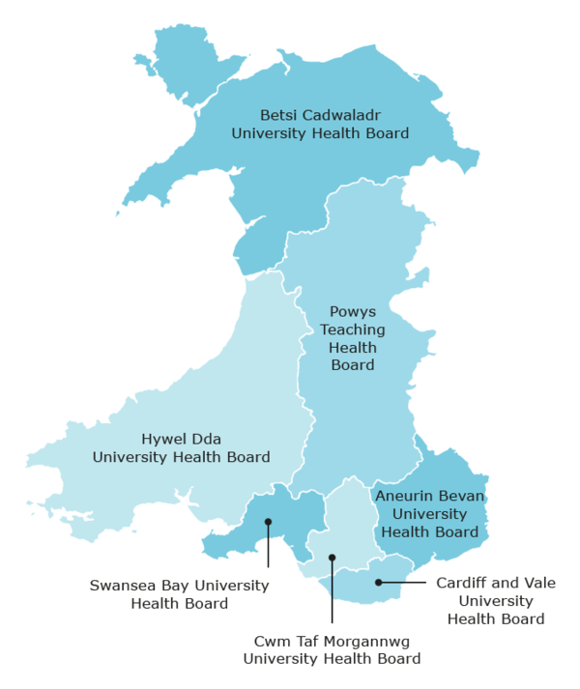
Agenda
Managing today’s estate
Developing a deliverable estate vision for the future
Achieving decarbonisation

Slide 3
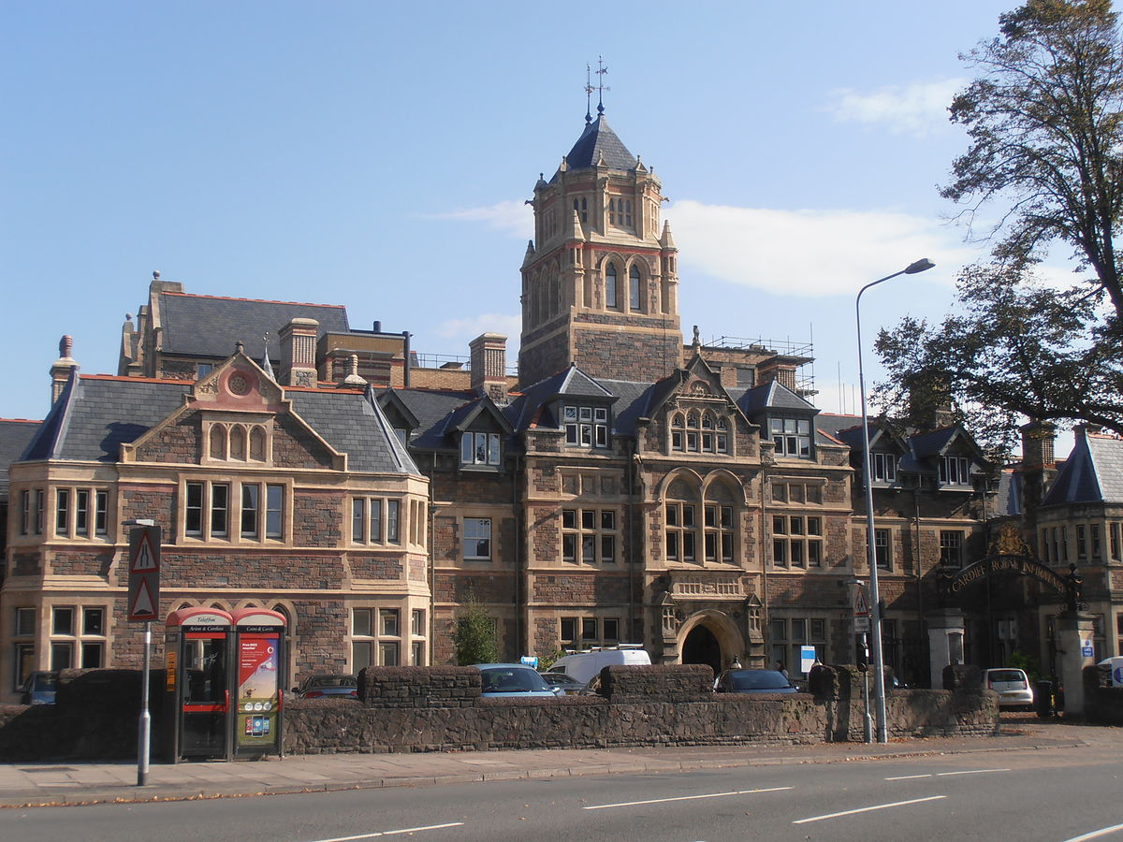
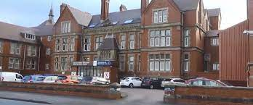
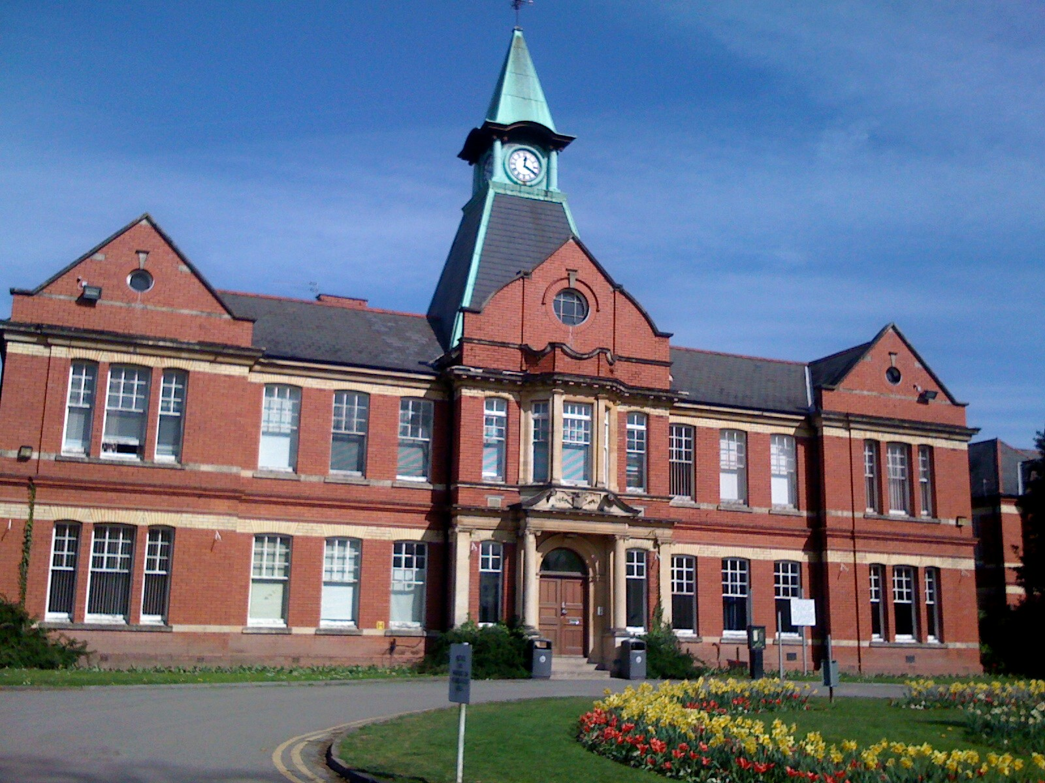
1. Managing Today’s Estate
Floor Area: 2million m2
Backlog £1Billion (Excluding impact of RAAC)
High and Significant backlog: £645m 64%
Unutilised Space: 145,000 (7%) – 20 football pitches
Age Profile: 1/3rd of Estate is >50 years old

Slide 4
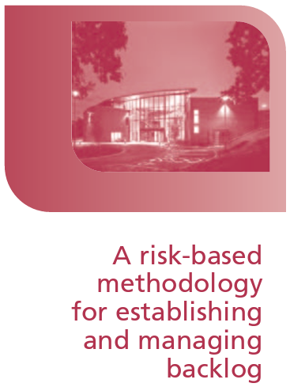
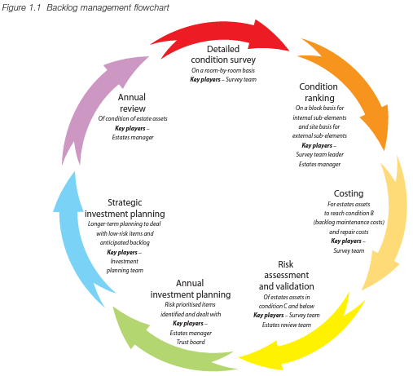
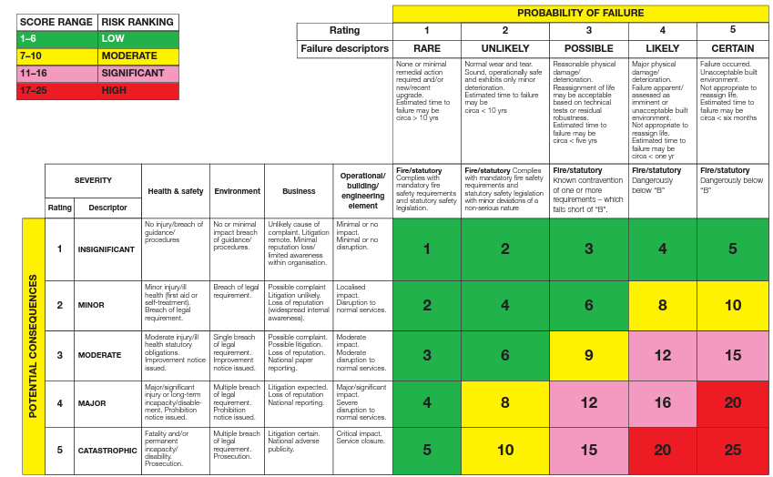
Using the navigation aids
Invest in good data – 5 yearly updates and constant monitoring
Ensure risks are monitored and understood – safety and continuity
Eradicate single points of failure – leading to loss of service continuity
Ensure Board sighted on status and obligations
WG heat maps will be generated to collate overall position

Slide 5
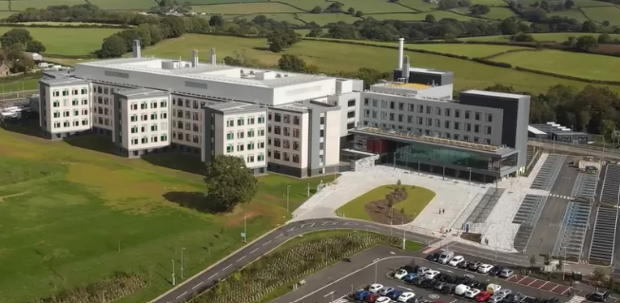
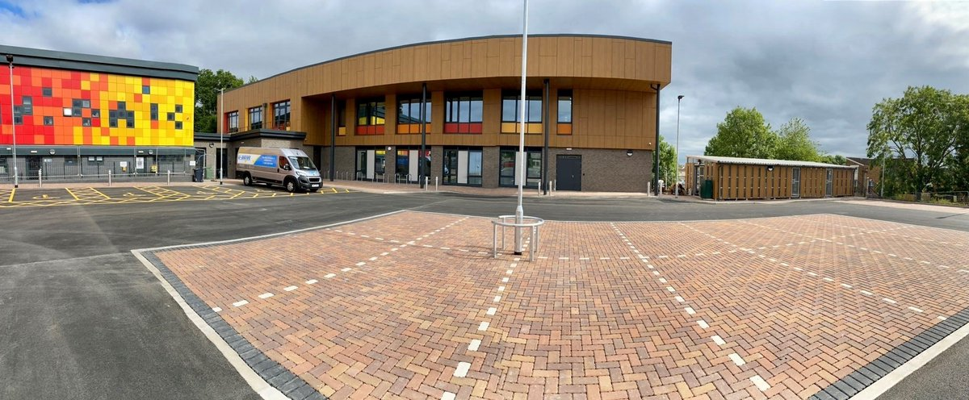
2. Developing a deliverable estate vision
Examples of projects completed in recent years
We all aspire to having a modern, well maintained estate, but we are all faced with managing a varied portfolio which is mainly older and not so well suited to modern health care.

Slide 6
Understanding the Estate
Do we really know how much unutilised space we have?
What type of space is it? (theatres, clinics, offices, stores etc)?
Are utilisation levels for say offices really this unchanged since Covid-19?
Opportunities available through managing our space more efficiently could be wide ranging

Slide 7
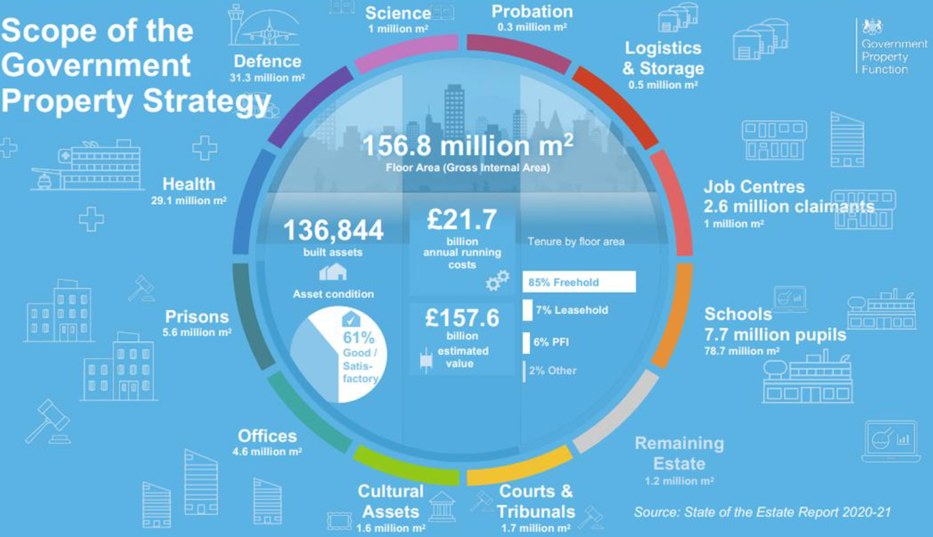
UK Government Property Strategy 2022-30

Slide 8
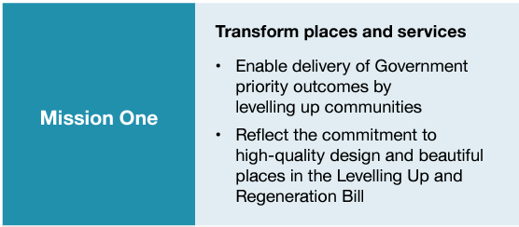
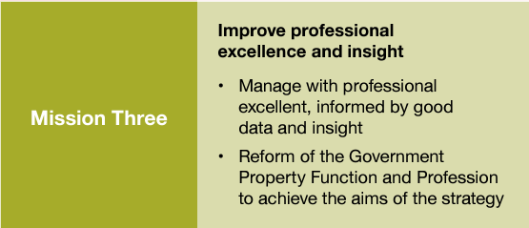
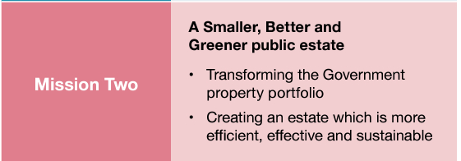
Principles for planning transformation
The UK Property Strategy offers a valuable model approach for achieving a modernised green and efficient estate profile for the public sector in Wales
UK Govt Property Strategy: 2022-2030

Slide 9
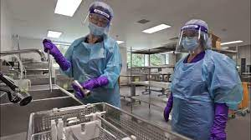
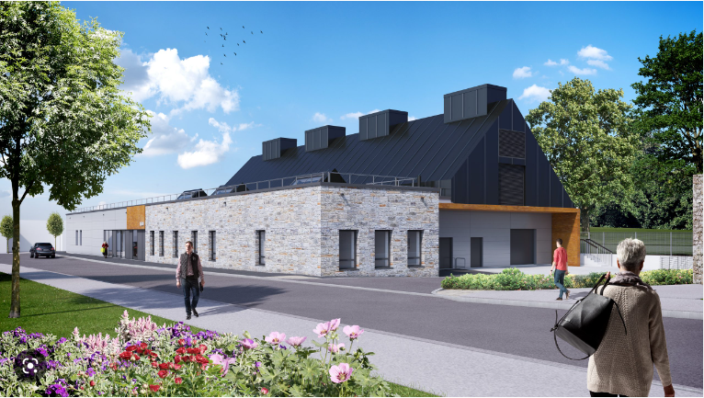
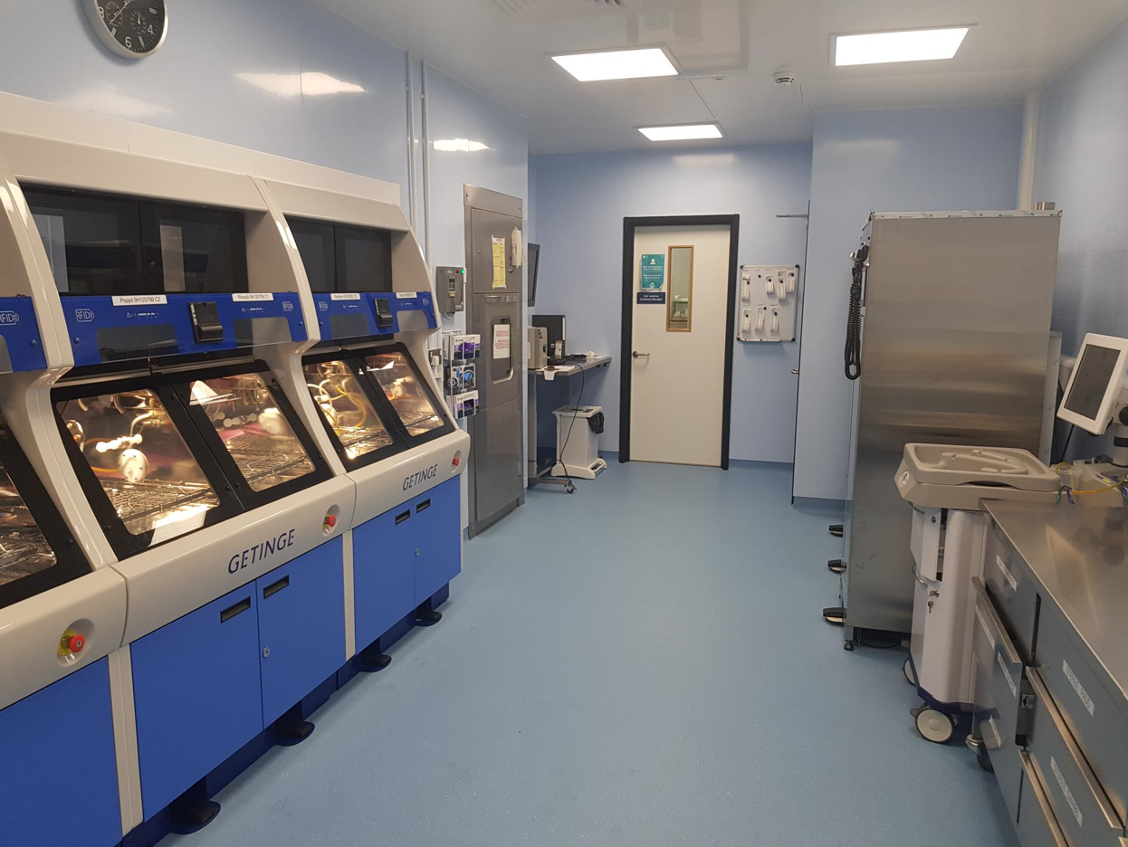
Organisational
Rationalisation / Centralisation: Achieving efficiency and consistency of service (whilst retaining resilience)
Example decontamination services
Photo: The Grange HSDU
Aneurin Bevan University Health Board
Photo: The Grange HSDU
SDS Engineering Consultants
Photo: Glangwili Centralised Decontamination Unit

Slide 10
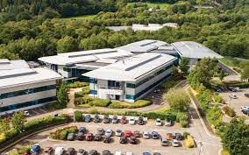
Collaborative
NHS Collaboration: Below is a photo of the recently acquired BA Hangar facility in Llantrisant. This is intended to be the base from which CTM, C&V and ABU health boards will provide diagnostics and treatment.
“We are grateful to Rhondda Cynon Taf County Borough Council for initially recognising the potential benefits of this facility for health partners and to the Welsh Government for securing this on behalf of the NHS and its patients.”
Paul Mears, CEO Cwm Taf Morgannwg University Health Board

Slide 11
Full Public Sector Collaboration
Integrated Strategies
  In Wales, we have an Integrated Care System body (Integration & Re-balancing Care Fund - IRCF) which promotes integration of services in delivery of care.
  With ICS’s in England producing Estate Strategies, perhaps we should look at this as an enabler to joint planning and shared use of resources?

Slide 12
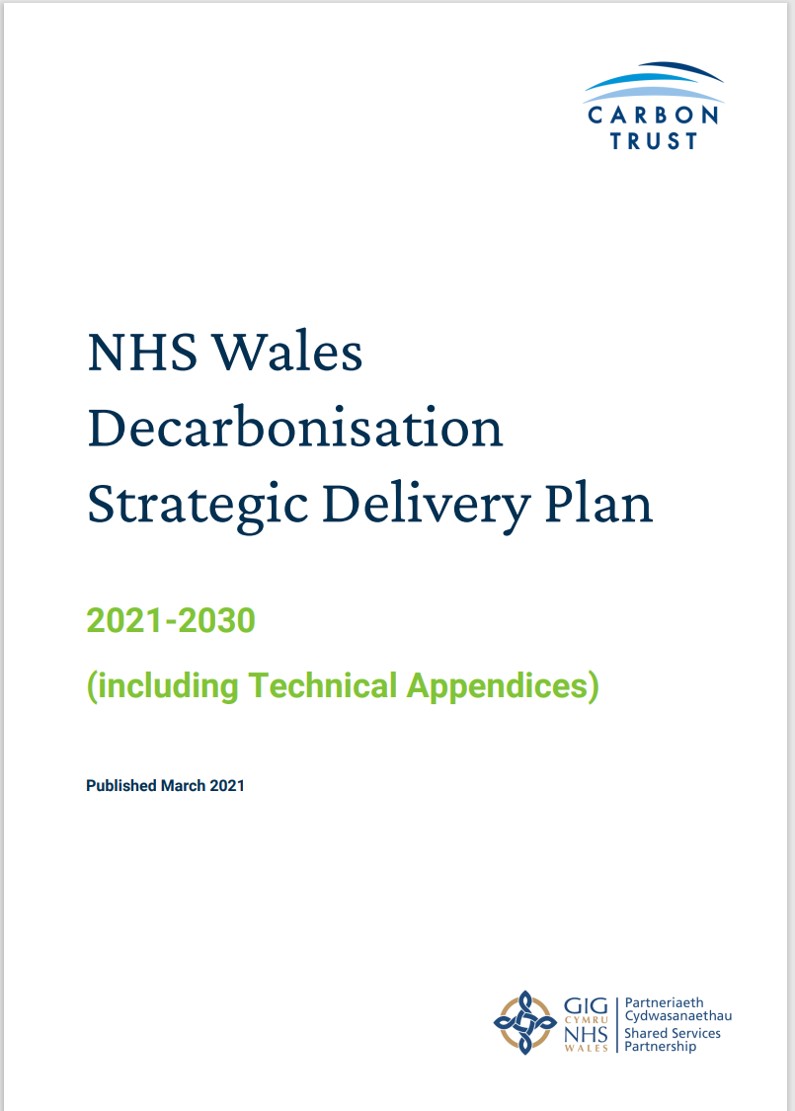

3. Decarbonisation
Ambitious targets by Welsh Government & NHS Wales to reduce emissions by 2030 by 34%; emerging NZ Building Standard (late 2023)
Limited funds
Implementing green technology in old hospital settings whilst maintaining operations
Lack of engineering infrastructure to support new technologies particularly on the electrical side

Slide 13
Decarbonisation opportunities
Review the EFAB decarbonisation projects delivered in 20/21 – talk to your colleagues
Pick up deliverable increments of change (BMS, LED, EV Charging, PV etc.)
Investigate all funding opportunities (EFAB, Re:fit Cymru, WGES)
Understand existing sites and opportunities available E.g Electrical capacity
Work jointly to develop and implement consistent approaches to initiatives such as EV charging provision and charging
Change attitudes

Slide 14
Conclusions
Provide health boards with clear risk adjusted picture of our estate
Develop a deliverable vision for the future
  Centralisation and rationalisation
  Collaboration and regionalisation
  Integration of planning across the public and 3rd sector
Embrace decarbonisation
  Good housekeeping
  Planning for future introduction
  Changing attitudes
…Don’t forget

