Slide 1
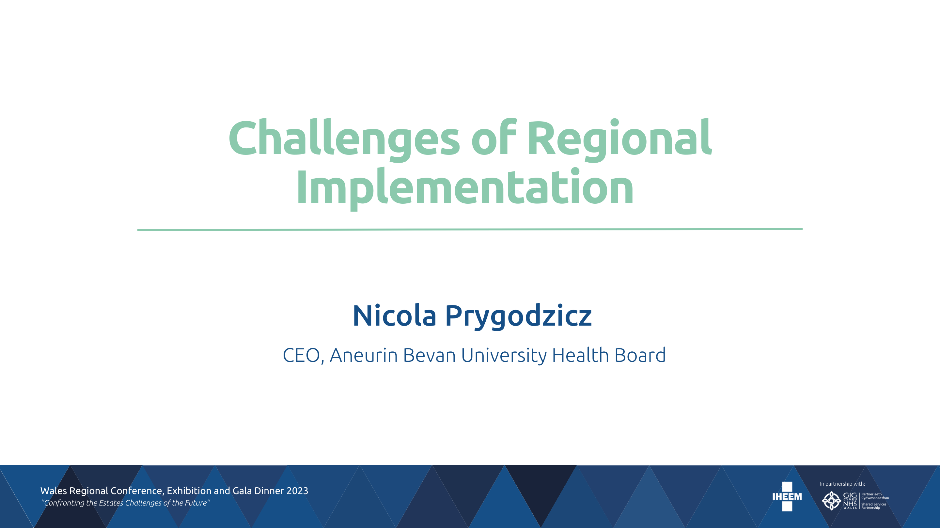

Slide 2




Policy Context

Slide 3
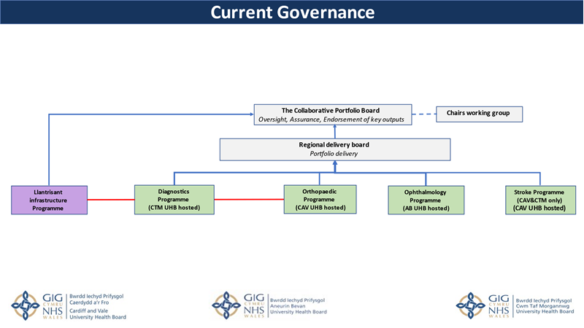
South East Wales Regional Planning Structure

Slide 4
Aneurin Bevan University Health Board
  Local Challenges
  Poor Health and inequalities of Gwent population
  Poor and deteriorating estate and patient environment
  Fragmented and duplicated services across sites – unsustainable and inefficient
  Over reliance on hospital system
  National Challenges
  Changing demographics
  Increasing acuity and chronic conditions
  Increasing standards of clinical care and outcomes
  National workforce challenges
  Technological advancements
  Need to improve productivity and efficiency
  Drive for prudence and improving value for money

Slide 5
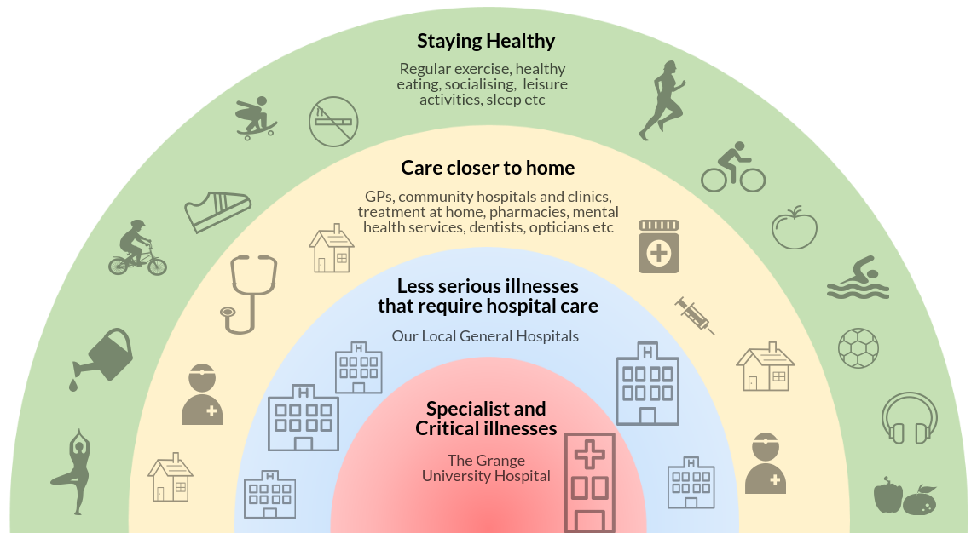
Aneurin Bevan – The Clinical Futures Strategy

Slide 6
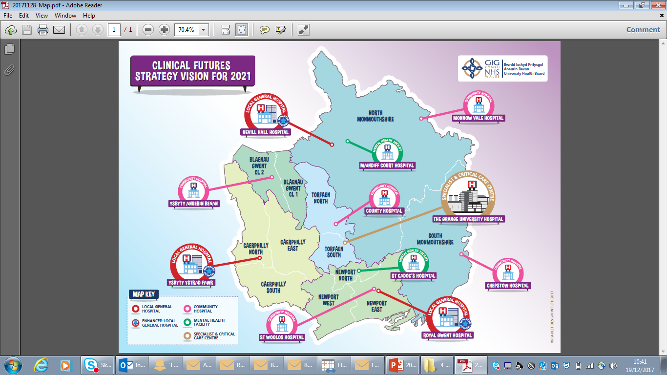

Slide 7

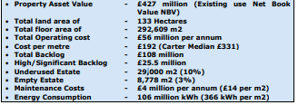
Aneurin Bevan Health Board – Current Estate

Slide 8
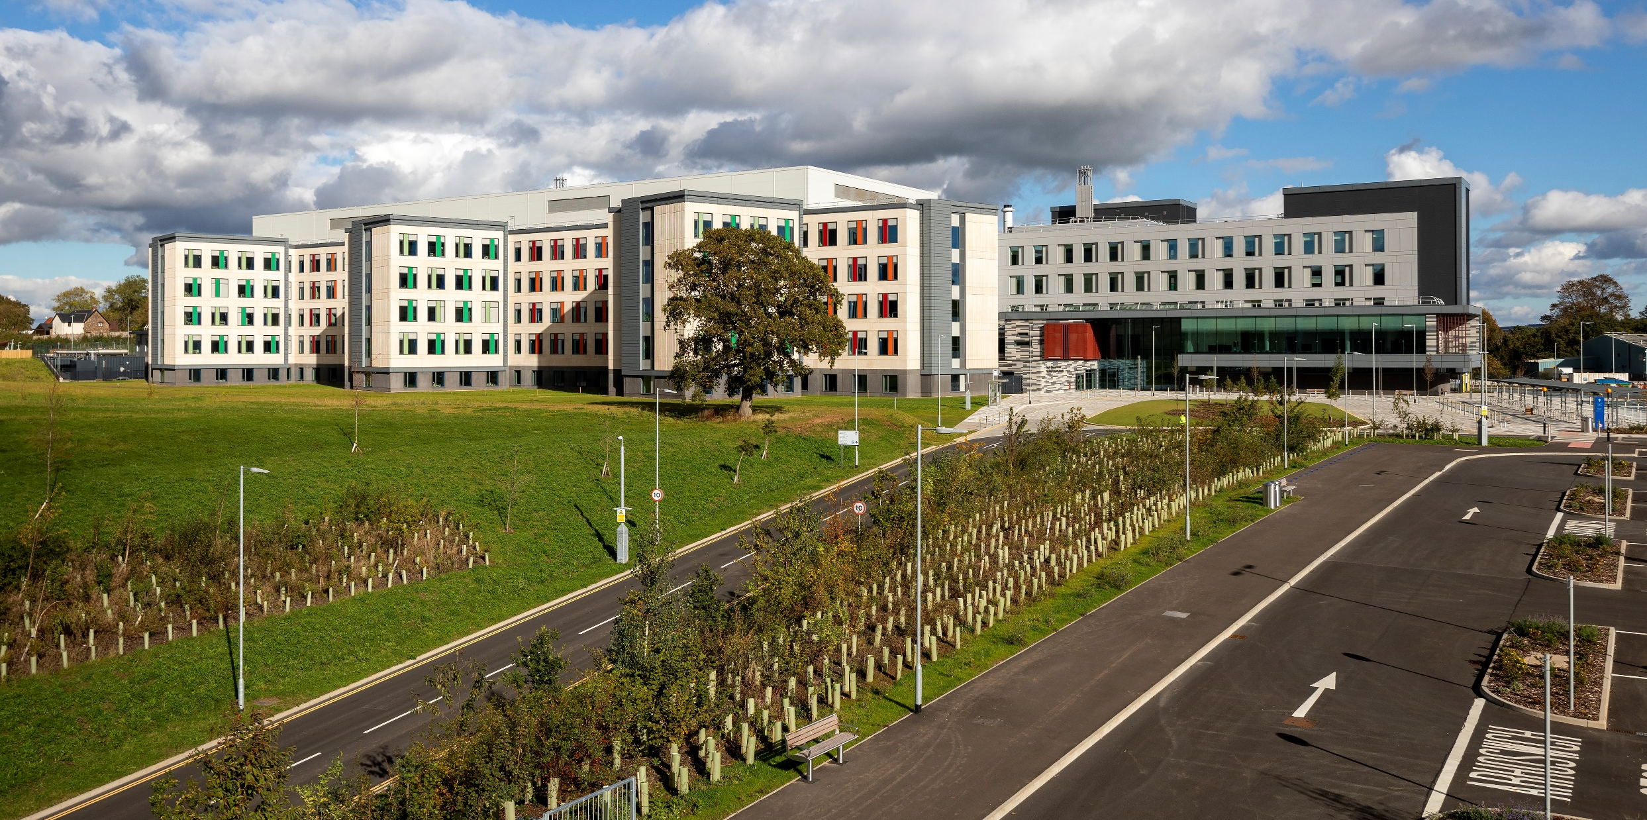
The Grange University Hospital

Slide 9
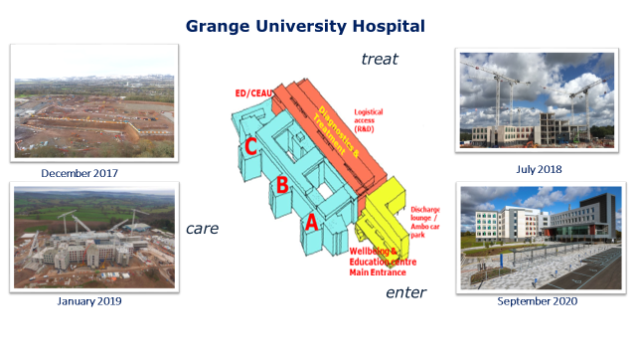

Slide 10
The Case for Change and Benefits
Service sustainability for Women and Children services
A more resilient and flexible Critical Care service
Improved infection control management
More resilient Specialist Acute services
Additional physical space across the system to manage the increased demand that presented in 2021 (the Health Board did not commission a field hospital unlike many other Health Boards in Wales).
Additional ED and Resus capacity to meet increasing demand and acuity
Improved recruitment in many areas particularly around specialist medical staff and registered nursing at GUH.
Ability to maintain elective activity at times of high emergency demand due to the separation of elective and emergency care and the POCU model at RGH.
Increased diagnostic capacity to support increasing demand and significant backlogs

Slide 11
What are the Challenges?
Covid impact – pathways / testing / staff absence
Patients and Professionals navigating the new system
Fragility of workforce at eLGHs and Community Hospitals (consistent with National challenges)
Patient Transfers – more complex than planned due to Covid
Patient Experience – long waits and communication

Slide 12
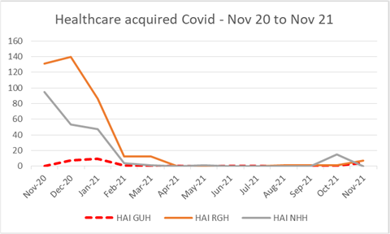
Patient Outcomes and Experience
Hospital Acquired Infections
  Key benefits of the GUH estate compared to more traditional hospital layouts in terms of infection control and particularly COVID transmission within hospital sites.
  Built environment is not the sole reason for this and significant measures and efforts from staff remain required to minimize the spread of incidence of infection.
Stroke
Falls

Slide 13
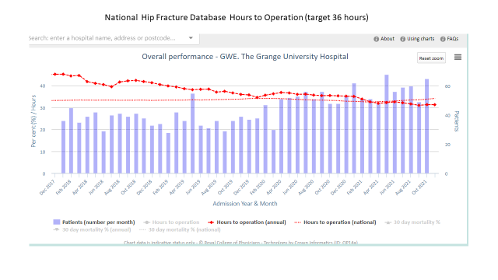
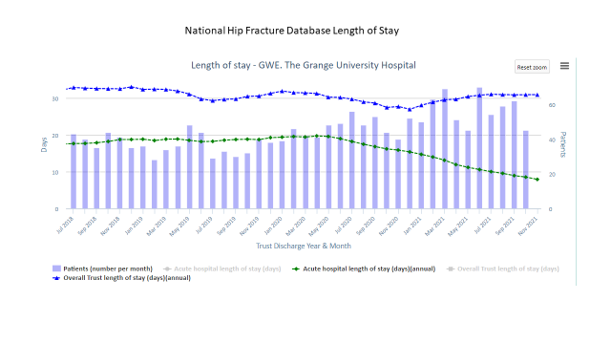
National Hip Fracture Database (NHFD)

Slide 14
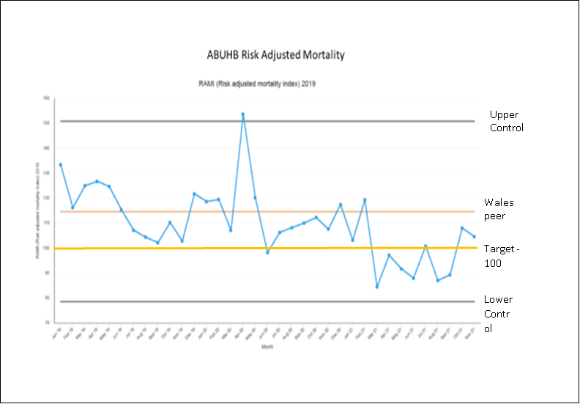
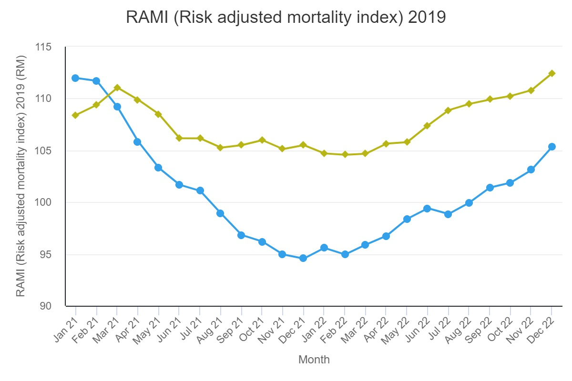
Risk Adjusted Mortality Index
RAMI Jan 19 – Nov 21
RAMI Jan 21 – Dec 22

Slide 15
Future Challenges
Care Closer to Home vs Regional
Funding Constraints
Old Estate and Backlog Maintenance

Slide 16
Quote from Dr Chris Chick
British Society of Interventional Radiology have awarded GUH exemplar status this year
Undertaking first trial of GAE in Wales (2nd in UK)
Regional Centre for HCC Treatments

