Slide 1
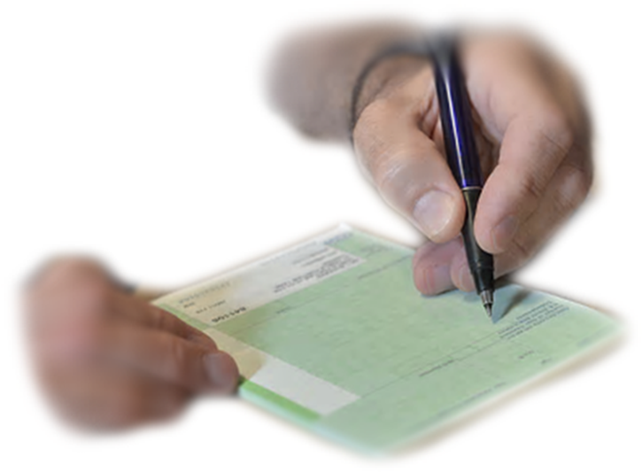
SUBMISSION GUIDE FOR PRESCRIPTIONS

Slide 2
INTRODUCTION
Contractors are currently required to submit their prescriptions to PCS for processing and payment by the 8th working day of the following month. When PCS receives the prescriptions, the account is registered on a database and then the batches are prepared for scanning.
PCS currently has 3 scanners which scan all prescriptions received from contractors. We receive up to 3.5 million prescriptions per month (at current prescribing rates). The 3.5 million prescription forms must be prepared before they are scanned as the machines are sensitive and may easily become jammed resulting in batches of scripts being scanned again and therefore delaying the whole reimbursement process.

Slide 3
EXPLANATION
PCS conducted an study during October 2022 of the time taken to prepare a batch for scanning. The time taken ranged from 90 minutes to prepare a submission of more than 11,000 forms to 8 hours, i.e., more than a full working day, to prepare a submission with only 4,438 forms.
Therefore, PCS have created this guidance document to demonstrate what constitutes a poor quality batch with a view to contractors improving their submissions and reducing the time taken to prepare the batches for scanning.

Slide 4
What constitutes a submission of poor quality?
Use of staples.
Patient Information slip still attached.
Edges requiring trimming.
Scripts with folded edges.
Bent, folded, or crumpled prescriptions.
Staple damage/damaged scripts
Torn or repaired prescriptions.
Stickers or labels on scripts (for example; CD item, Fridge, MUR)
Unsorted / poorly packed. Groups not clear.
Images on the following slides provide examples of each of these.

Slide 5
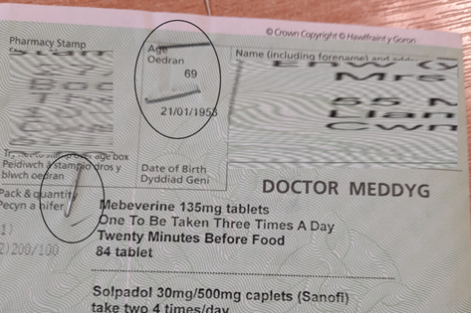
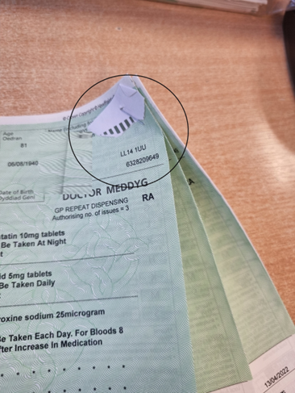
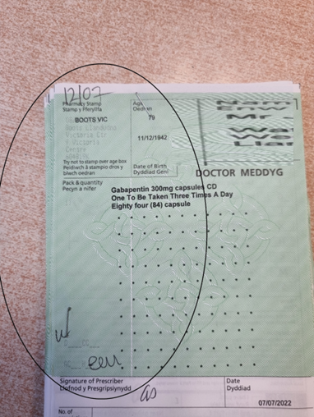
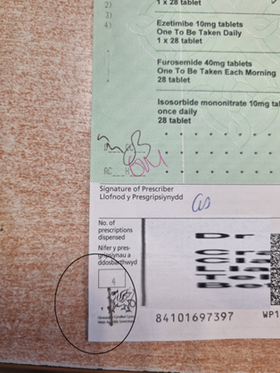
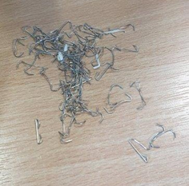
Staples
Notes:
The scanners are very sensitive machines, if any scripts amongst these batches have staples still attached, they can drag multiple scripts through together and cause stoppages, which result in wasted time as the problem has to be identified, resolved and scripts rescanned. They can also damage the inner workings of the scanner and cause further and longer downtime if, for example, they become stuck in the rollers, scratch the imaging guides, or affect the sensors in any way. Parts may have to be replaced and time ultimately lost.
Action: Remove all staples carefully before prescriptions are submitted.

Slide 6
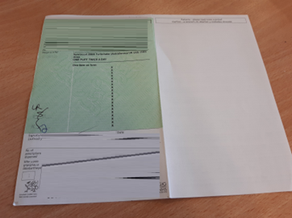
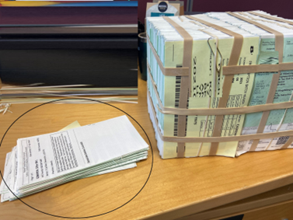
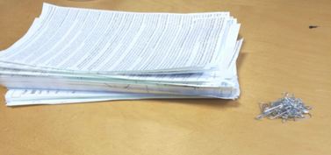
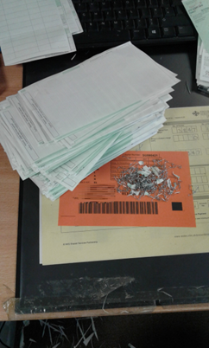
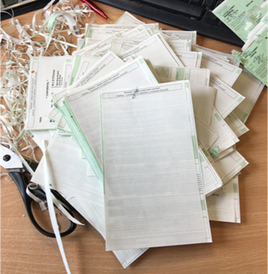
Patient info slip still attached
Notes:
Non or partial removal of the patient information slip is a common problem we have when scanning the scripts. The slip that contains any additional patient information / notes has should be completely removed along the perforated edge. The Patient Information Slip can be folded over behind the main script and have gone unnoticed by the staff member who prepared it for scanning and the Pharmacist themselves. Possibly the pharmacist has noticed it but was not aware that it should be removed.
Why?
When scanning scripts, our scanners are very finely calibrated to read and capture script information from one script at a time. Our scanners can capture up to 10K scripts per hour, the rate of data capture is very high; any “foreign” information identified in this cycle will result in an error message.
When this error occurs the person scanning must find the script with the patient information slip still attached, remove this and rescan. This significantly increases the time spent scanning.
Action: Remove all Patient Information Attachments.

Slide 7
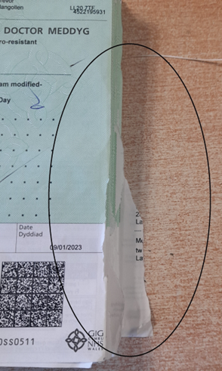
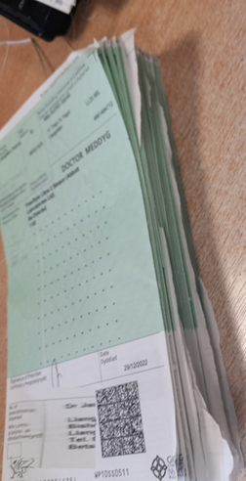
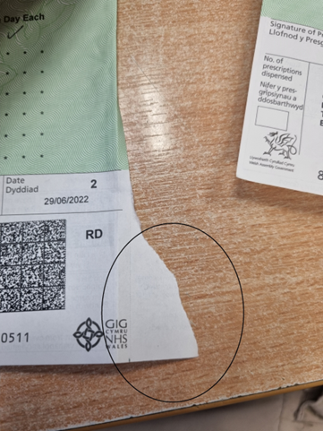
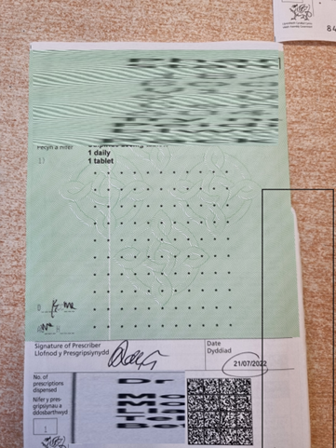
Edges require trimming
Notes:
From the images you can see some examples of scripts that require “trimming” before going through our scanners.
Why do the scripts need trimmed?
The Scanners we use are calibrated to capture data at a very fast rate and aligned to accept scripts of a certain size with a small margin of difference. The scripts in the images above show a couple of different types of scripts which would require trimming.
The image on the left shows a significant portion of the patient information that is still attached; this will need to be removed as the scanner will not read the script correctly. This part of the script might also be folded over behind the main script and will cause one of the errors mentioned previously; all ultimately resulting in more time lost.
The other images show a smaller section that has been left, and in itself this would not seem problematic, however during the scanning process, when scripts are travelling through our scanners at a very fast rate, these edges will break off and can clog the scanners resulting in image quality problems, scanning errors and possibly scanner downtime due to maintenance work required to remove these script particles.
Action: Remove all uneven edges. Use scissors if required.

Slide 8
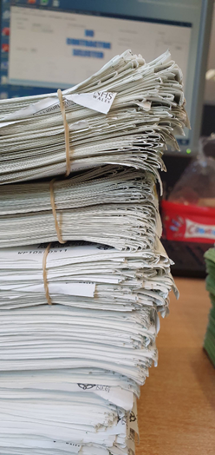
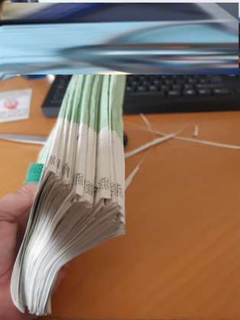
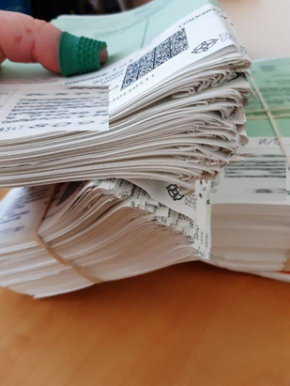
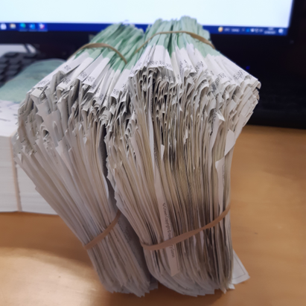
Scripts with folded edges
Notes:
These images are where scripts have not been folded along the serration leaving a fold. This takes a significantly long time to flatten before scanning.

Slide 9
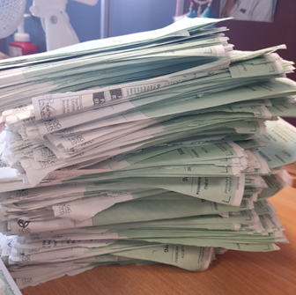
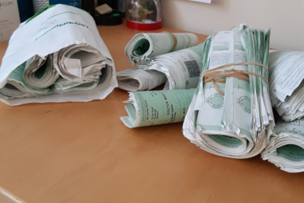
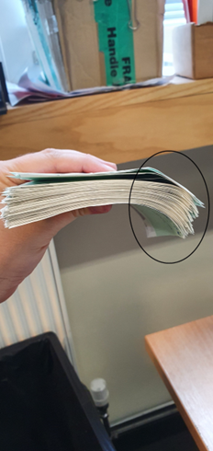
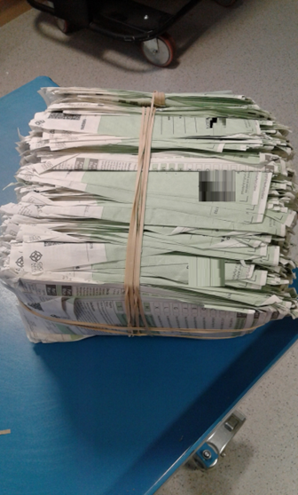
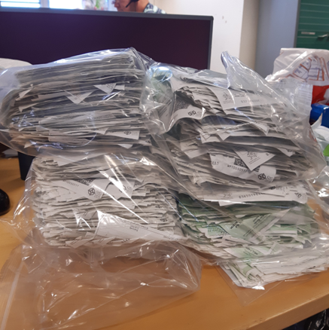
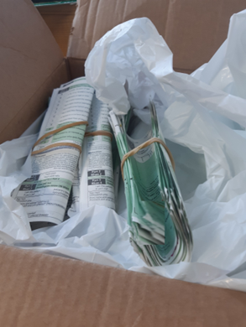
Bent, folded or crumpled scripts
Notes:
It is very common for scripts to be included in the monthly submissions batched like the images above.
This creates a problem at the scanning stage due to the scripts being held together with very tight elastics, so tight that the scripts have been folded in two. When we remove the elastic, the scripts will have a “bend” or “curve” in them and despite the best efforts of the staff member who is preparing it, this curve will remain. Scripts should be kept flat and in as best condition as possible.
Action: Ensure all scripts are submitted flat. Do not submit them bent or crumpled

Slide 10
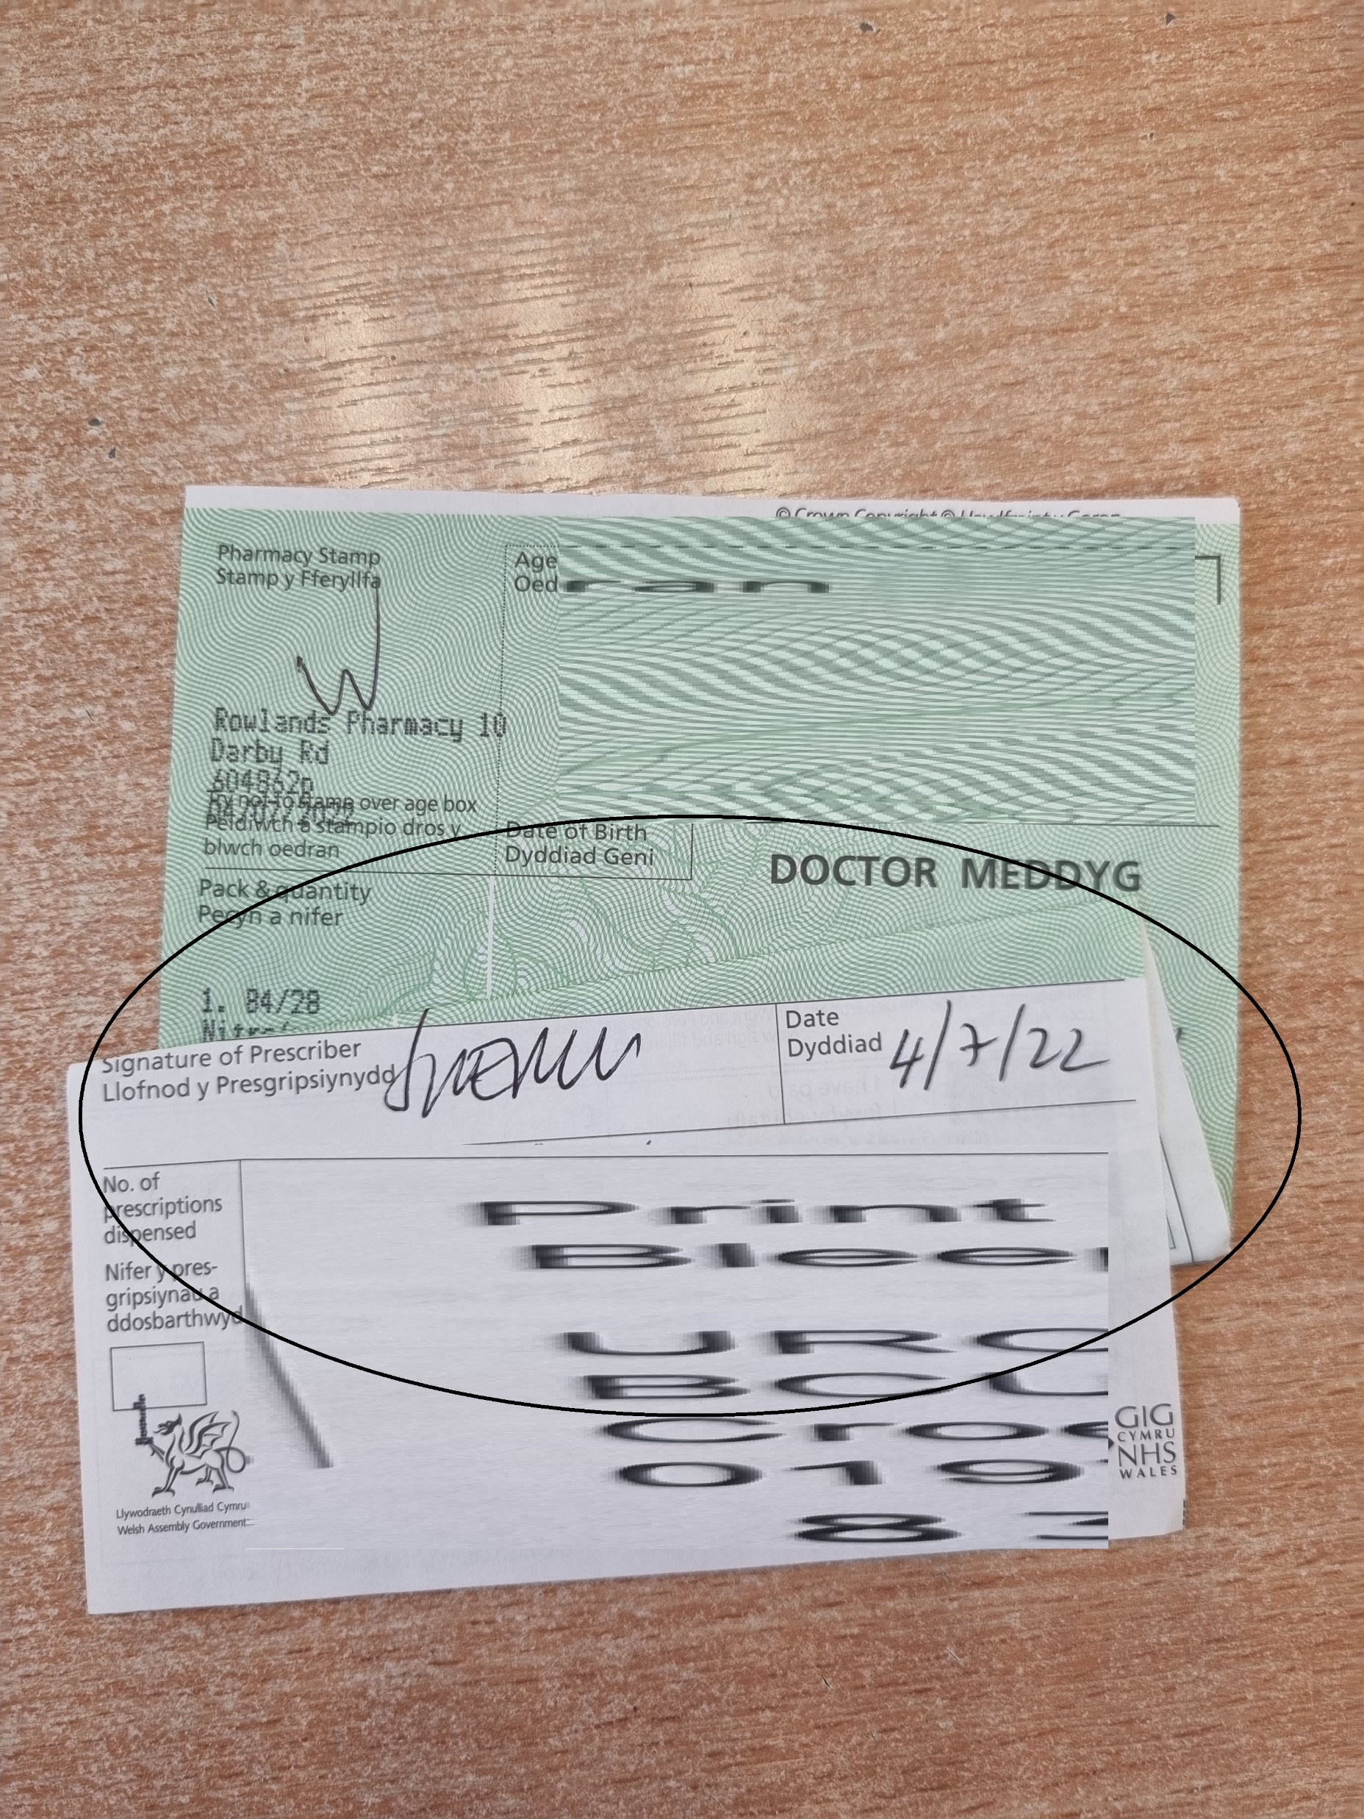
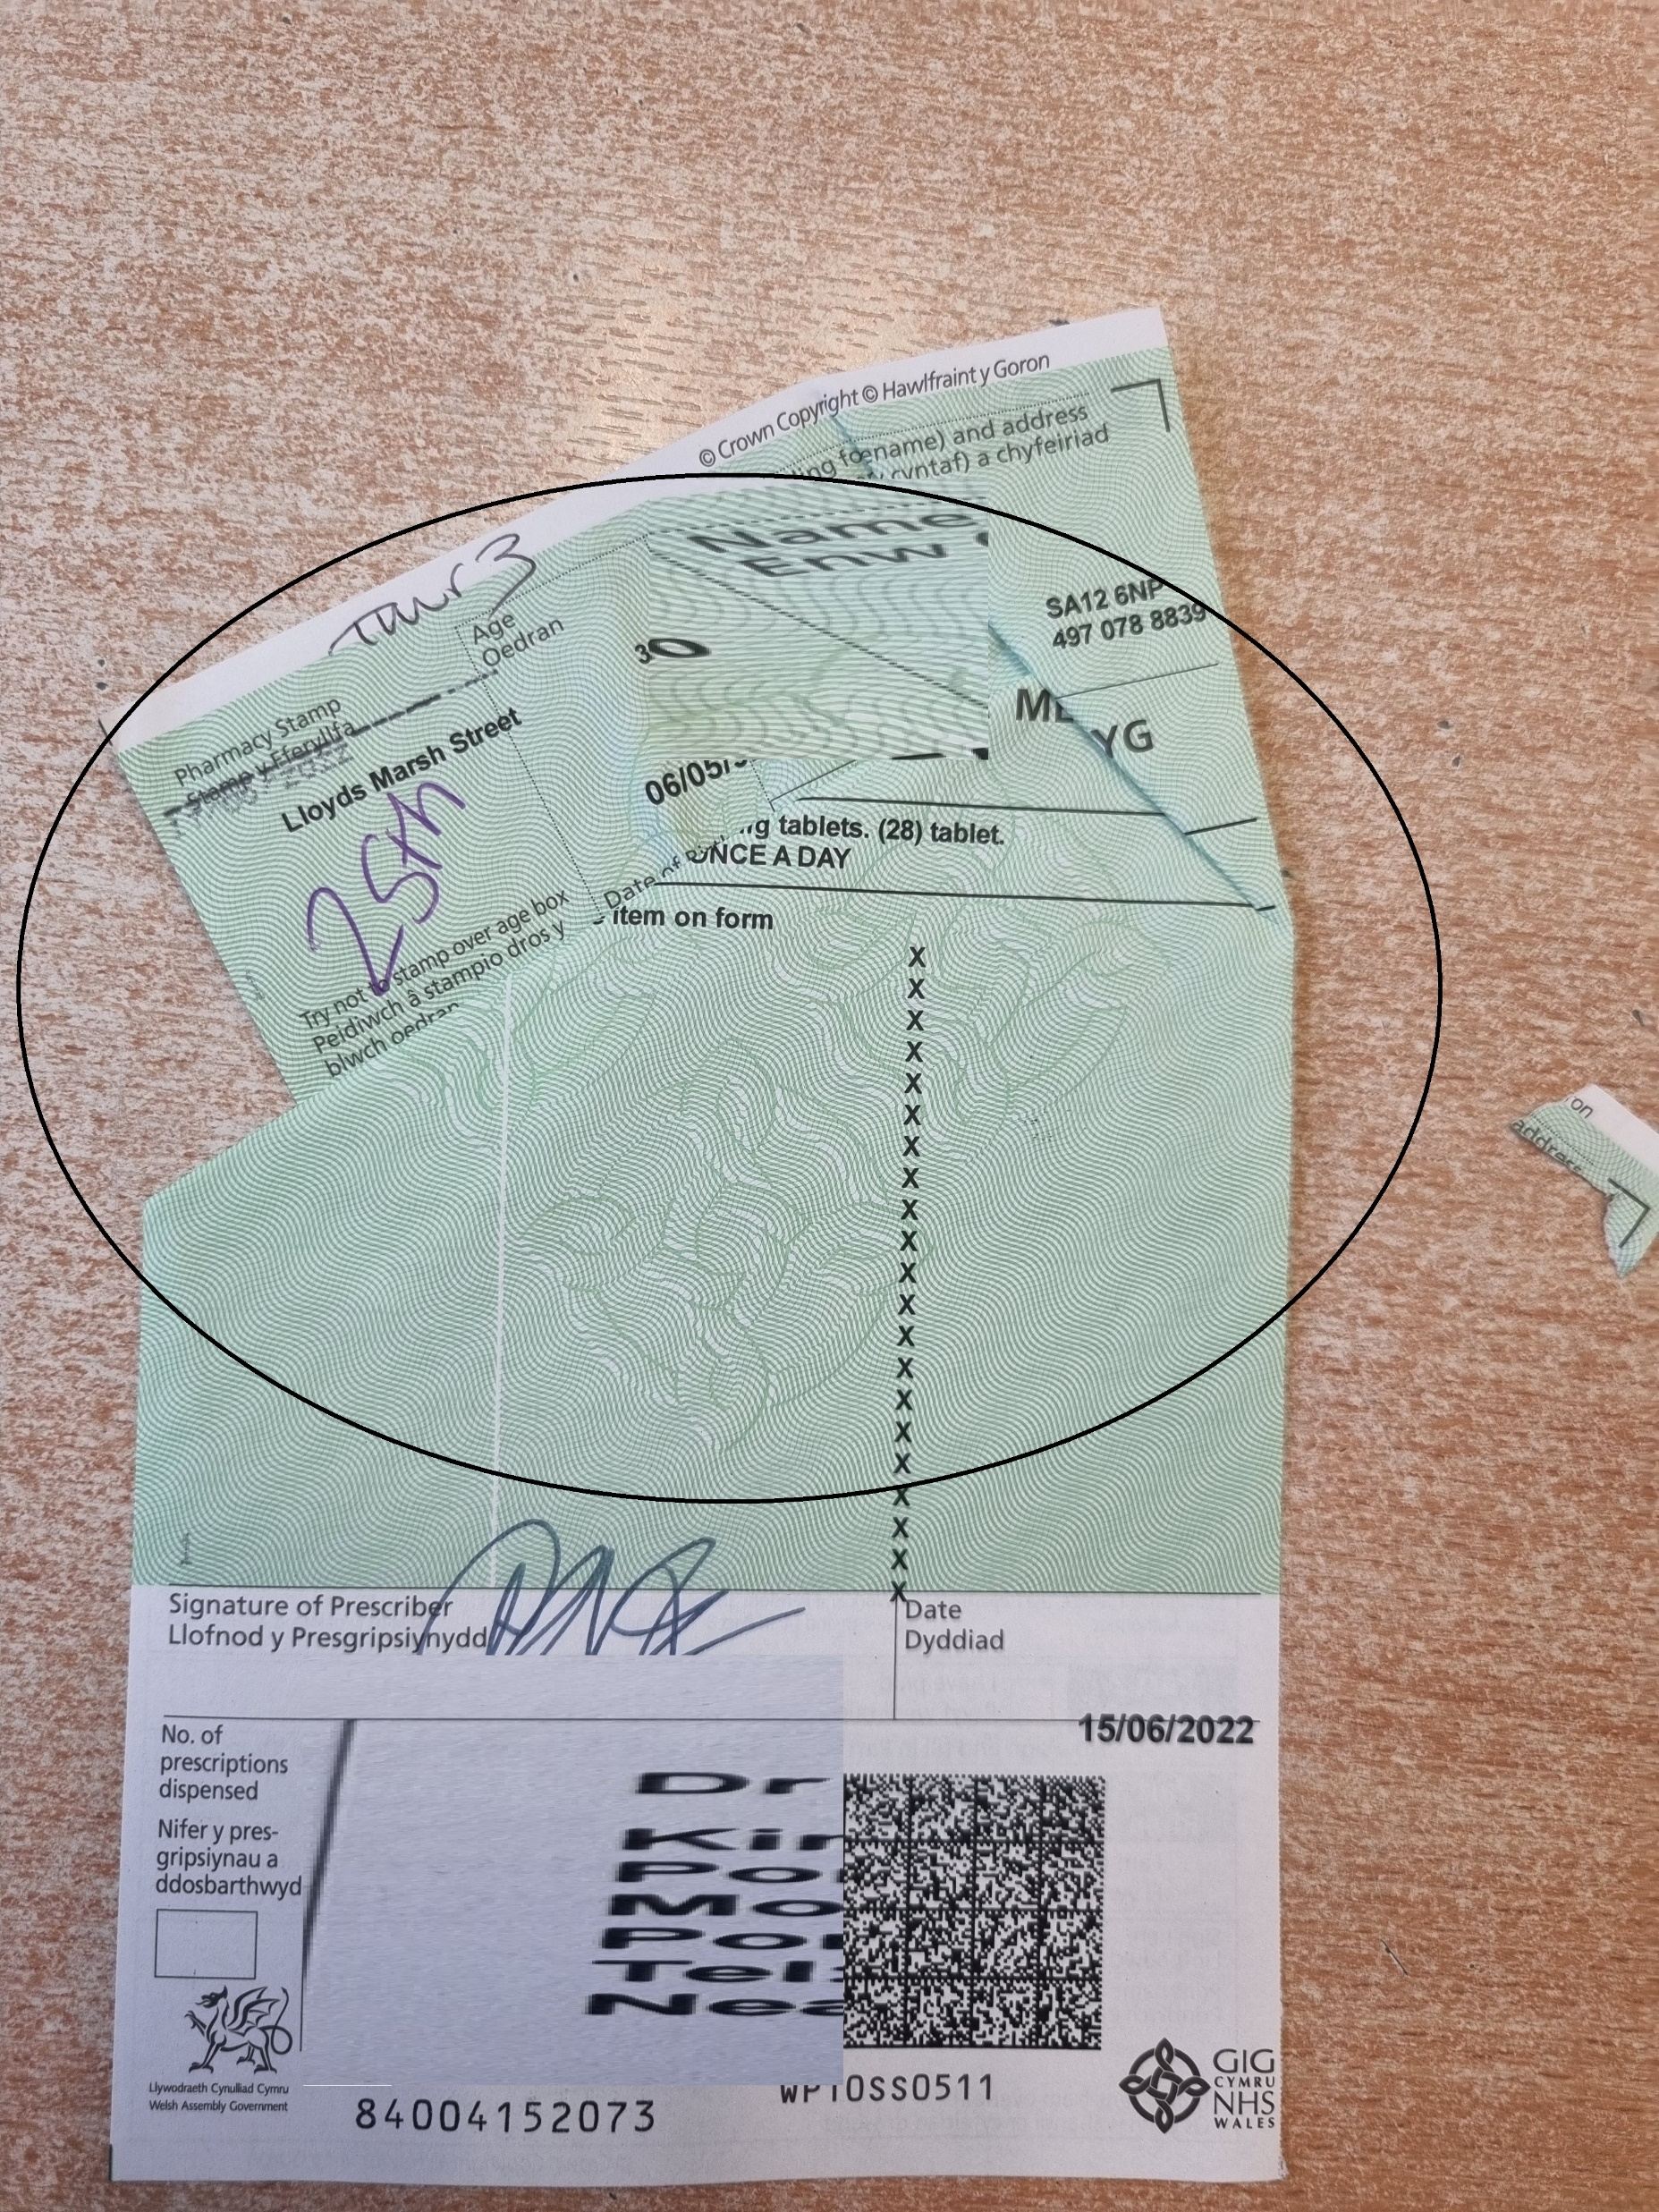
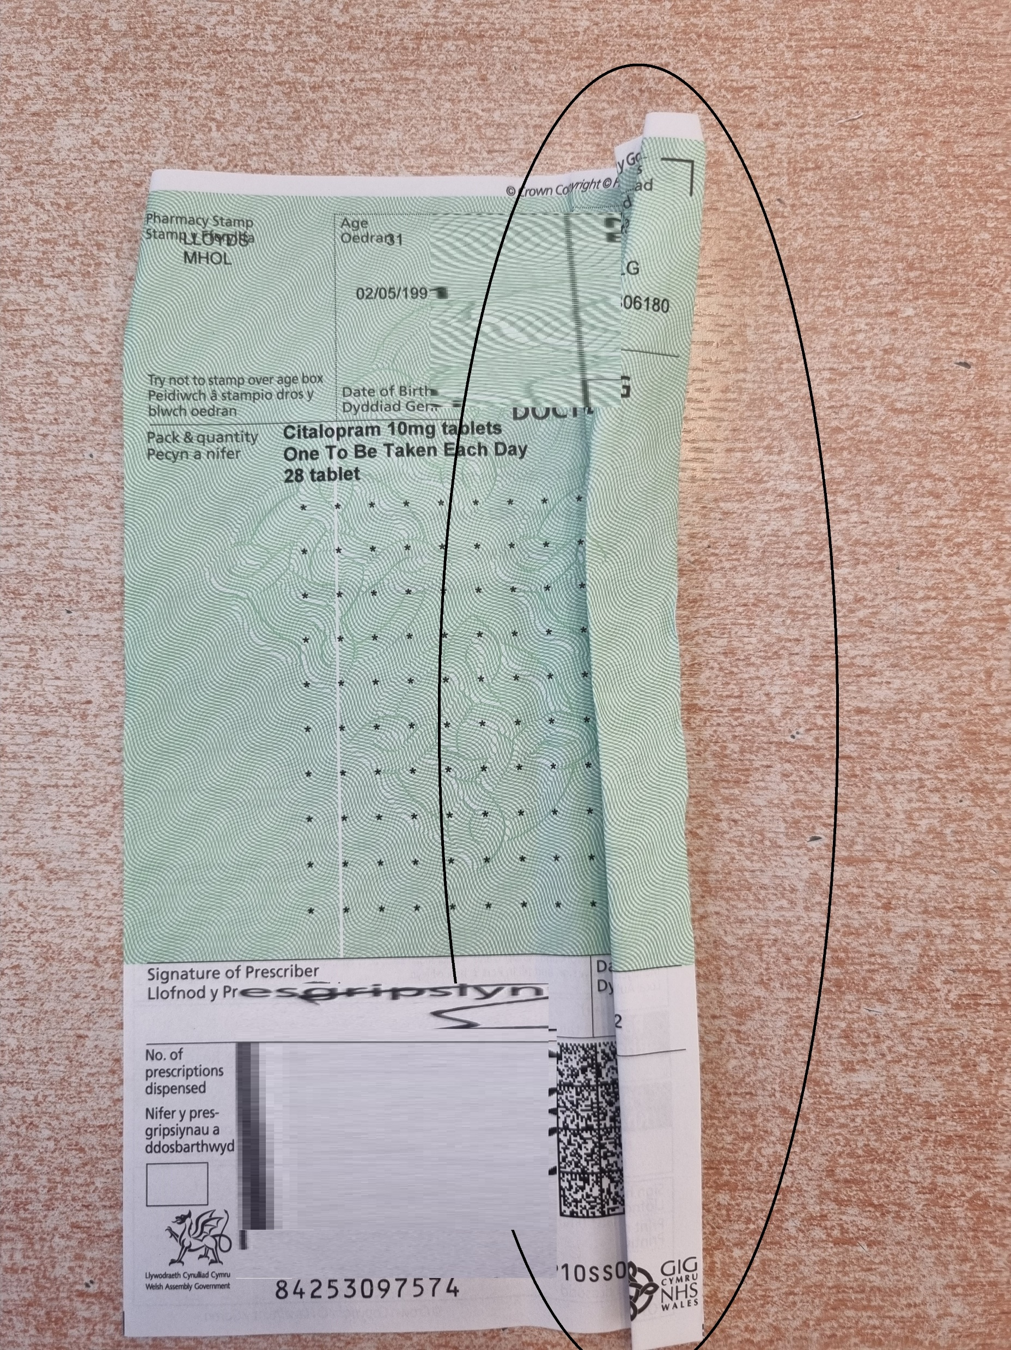
Crumpled scripts
Notes:
Scripts that have been “scrunched” up cause additional time to be added both at the preparation and scanning stages. During the preparation stage the staff member will try and smooth out the script as best as they can. Scanning the scripts in this condition can be awkward to scan as the scanner may not detect it, the person scanning may have to scan these one at a time to ensure everything is captured. If these are missed and scanned amongst a batch it can cause multi-feed and paper jam errors, both resulting in lost time.
Action: Ensure all scripts are submitted flat. Do not submit them bent or crumpled

Slide 11
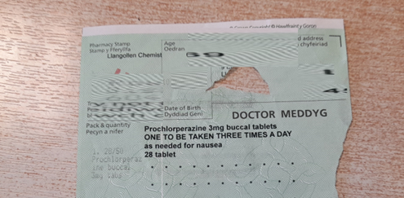
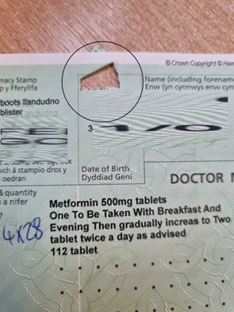
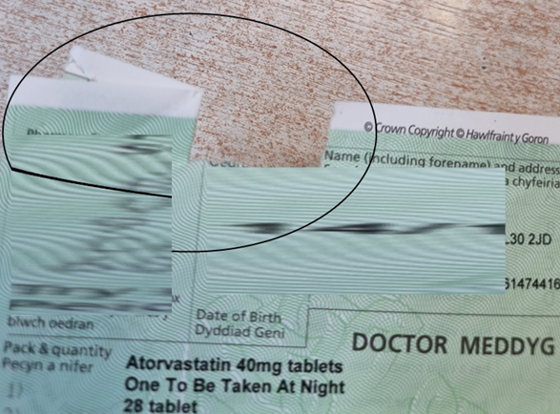
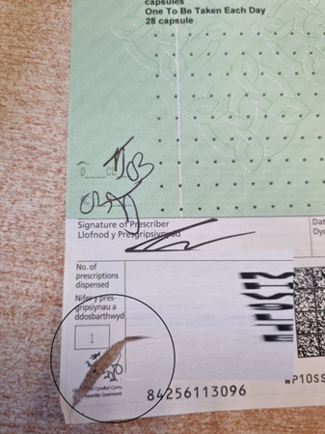
Staple Damaged scripts
Notes:
Damaged scripts through either staple removal or ripping from bags. The above images show the type of damage to scripts. These cause jams and stoppages whilst scanning and staff have to try and pull-out damaged forms from the batch to scan manually therefore adding time to the preparation and scanning of scripts.
Action: Remove all staples carefully before prescriptions are submitted.

Slide 12
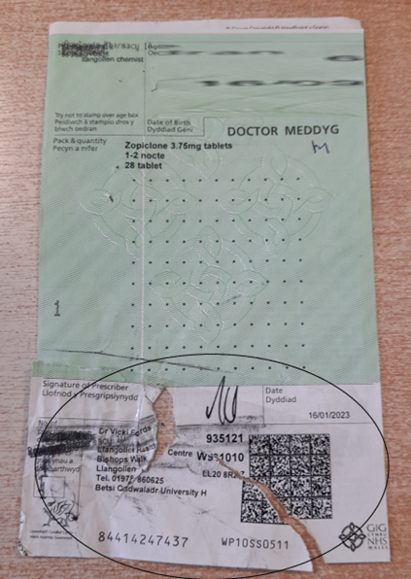
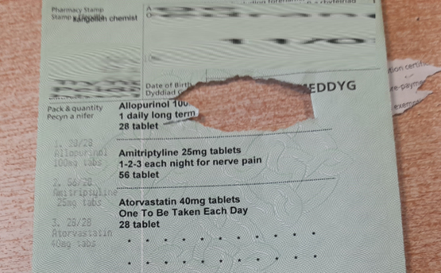
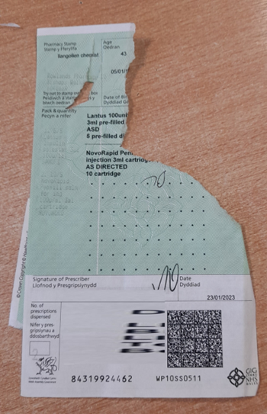
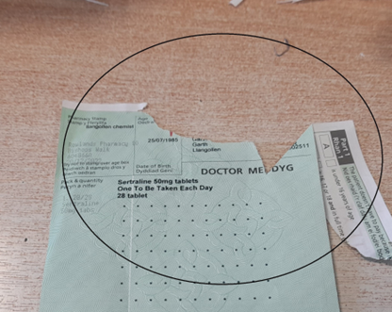
Damaged scripts
Notes:
The above images show the type of damage to scripts. These cause jams and stoppages whilst scanning and staff have to try and pull-out damaged forms from the batch to scan manually therefore adding time to the preparation and scanning of scripts.
Action: keep scripts in good condition and submit damaged scripts separately in the box.

Slide 13
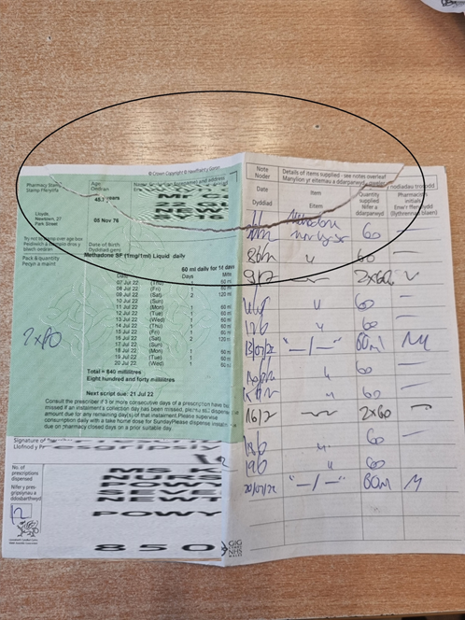
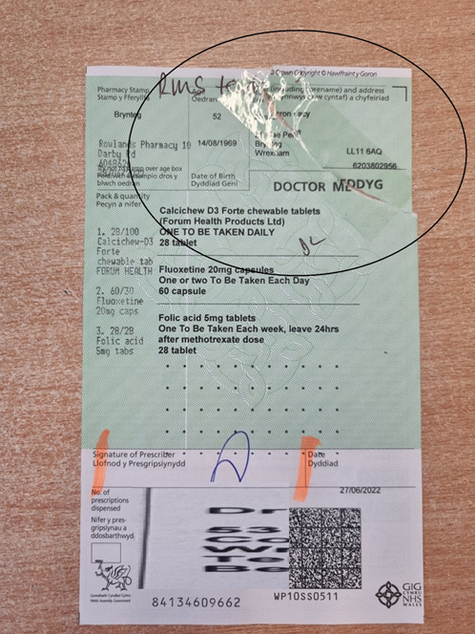
Torn and repaired scripts
Notes:
Even with a repair these scripts will cause problems when scanning.
Action: keep scripts in good condition and submit damaged scripts separately in the box.

Slide 14
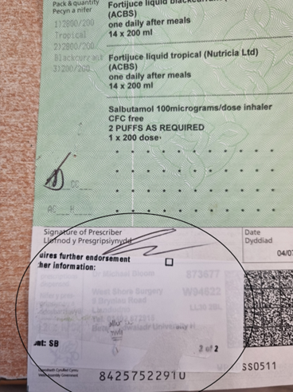
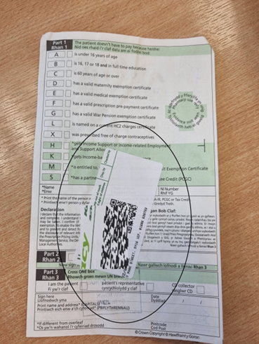
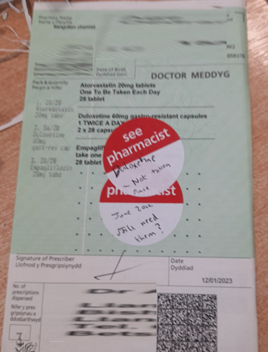
Stickers
Notes:
The major problems that arise from scripts with Sticky Labels on them are “multi-feed” and “paper jam” errors. Scripts that have Labels attached will trigger the scanner to multi-feed as it “thinks” more than one script has been pulled through. Also, the position of the labels can impede the reading of the 2D barcode.
The biggest problem we have found with Labels is when they have been removed and the “sticky residue” is left behind on the script. This causes problems as our scanners pull the scripts through at a very fast rate and because several scripts may be stuck together, the only solution is to scan each of the effected scripts individually.
Action – avoid using stickers

Slide 15
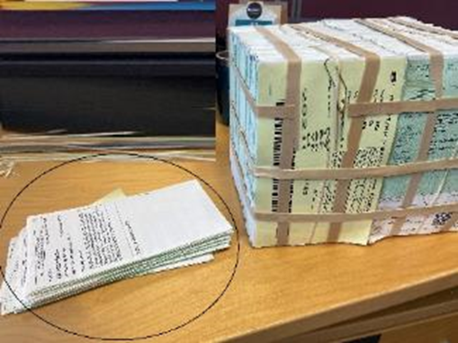
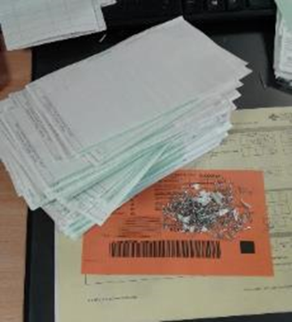
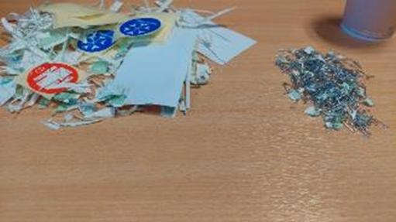
What is typically removed from a poorly submitted batch
Notes:
The images shows just what a staff member has removed from a contractor submission.
As you can see, there was a substantial amount of work involved in preparing these batches for the scanning process. The total time taken to prep was significantly above average. Based on the condition of scripts and time spent prepping would mean this would be classified as a poor submission.
Action – read the guidance on our Website and follow the simple step by step instructions

Slide 16
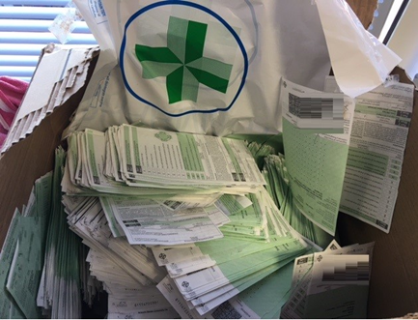
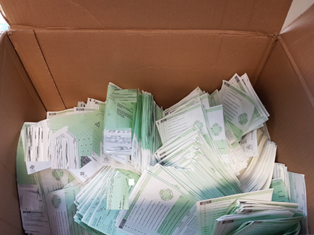
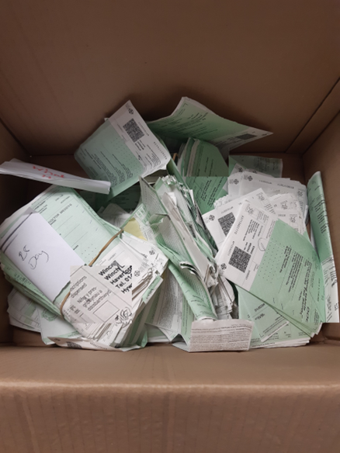
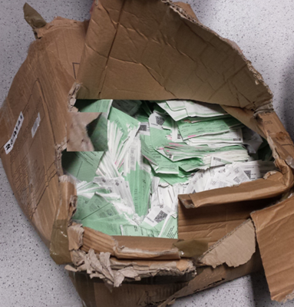
Unsorted, poorly packed
Notes:
Another issue we find under this section, is those submissions that are simply “thrown” into a box with no sorting of the scripts into their relevant Groups. The result of this is a staff member having to take extra time to identify each Group. Depending on the total number of scripts submitted, this will take significantly longer to prepare it for scanning.
Action follow the official sorting guidance ensuring groups are clearly identified. If the exception group (G1A) is not clearly identified scripts could be scanned as G1 which could affect the accuracy oy payment for those scripts.

Slide 17
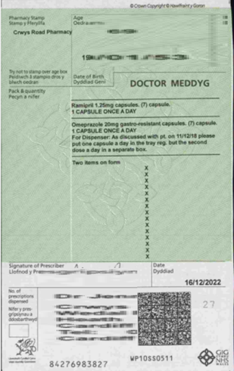
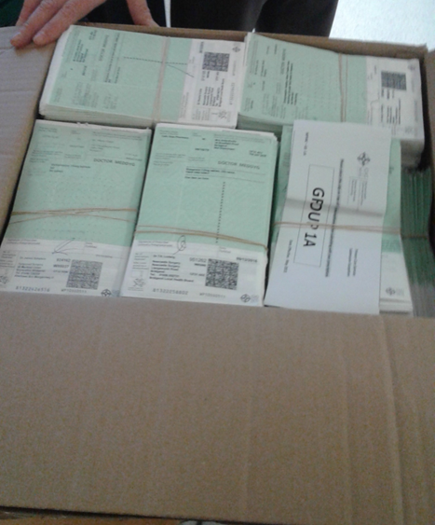


The perfect submission
Notes:
Script in mint condition, no staples, tears or rips and patient info section removed. Scripts are secure within a strong box.

Slide 18

For full instructions for submitting prescriptions please visit our Website
Document Scanning Service - NHS Wales Shared Services Partnership

