Slide 1
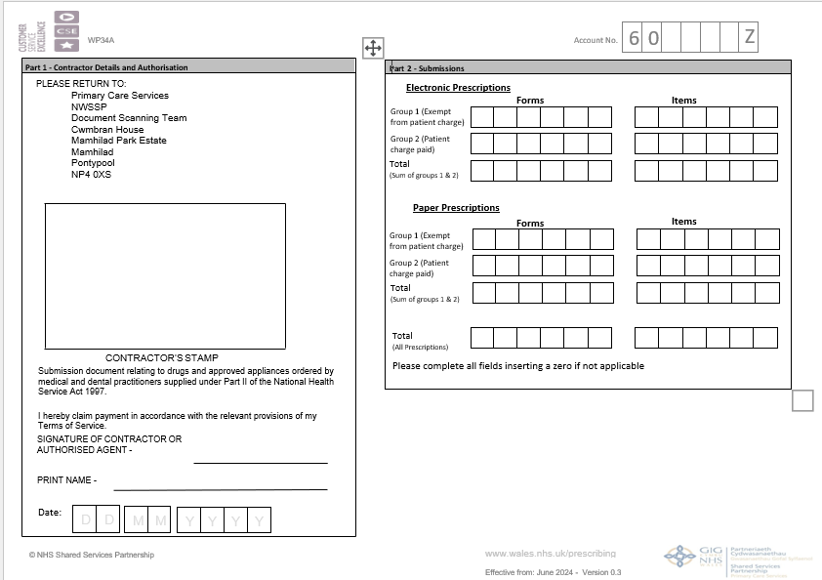
HOW TO COMPLETE THE WP34A(EPS)
Complete the Account No. section at top of form
Complete the Contractors details section, labelled Part 1

Slide 2
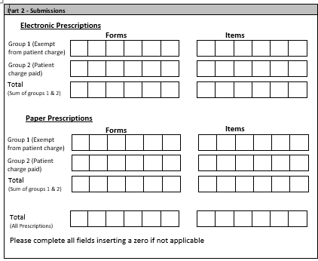
HOW TO COMPLETE THE WP34A(EPS)
Now complete Part 2 for your submissions. Taking care to split your electronic claims and your paper claims.
Enter the total of both electronic and paper claims (this will be the figure used to generate your Advance payment)

Slide 3
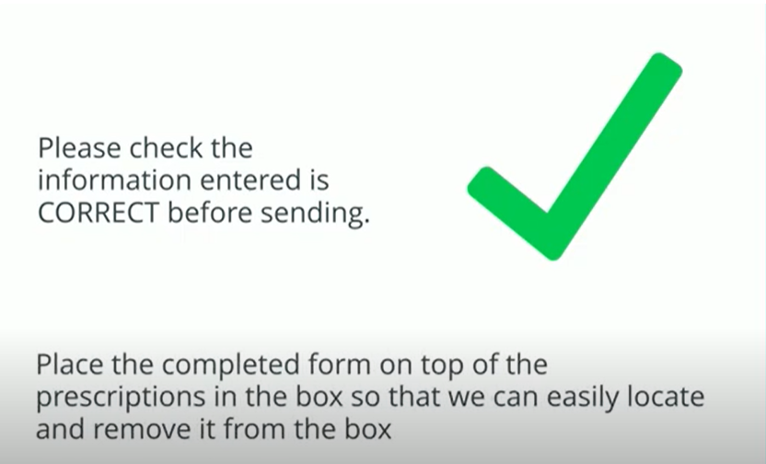
HOW TO COMPLETE THE WP34A(EPS)

