Slide 1
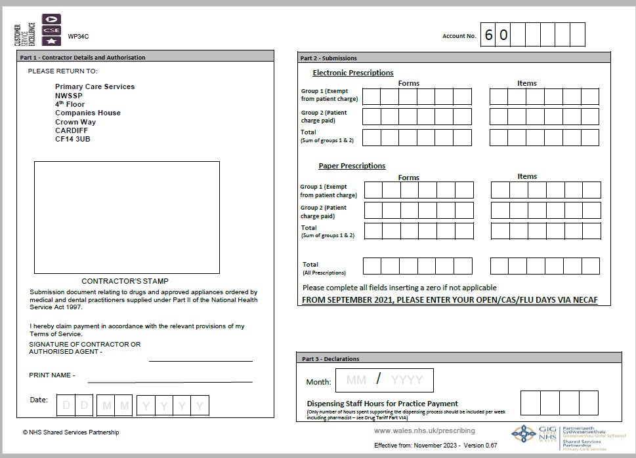
HOW TO COMPLETE THE WP34C(EPS)
Complete the Account No. section at top of form
Complete the Contractors details section, labelled Part 1

Slide 2
HOW TO COMPLETE THE WP34C(EPS)
Now complete Part 2 for your submissions. Taking care to split your electronic claims and your paper claims.
Enter the total of both electronic and paper claims (this will be the figure used to generate your Advance payment)
Finally complete Part 3 with the month the prescriptions were dispensed and your weekly dispensing staff hours.

Slide 3
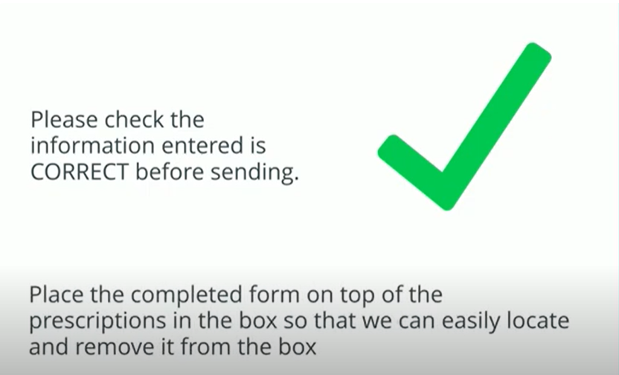
HOW TO COMPLETE THE WP34C(EPS)

