Slide 1

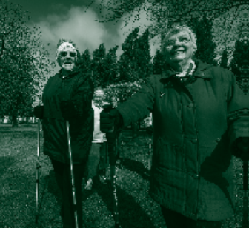
HEALTH AND CARE STANDARDS
APRIL 2015

Slide 2
Background
Ministerial commitment 2013 – Safe Care Compassionate Care
Review “Doing Well Doing Better” Standards for Health Services in Wales and the Fundamentals of Care Standards
Legislation – Section 47 Health and Social Care Act 2003

Slide 3

Vision and Principles
Safe Care Compassionate Care
doing the right things well
knowing how well we are doing
being open and honest in all that we do
showing care, compassion and commitment
leading by example

Slide 4

Vision and Principles
Welsh Government Quality Delivery Plan in Wales (2012 – 2016):
providing the highest possible quality care and excellent experience
improving health outcomes and helping reduce inequalities
getting high value from all our services

Slide 5
Vision and Principles
Wales Framework for Assuring Service User Experience (2013)
positive first and lasting impressions
receiving care in safe supportive and healing environments
understanding and involvement in care

Slide 6
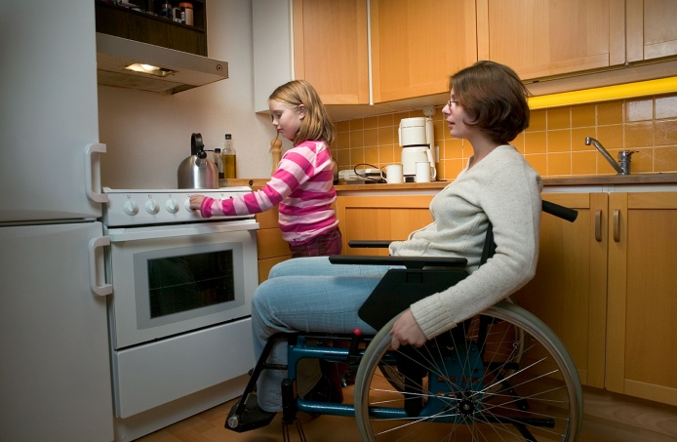
Co-production
Central to the Social Services and Wellbeing Act.
Everyone has a right to be given a voice and heard;
To shape the decisions that affect them;
To exercise greater control over their day to day lives;
To be equal partners.

Slide 7
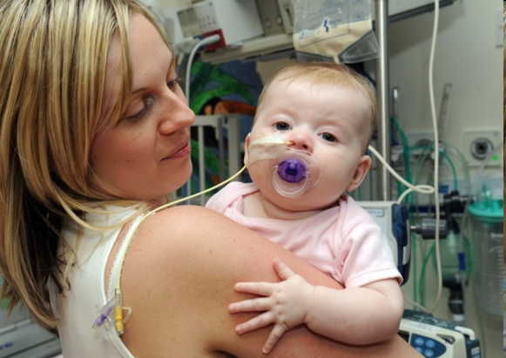
Prudent Healthcare
Caring for those with the greatest health need first.
Making the most effective use of all skills and resources.
Doing only what is needed and doing no harm, no more, no less.
Reducing inappropriate variation using evidence-based practices consistently and transparently.

Slide 8
Purpose
Embrace the principles of co-production and prudent health care.
Offer a common language to describe what high quality, safe and reliable healthcare services look like.
Can be used by people of all ages to understand what high quality safe healthcare should be and what they should expect from a well-run service.

Slide 9

Purpose
Enable a person-centred approach by focusing on outcomes for service users and driving care which places people at the centre of all that the service does.
Create a basis for improving the quality and safety of healthcare services by identifying strengths and highlighting areas for improvement.

Slide 10
Purpose
Can be used in day-to-day practice to encourage a consistent level of quality and safety across the country and across all services and all professions.
Promote practice that is up to date, effective, and consistent.
Promote accountability of health services to service users, the public and funding agencies for the quality and safety of services by setting out how providers should organise, deliver and improve services

Slide 11

Purpose
Enable people to contribute fully to their own health and wellbeing.
Recognise the quality standards for other care and support providers issued under the Social Services Regulation and Inspection Bill.
Support the implementation of national clinical and professional guidelines.

Slide 12
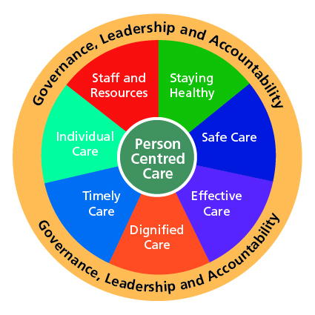
THE HEALTH AND CARE STANDARDS

Slide 13
How the Health and Care Standards are Structured
The 7 themes work together;
Collectively they describe how a service provides high quality, safe and reliable care centred on the person.
Each theme includes a number of standards, there are 22 standards in total.
The standards are not listed in priority order, and some overlap across themes and standards.

Slide 14
Person Centred Care
Co-production - people focused, equal partnership.
Promotes independence and autonomy.
Provides choice and control.
Collaborative team philosophy.
Takes into account peoples needs and views.
Builds relationships with family members.
Holistic care – spiritual, pastoral and religious.
PERSON CENTRED CARE

Slide 15

Governance, Leadership and Accountability
The provision of high quality safe and reliable care is dependent on good governance and leadership;
Health services demonstrate effective leadership by setting direction, igniting passion, pace and drive, and developing people.

Slide 16

Governance, Leadership and Accountability
Strategy is set with a focus on outcomes, and choices based on evidence and people insight. The approach is through collaboration building on common purpose.

Slide 17
Governance, Leadership and Accountability
Health services innovate and improve delivery, plan resource and prioritise, develop clear roles, responsibilities and delivery models, and manage performance and value for money.
Health services foster a culture of learning and self-awareness, and personal and professional integrity.

Slide 18
STAYING HEALTHY
Outcome - People are well informed to manage their own health and wellbeing.
1 Standard – Health Promotion, Protection and Improvement

Slide 19
Outcome: People are protected from harm and supported to protect themselves from known harm.
SAFE CARE
9 Standards:
Managing Risk and Promoting Health and Safety
Preventing Pressure and Tissue Damage
Falls Prevention
Infection Prevention and Control and Decontamination
Nutrition and Hydration
Medicines Management
Safeguarding Children and Safeguarding Adults at Risk
Blood Management
Medical Devices, Equipment and Diagnostic Systems

Slide 20
Outcome: People receive the right care and support as locally as possible and are enabled to contribute to making that care successful.
5 Standards:
Safe and Clinically Effective Care
Communicating Effectively
Quality Improvement, Research and Innovation
Information Governance and Communications Technology
Record Keeping
EFFECTIVE CARE

Slide 21
Outcome: People are treated with dignity and respect and treat others the same.
2 Standards:
Dignified Care
Patient Information
DIGNIFIED CARE

Slide 22
Outcome: People have timely access to services based on clinical need and are actively involved in decisions about their care
1 Standard:
Timely Access
TIMELY CARE

Slide 23
Outcome: People are treated as individuals, reflecting their own needs and responsibilities.
INDIVIDUAL CARE
3 Standards:
Planning Care to Promote Independence
Peoples Rights
Listening and Learning from Feedback

Slide 24
Outcome: People can find information about how their NHS is resourced and make careful use of them
STAFF AND RESOURCES
1 Standard:
Workforce

Slide 25
Using the Health and Care Standards
The Health and Care Standards:
Are person centred and prioritise putting patients, their families and carers at the heart of all decisions and plans about healthcare.
Are locally owned by health services.
Provide the framework for how services are organised, managed and delivered on a day–to–day basis.
Are based on the best available evidence and information.

Slide 26
Using the Health and Care Standards
Through honest self assessment, well tested through use of mechanisms such as internal audit and clinical audit.
Participation in peer review processes.
Encouraging and responding to external reviews from bodies such as Healthcare Inspectorate Wales.
Acting on feedback from bodies such as Community Health Councils and the people they serve.

